Slide 1


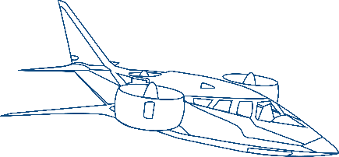

Engineering Sustainable Mobility
Corporate Overview

Slide 2





























HINDUJA GROUP
One of India’s
Founded in
HQ in
London, UK
Multi Billion $
Global presence across
Employs over
Premier transnational conglomerates
1914
Global Business conglomerate
38 countries
200,000 people
Automotive
IT & ITeS
Banking & Finance
Oil & Specialty Chemicals
Power
Media
Real Estate
Healthcare
Project Development
Trading
Work to Give | Word is a Bond | Act Local, Think Global | Partnership for Growth | Advance Fearlessly

Slide 3













Hinduja Tech: Who We Are
We Deliver SUSTAINABLE ENGINEERING & DIGITAL SOLUTIONS across Mobility Industries
Our Group
Hinduja Tech, a key part of India's leading multibillion dollar transnational conglomerate, Hinduja Group
End to End Vehicle Engineering & Integration
33 + years
Purpose
of serving 100+ Global OEMs, Tier 1s and Disruptive players
Creating Sustainable Mobility
360°
Ecosystem for PV/CV/ EV development using robust processes based on Frugal engineering paradigm
An advanced Powertrain Engineering Division of Hinduja Tech
2650 +
Mobility and eMobility experts Globally
Vision
To be among the Top 10 Global Mobility Engineering and R&D Companies
An advanced Virtual Simulation Division of
Hinduja Tech
100 +
Co-developed vehicle models in Production and running

Slide 4




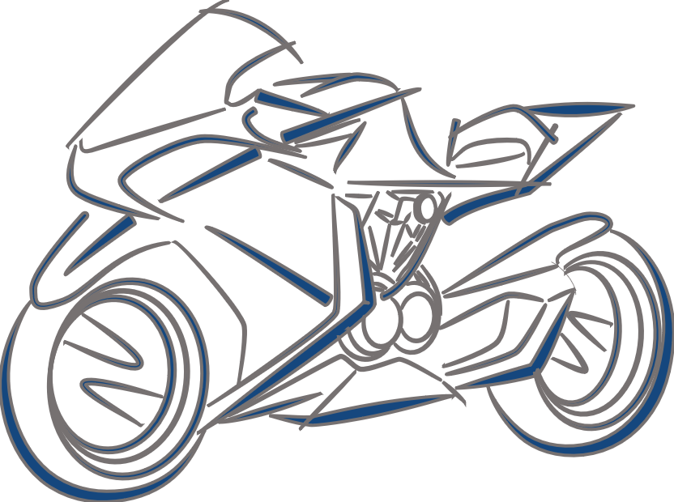
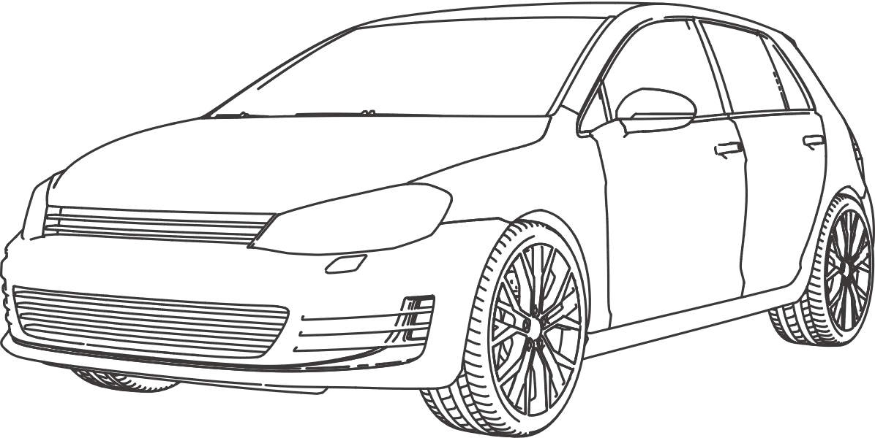


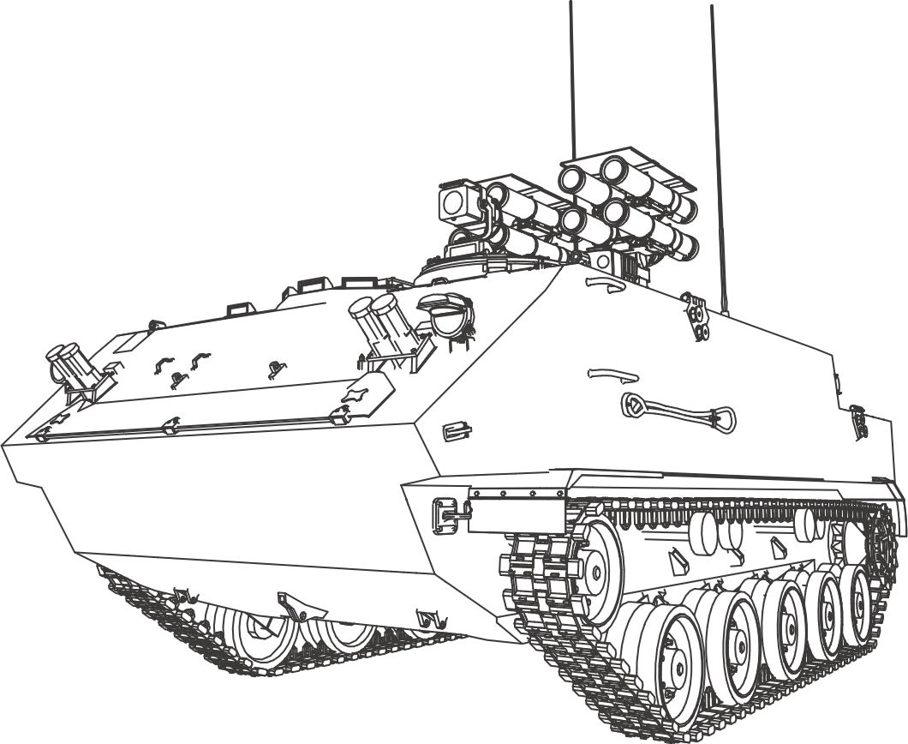
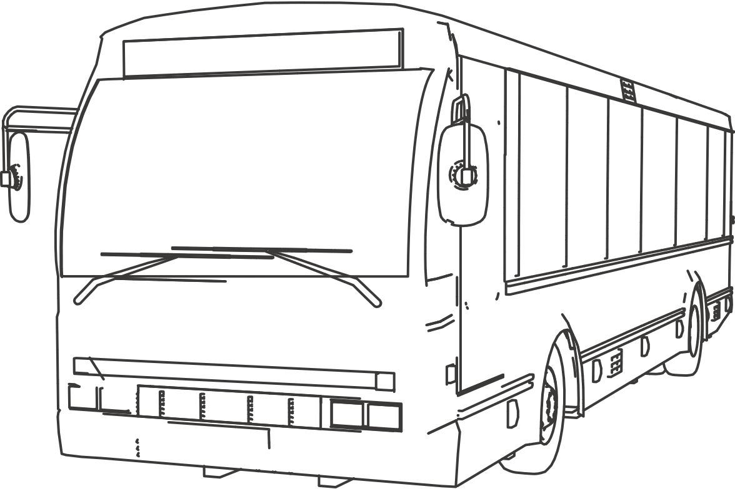



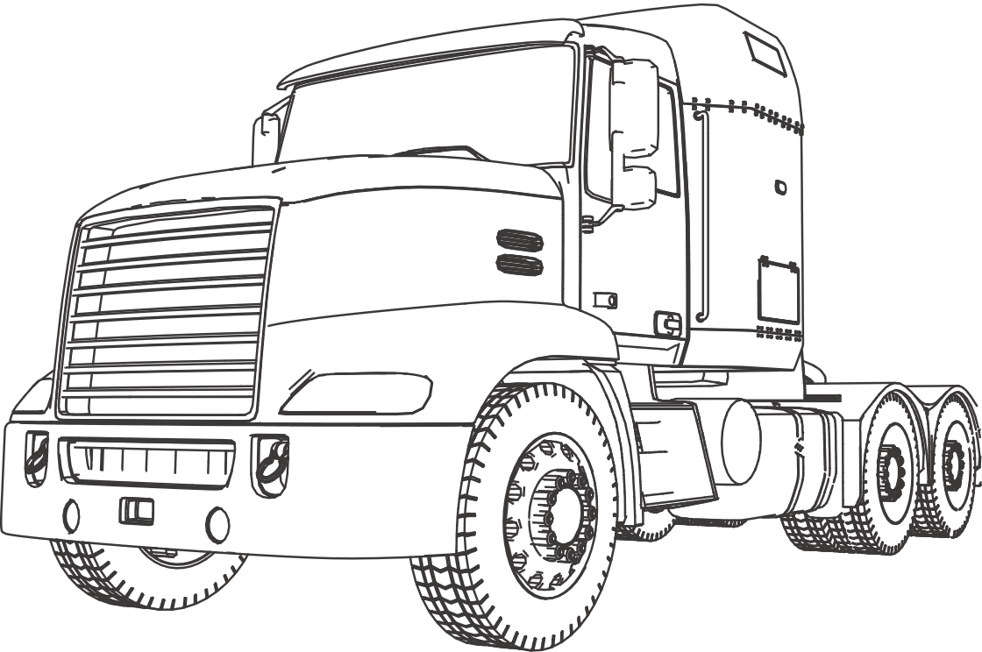



Engineering Sustainable Solutions for the Mobility Industry
An Overview
Automotive Verticals
Other Industry Verticals
Digital Technologies
Powertrain
Two
Wheeler
Off-road
Vehicle
Systems Engineering & Integration
Passenger
Vehicle
Embedded
Electronics
Body
Engineering
Defense Vehicle
Commercial
Vehicle (Bus)
Vehicle Integration
Virtual Validation
Aerospace/Aircraft (eVTOL)
Commercial
Vehicle
(Truck)
Costing & Sourcing
Manufacturing Engineering
Marine
Americas | APAC | EMEA | India

Slide 5
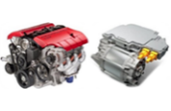
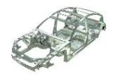
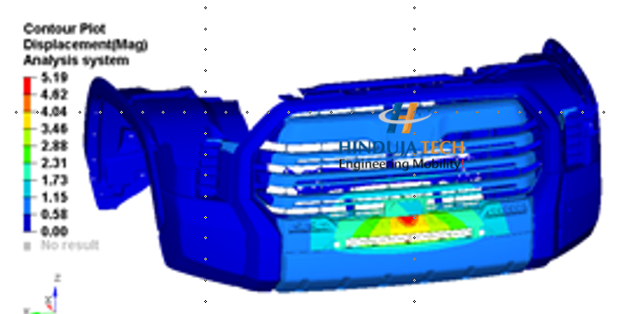



Concept to SoP Development and Digital Transformation
Powertrain | Body Engineering | Virtual Validation | Vehicle Integration | Embedded Electronics | Digital Technologies
Concept to SoP Development
Concept to SoP Development
Simulation led Engineering
Engineering to Integration
Concept to SoP Development
Digital Transformation
Sub-Offering
‘(up to) 8 in 1’ Electrified propulsion
Conventional and xEV driveline and transmission system solutions
Hybrid powertrain
‘3+in1’ sub-system / component solutions
Control systems and supervisory
Driveline and transmission testing
IC Engine design and development
Sustainability
Sub-Offering
Body in White
Closure
Interiors
Exteriors
Sub-Offering
CAE
CFD
Static & Dynamic Analysis
Modal Analysis
Thermal / Flow Analysis
Multibody Analysis
NVH
Performance Prediction
Acoustics
Sub-Offering
Certification / Homologation
Vehicle Ergo & Integration
Vehicle Proto & Physical Validation
Benchmarking, DMU, Cost & BOM Management
Chassis Systems
Vehicle Thermal, E&E, Diagnostics, Software System & Validation
Sub-Offering
Onboard charger
DC-DC Converters
Traction Inverters
BDU/PDU
BMS
Sub-Offering
SAP services ​
Application Services ​
Digital Consulting and Solutions​
Solutions
Full System Development
Virtual Validation
Regulatory Compliance
Prototyping
Physical Testing
  System Level
  Vehicle Level
Costing / Sourcing
Solutions
Enterprise Application (SAP)
Implementation
Customization
Support
Dealer management systems
Cloud Technologies
Implementation
Customization
Support
Web/Mobile applications
Industry 4.0 / IIoT
Telematics
PT VI EE VV Body Digital
Solutions
Full System Development
Hardware
Software (AUTOSAR)
Functional Safety
HW/SW/ Mechanical / Electrical Integration
Prototyping
Testing (MIL/SIL/HIL)
Costing / Sourcing
Solutions
Structural Analysis
Durability Analysis
Multi Body Dynamics
Crash & Safety Analysis
Lightweighting & Optimization
Computational Fluid Dynamics (CFD)
NVH
Battery Thermal
Manufacturing
Solutions
Benchmarking & Targets
Vehicle Concept & Architecture
System Sizing, Specs, & Integration
Electricals & Control Systems
Costing, Sourcing, & PPAP
Prototyping & Physical Testing
Regulatory Compliance
Solutions
New Design
Application Engineering
Power / Torque upgrades
Emission Upgrades
Benchmarking
Target Setting
Concept Development
Detailed Design
Design Validation
Strategic Sourcing
Proto development
Testing
SOP

Slide 6






Our Value Proposition
We strive to deliver
Product BOM
Cost Reduction
7-21%
Faster Time
to Market
15 - 33%
R&D Cost
Optimization
30-50%
BCC Sourcing
14-38%
Customer
Experience
4.2/5
through
Simplicity.…..
Focus on core functions, simplify with
3-click setups, and use integrated designs
Hinduja Tech‘s
Frugal 7S Model
Sustainability
Minimize waste, use recyclables,
and design for longevity
S1
S7
7-21%
Product BOM
Cost Reduction
Speciﬁcation and Substitution
Align localized specs to target markets using cost-effective materials without quality loss
Sourcing and Serialization
Optimize sourcing, industrialization, and localize to cut logistics costs
S2
S6
Standardization and Scalability
Scale in homogeneous markets with
ﬂexible resources for customer needs
S3
S5
Simulation
Use simulation led engineering to minimize prototyping and testing
S4
Serviceability
Enabling seamless integration and efficient engineering support

Slide 7












Our Global Footprint
220+
130+
UK
Germany
~300+
Germany
Americas
United Kingdom
Basildon
London
Norwich
Warwick
Hamburg
Cologne
Munich
Stuttgart
Wiesbaden
United States
Farmington Hills
Irvine
Phoenix
20+
France
APAC
Paris
Japan
1850+
Osaka
India
Mexico
Romania
India
Monterrey
Cluj-Napoca
Chennai
Bengaluru
Pune
100+
Sydney
Romania
Corporate HQ
Sales Office
Delivery Centre
Overall Headcount
Labs

