Slide 1
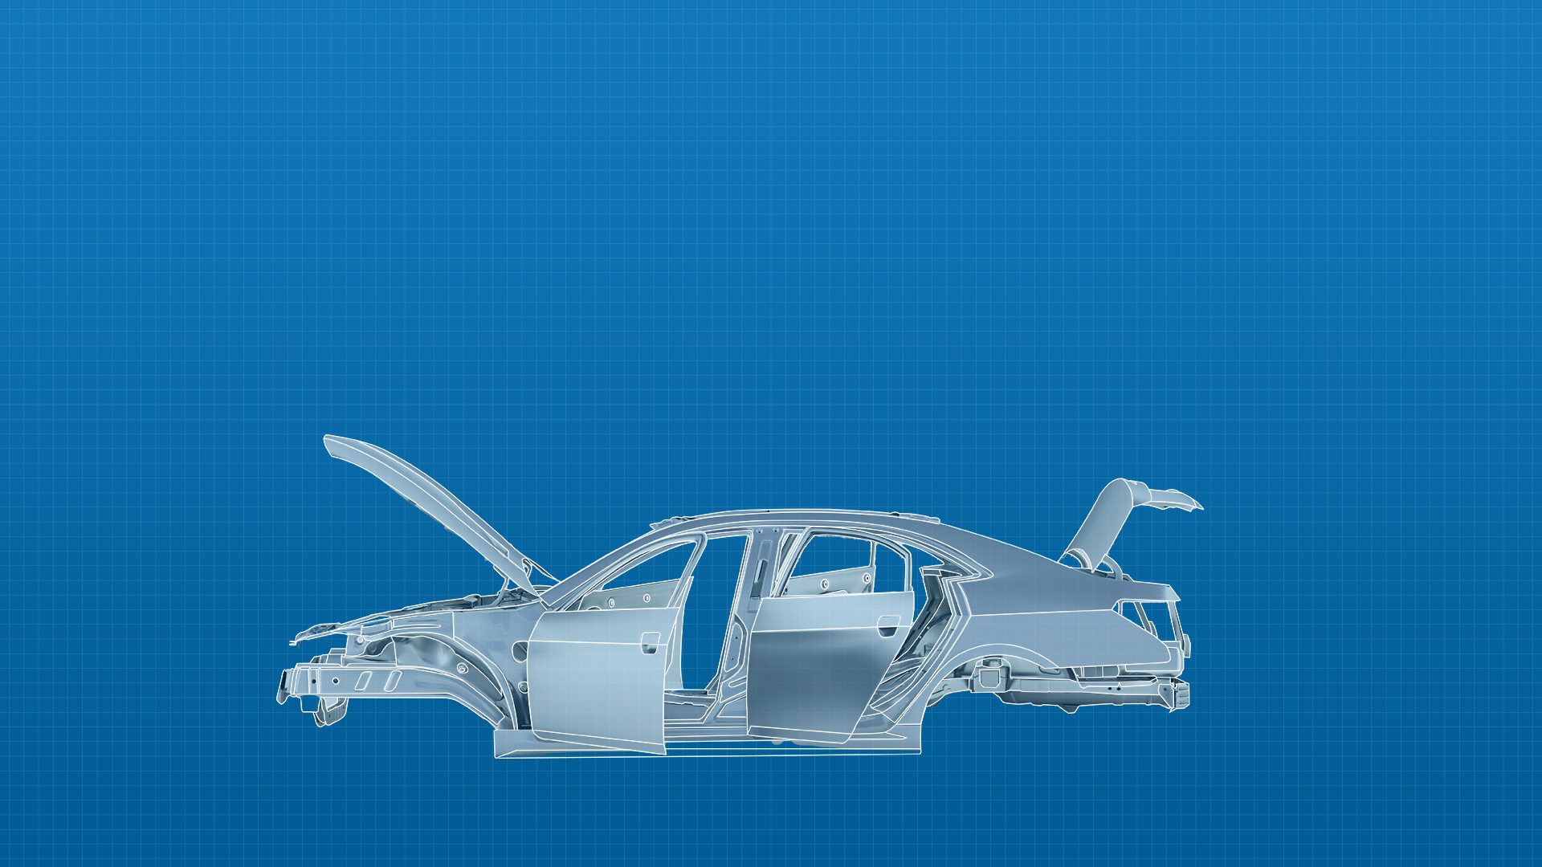

Body Engineering
Notes:
Update with T version of the tri logo
Body Engineering – Capability Overview

Slide 2
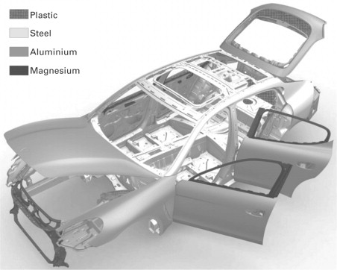

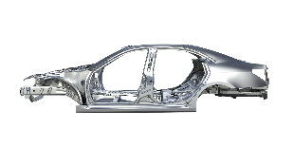
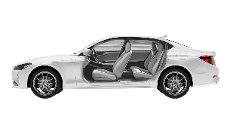
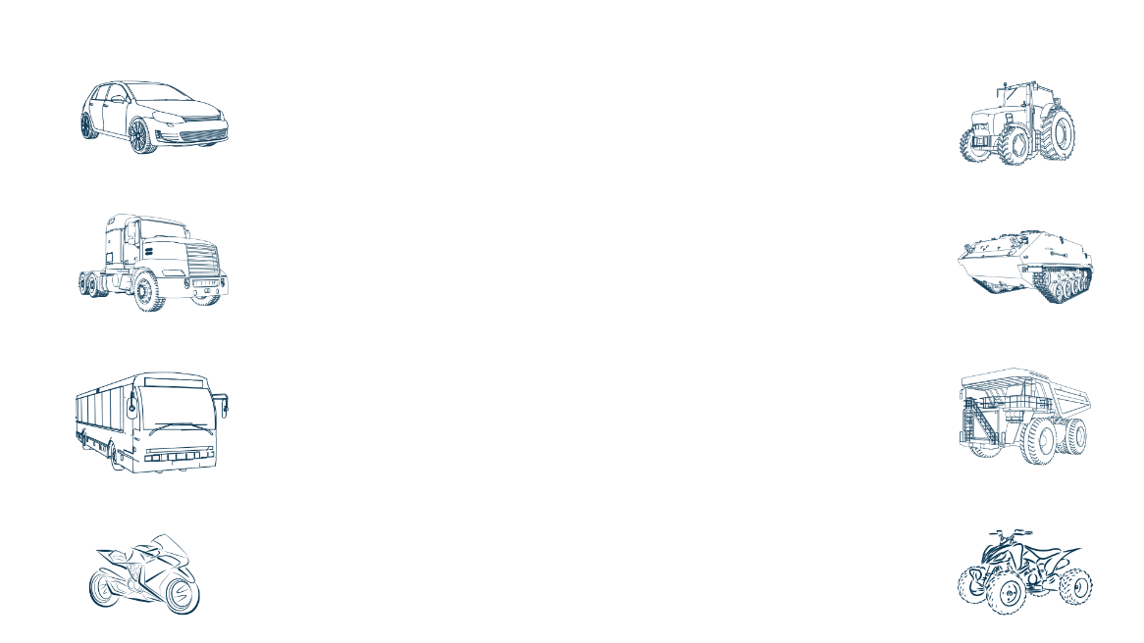



Body engineering offerings for the mobility industry
Concept to SOP Support
USP
Trusted by major Global OEMs
Design to Cost
Frugal Engineering
Global Delivery Model
Over 100+ project experience
700+ Supply Chain partners
BiW Closures Interior Exterior
Services
Underbody & upper body design & devolvement
Refreshes & facelifts
Variants
development
Electrification related Changes
Areas
Underbody / Platform / BiW
Closure Systems
Interior Trims
Exterior Trims
Passenger vehicle
Agriculture vehicle
Commercial vehicle (Truck)
Defense vehicle
Materials Handled
Manufacturing Process Expertise
Stamping
Extrusion
Injection molding
Blow molding
Vacuum Forming
CFRP
RTM
Auto
steel
Aluminum
Alloy
cast
CFRP
Commercial vehicle (Bus)
Mining vehicles
Plastics (PP, PU, ABS, PC)
CFRP
Two wheeler
Off-road vehicles
Notes:
Closures
AMERICAS,APAC, EMEA and India
Remove the word verticals
All sentence case in Brit English

Slide 3
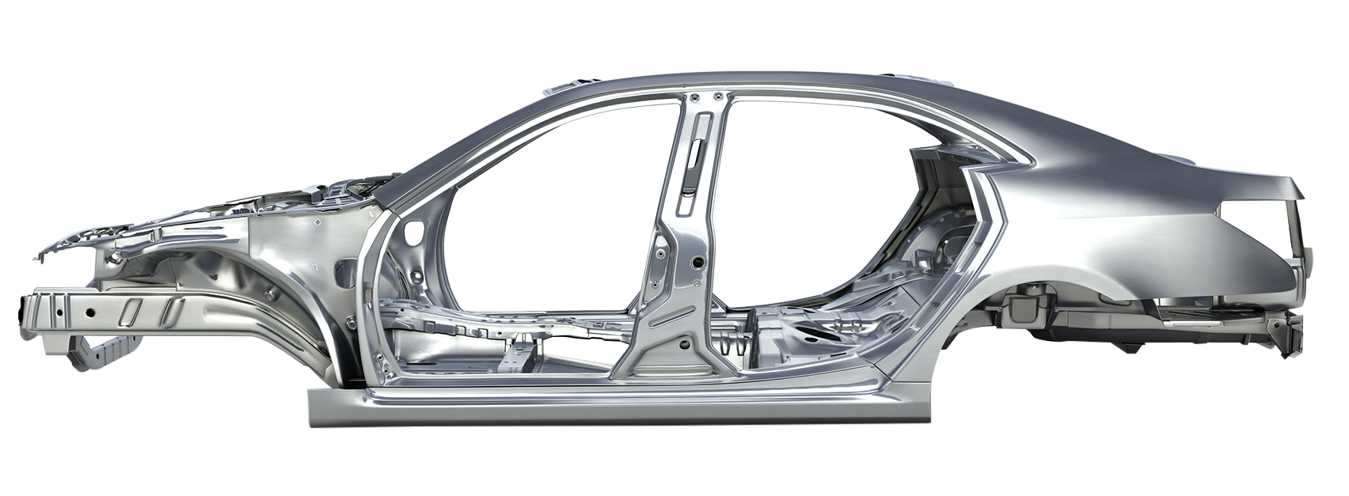
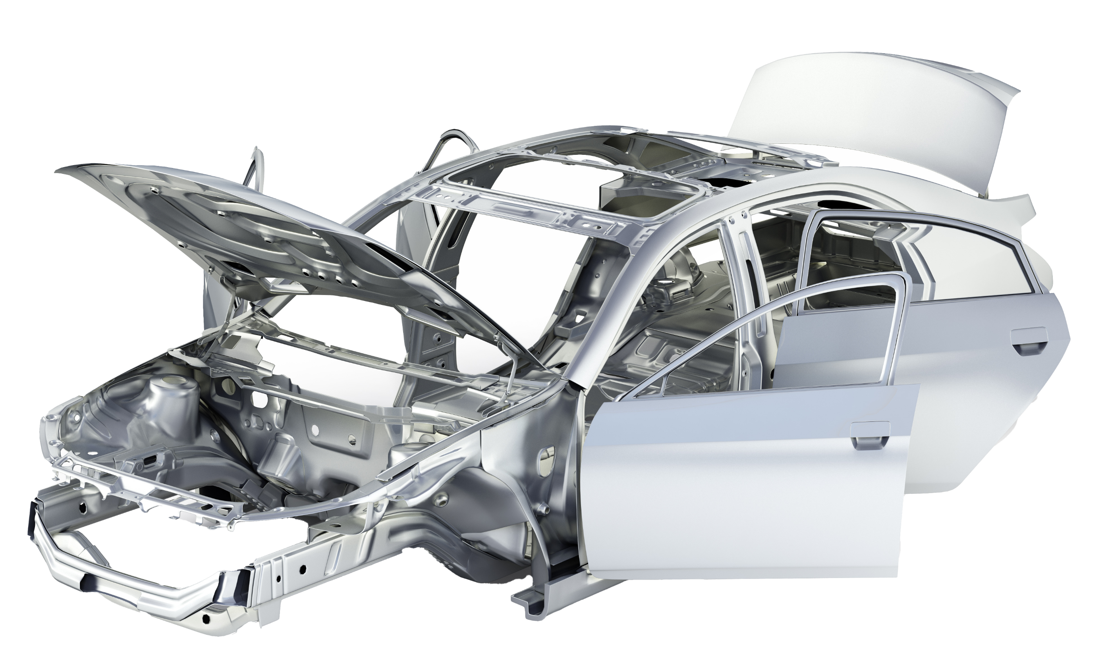
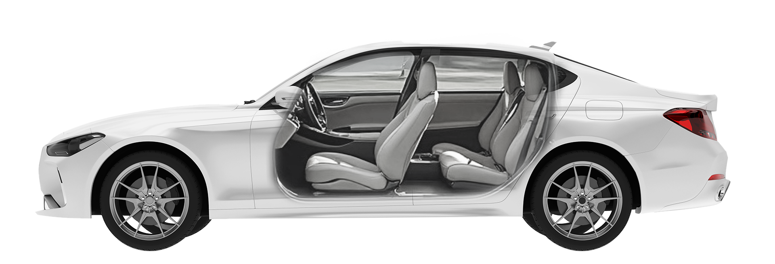




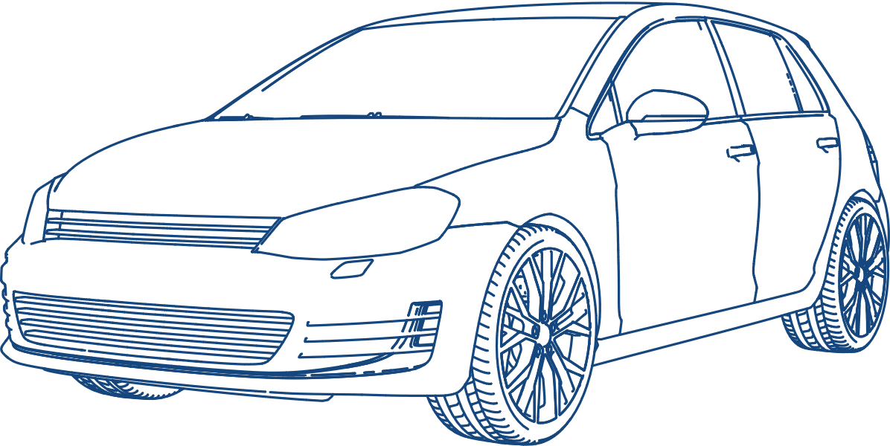
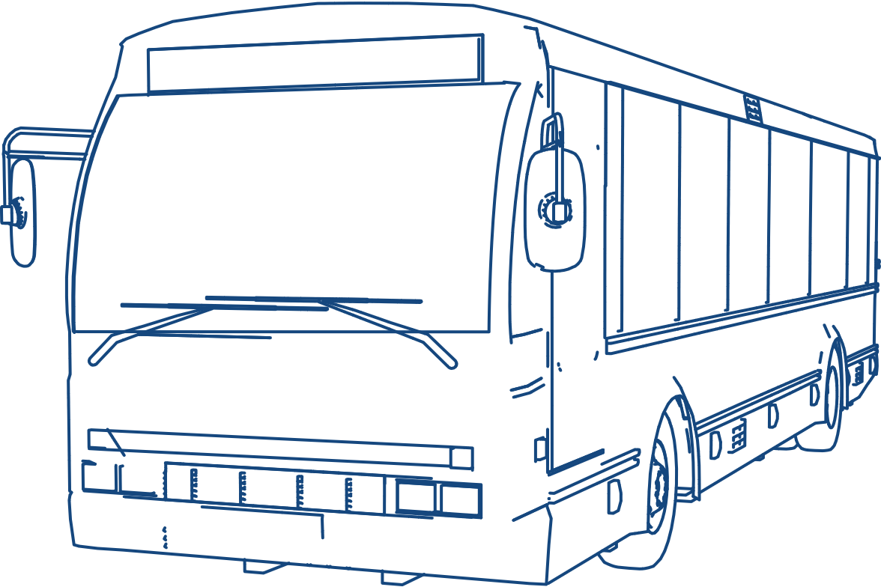
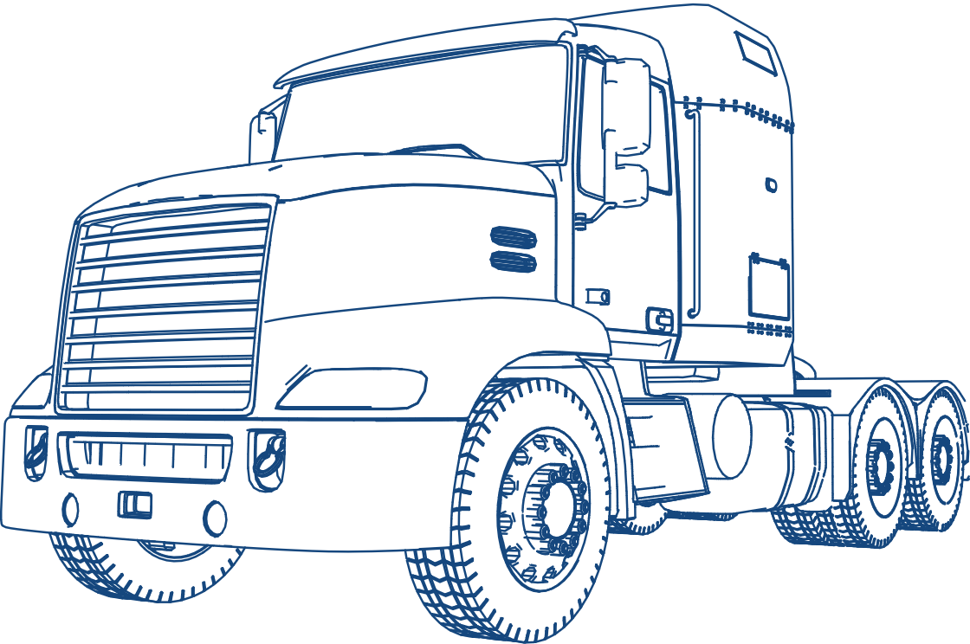
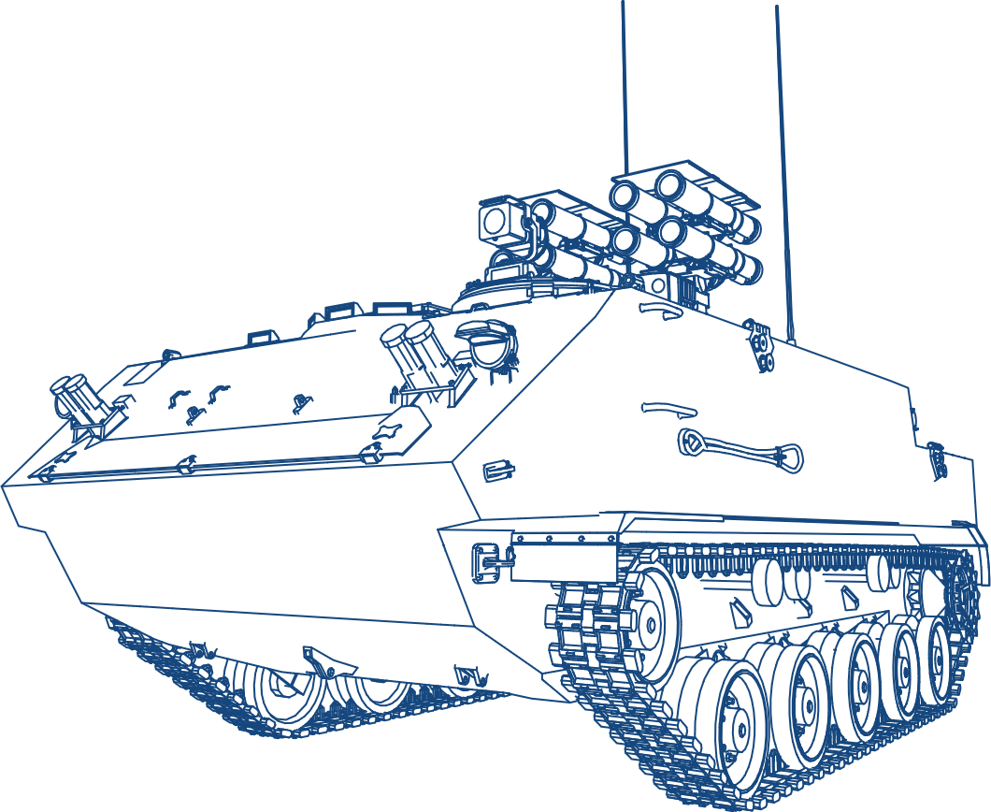
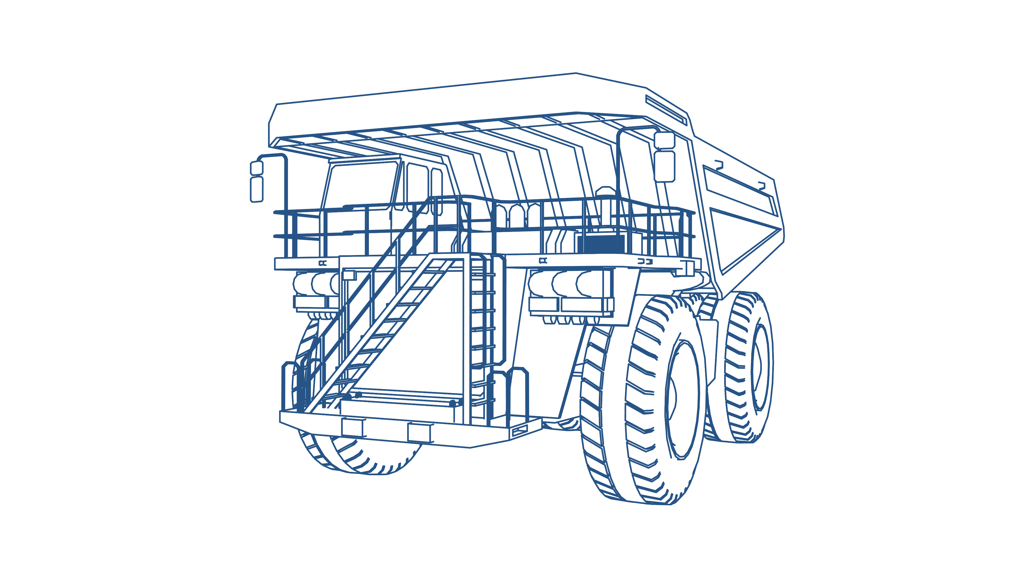
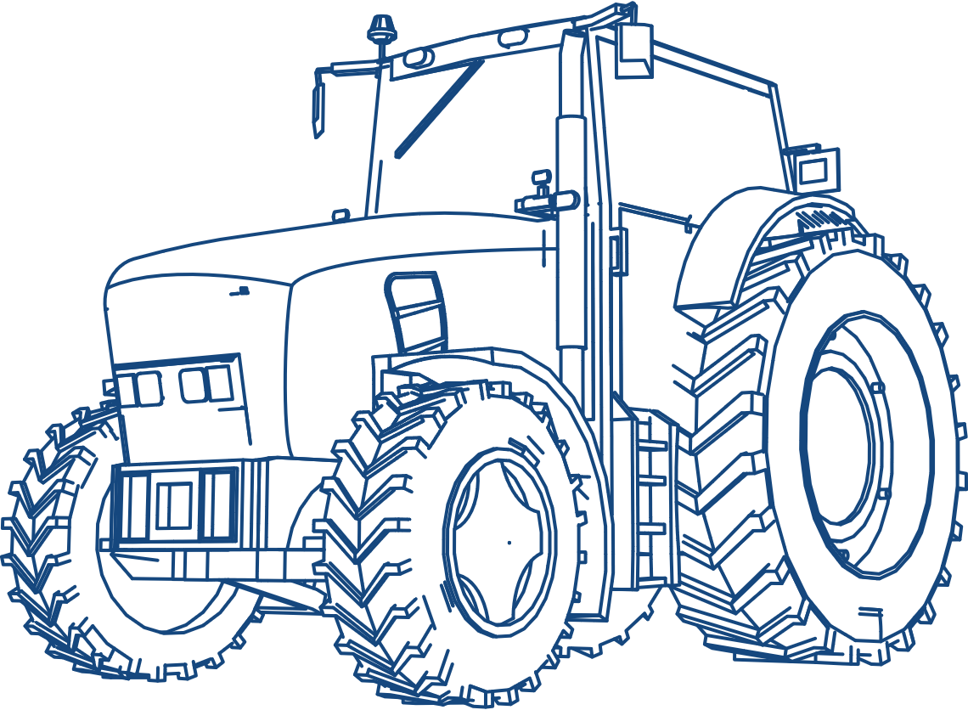
Body engineering offerings for the mobility industry
Concept to SOP Support
USP
Trusted by major Global OEMs
Design to Cost
Frugal Engineering
Global Delivery Model
Over 100+ project experience
700+ Supply Chain partners
BiW
Closures
Interior
Exterior
Services
Areas
Manufacturing Process Expertise
Underbody & upper body design & devolvement
Refreshes & facelifts
Variants
development
Electrification related Changes
Underbody / Platform / BiW
Closure Systems
Interior Trims
Exterior Trims
Stamping
Extrusion
Injection molding
Blow molding
Vacuum Forming
CFRP
RTM
Two
wheeler
Passenger vehicle
Commercial
vehicle (Bus)
Commercial vehicle (Truck)
Materials
Handled
Auto steel
Aluminum
Alloy cast
CFRP
Plastics (PP, PU, ABS, PC)
Agriculture
vehicle
Defense
vehicle
Mining vehicles
Off-road
vehicles
Notes:
Closures
AMERICAS,APAC, EMEA and India
Remove the word verticals
All sentence case in Brit English

Slide 4
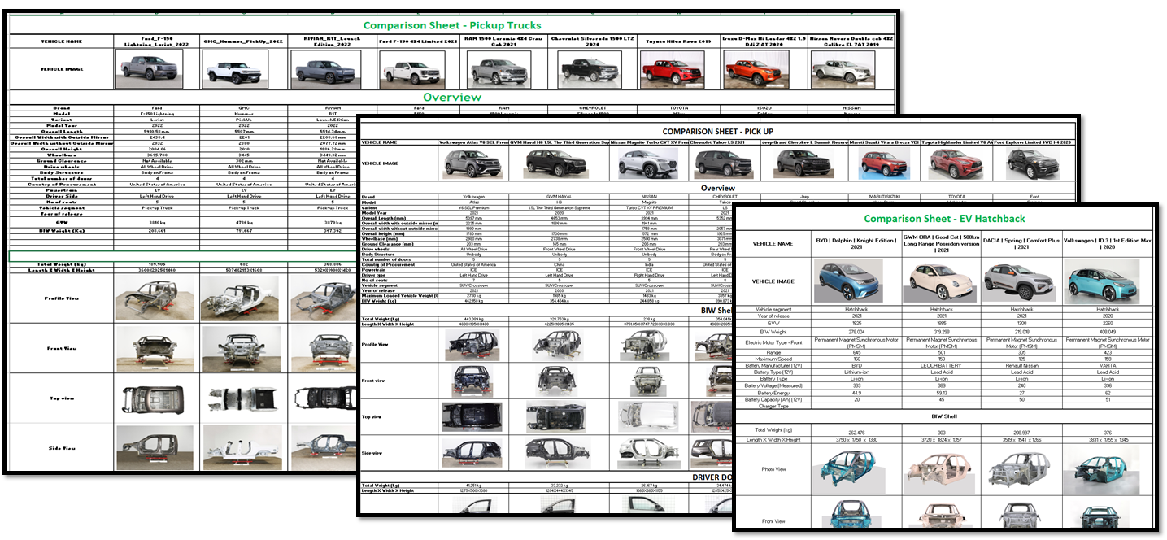
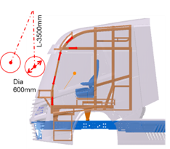
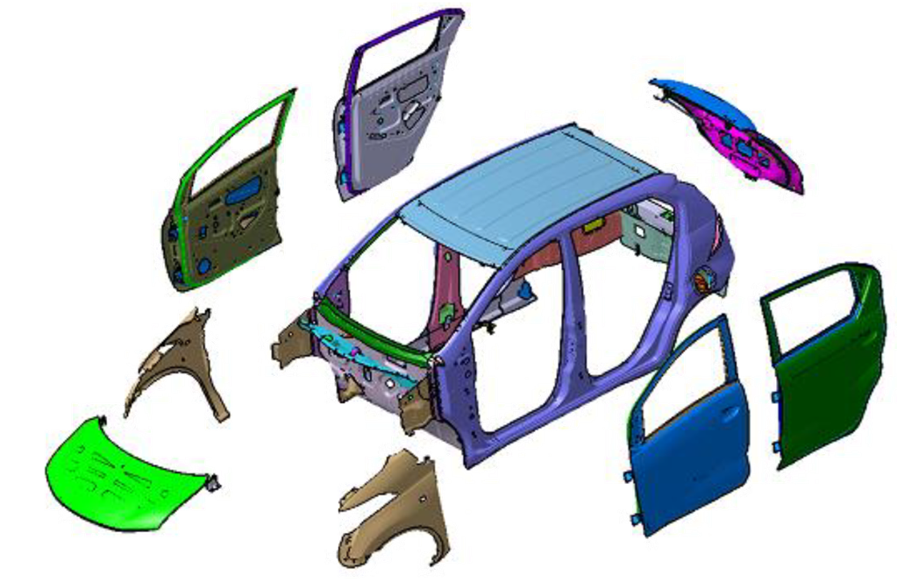
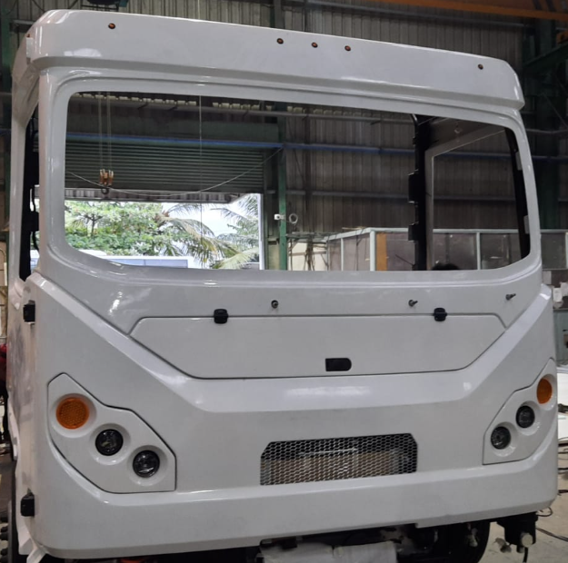
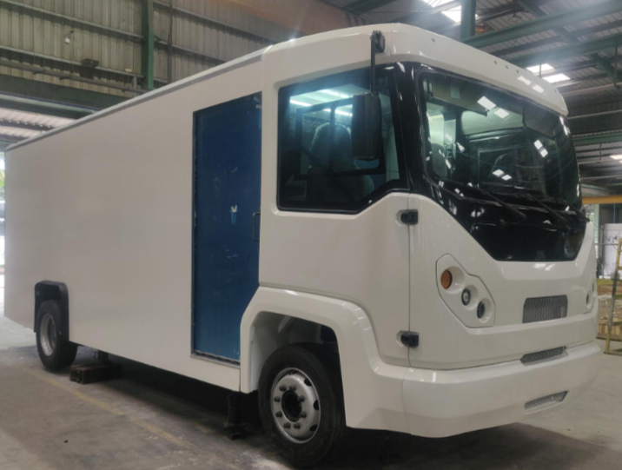
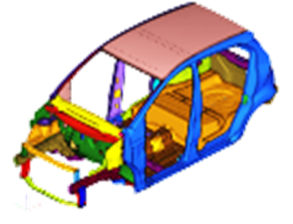

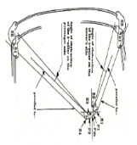
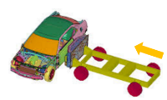
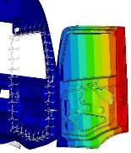

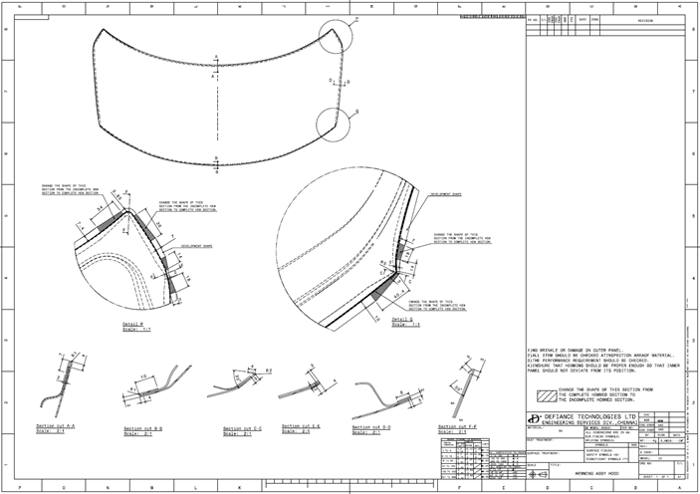
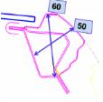
End-to-End product development cycle: A holistic approach
CAE & Mfg. Feedback integration
Detail design data updates
Assembly & joining finalization
Design documentation.
Supplier coordination.
Static benchmarking
Performance benchmarking
Engineering assessment
Zero-base costing
Concept 3D CAD concept design
Material & thickness definition
Initial assembly sequence
Material & thickness definition
Build support
Build & testing failure concern resolution
Design update & supplier coordination
Benchmarking
Concept design
Detail design & sourcing
Build & testing
Styling feasibility
Virtual validation
Design validate & release
SOP Build & support
Style surface quality check
Regulatory compliance check
Critical master sections
Material & Mfg. strategy check
Torsional & bending analysis
Crash analysis
Modal & NVH analysis
Fatigue & durability
CAE Loop 2 analysis
Design updates & 2D drawing
Design release
Design support for SOP build
Field failure concern resolution
Supplier coordination for concern resolution

Slide 5

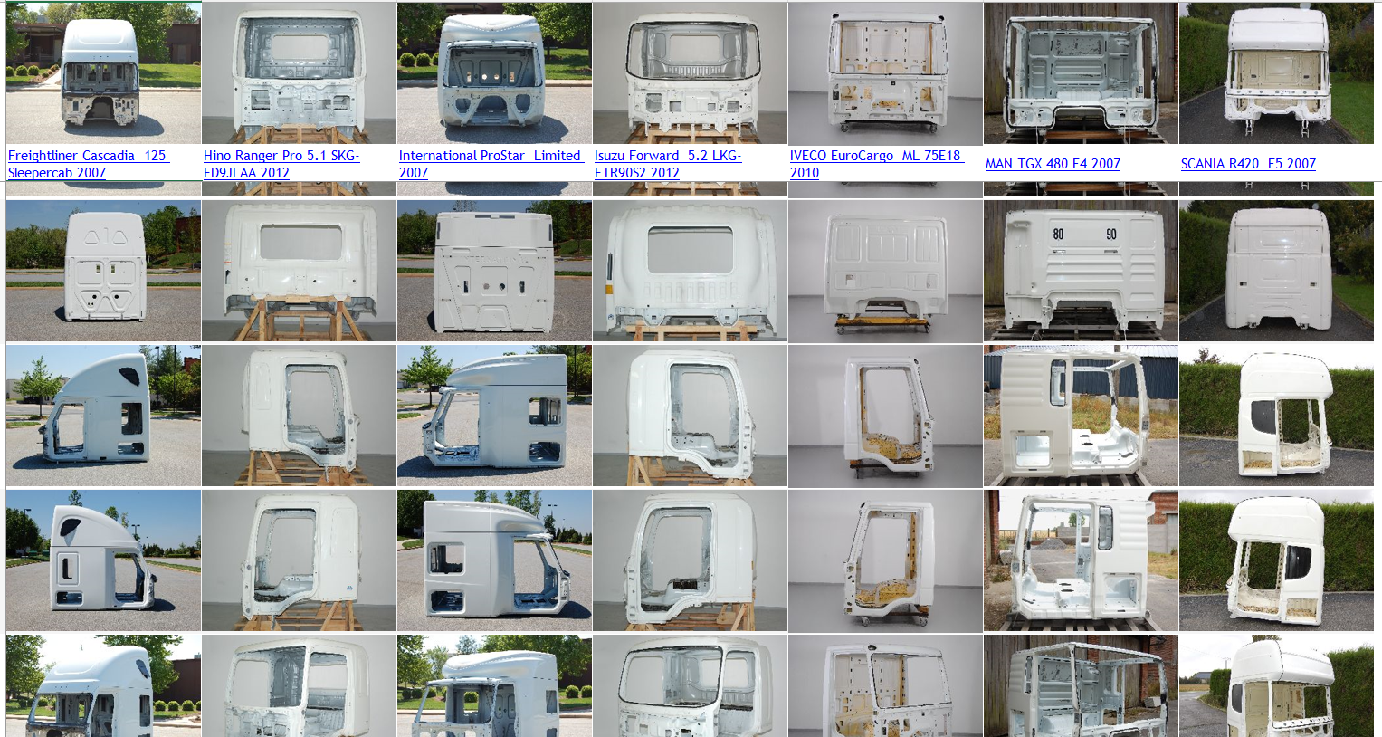

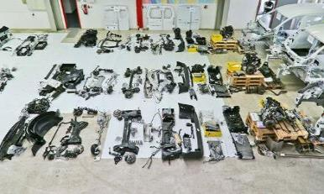
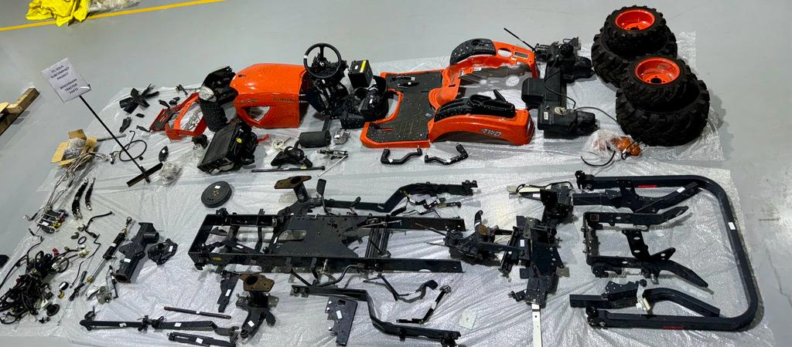
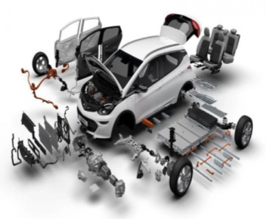
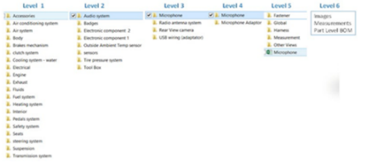
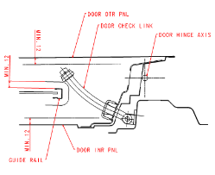
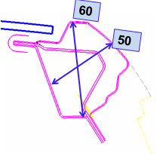
Benchmarking
Tear down/part level analysis/ features study
Experience of more than 100+ vehicle benchmarking data
Comparison & benchmarks
Teardown
Dimensional benchmarking
Gap & flushness study
Weight/CG benchmarking
Scan 3D data generation
Teardown
Performance benchmarking
Section & material analysis
Zero base costing
BOM - Levels
Section study
Interpretation studies
Manufacturing process studies
Note: Image for illustrative purposes only

Slide 6

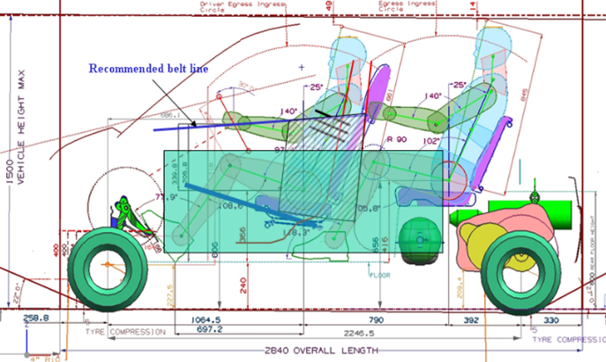
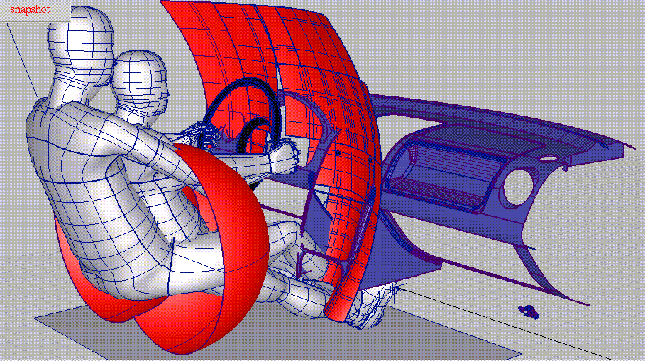
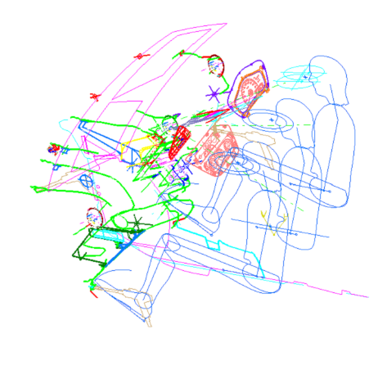
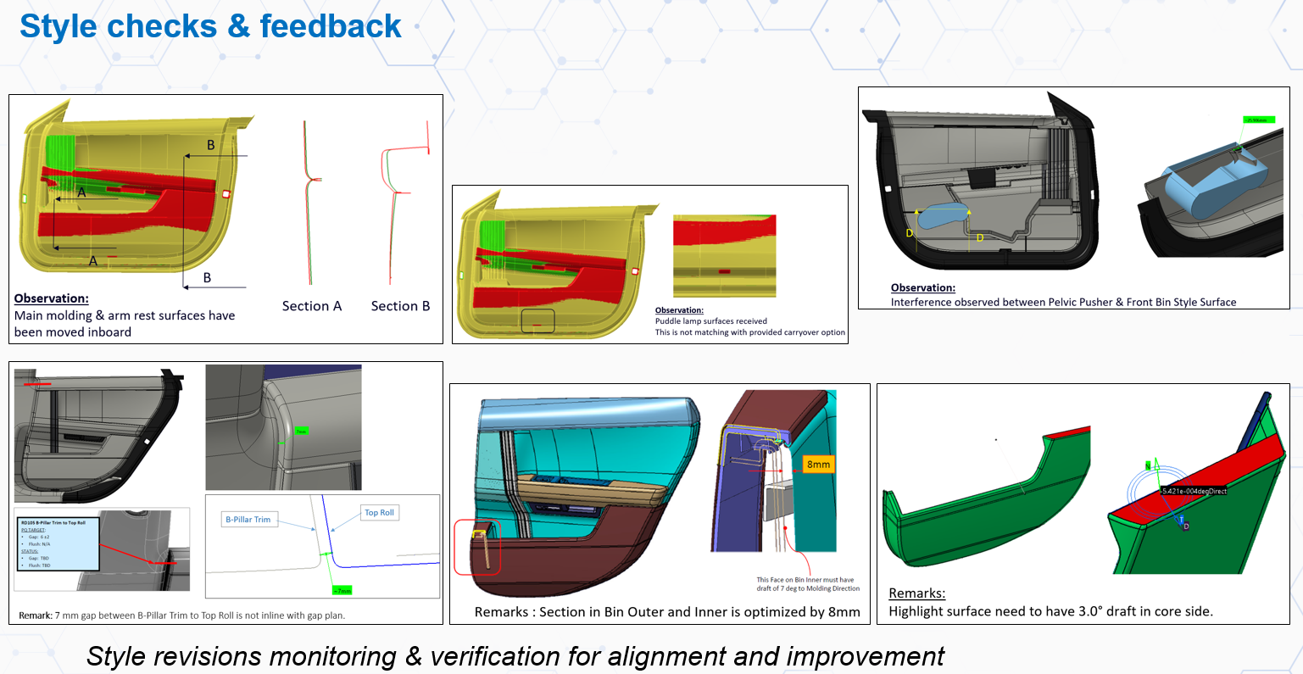
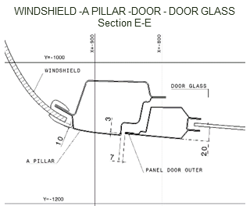
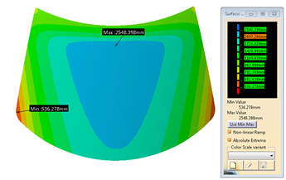
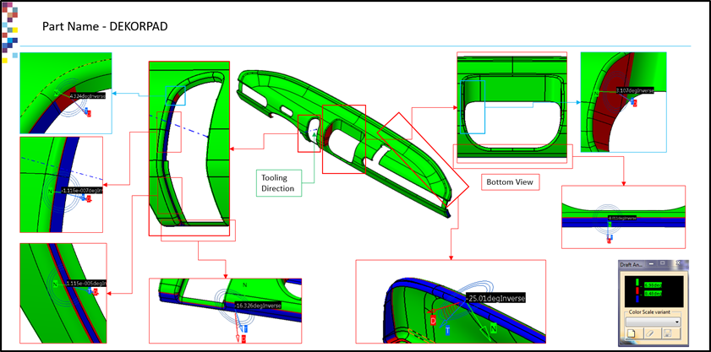
Styling feasibility
Style surface quality check
Regulatory compliance check
Ergonomics checks
Engineering section feasibility
Manufacturability check
Gap & flushness study
Packaging study
Glass drop feasibility check
Spilt line feasibility for closures kinematics
Preliminary BOM
Styling surface quality check
Regulatory compliance
Ergonomics checks
Engineering section feasibility
Gap & flushness study
Manufacturability check
Note: Image for illustrative purposes only

Slide 7
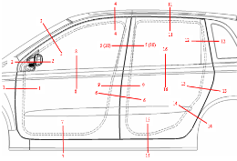
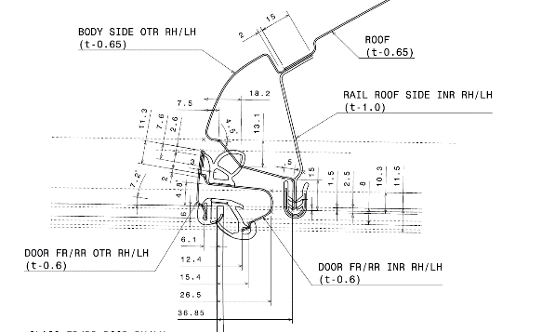
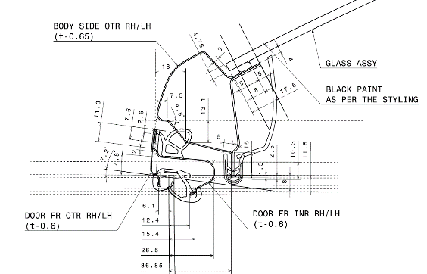
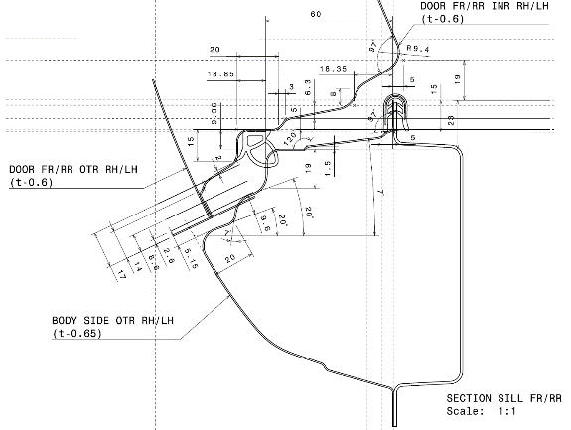
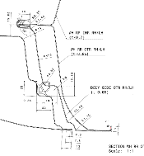
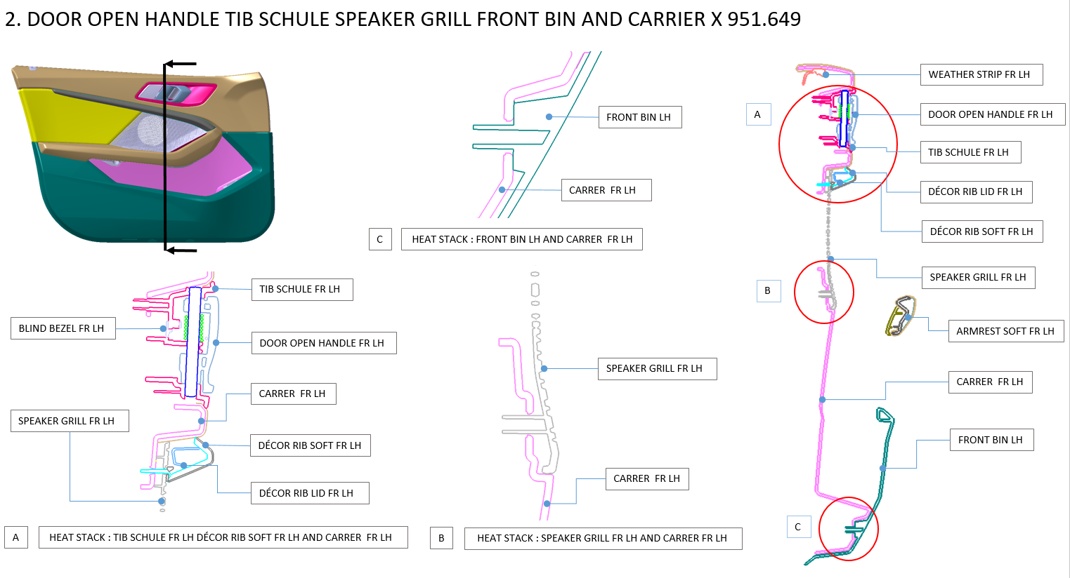
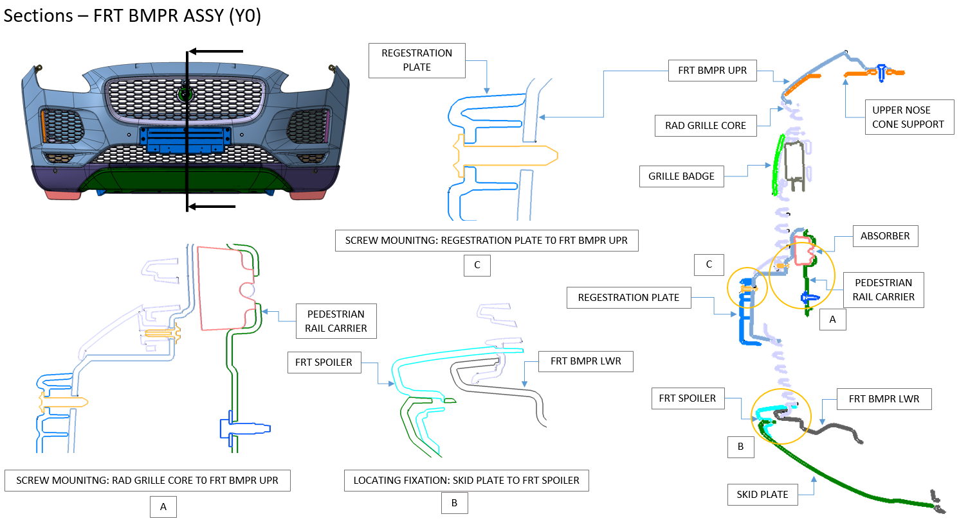
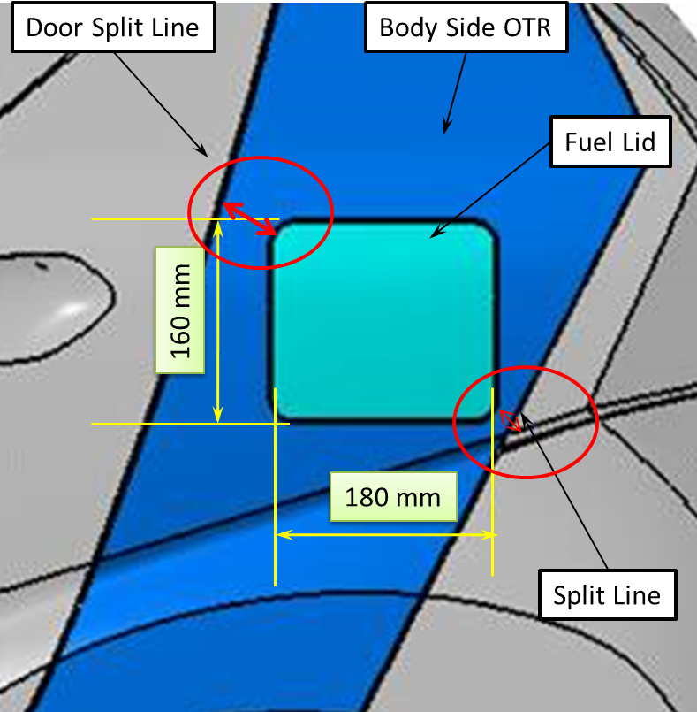
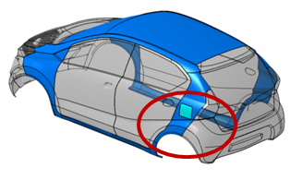

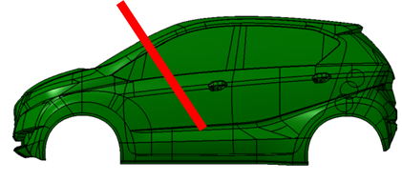
Master section development
Master section creation
Joinery definition
Gap & flushness
Manufacturing feasibility
Packaging study
Regulatory checks
Datum strategy
System performance study
Assembly sequence definition
Baseline material and thickness definition
Master sections
Roof rail section
A-Pillar section
Side sill section
Wheel arch section
Door trim master section & Joinery definition
Front bumper master section & Joinery definition
Manufacturing feasibility
Regulatory checks
Driver field of vision - A pillar obstacle
Note: Image for illustrative purposes only

Slide 8
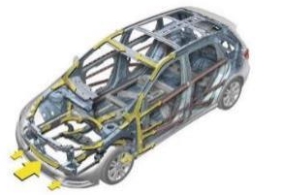








CAD design (Concept & detail design)
Crash load path finalization
3D CAD concept design
Regulatory requirements
DMU packaging
Material & thickness definition
Assembly sequence
Design docs.(DFMEA,DFA,DFM,DVP)
Bill of material (BOM)
Value engineering
Cost & weight management
Crash load path finalization
3D CAD concept
Regulatory requirements
Assembly sequence finalization
Note: Image for illustrative purposes only

Slide 9





2D drawing / 3D annotation, GD&T, 3DCS
Creation of part 2D drawing
Assembly level drawings
Dimensional and geometric annotations
Installation & manufacturing drawing
GD&T & datum
Stack up calculation
Defining tolerances on 2D/3D
3DCS - Dimensional control systems
Deviation analysis
Assembly gap and flushness analysis
Bill of material (BOM)
Assembly drawing
Part level drawing
3DCS - Gap and flush dimensional variation analysis study
Note: Image for illustrative purposes only

Slide 10







Design validation/CAE (virtual) - Body level
Modal analysis
Torsional stiffness
Bending stiffness
Crash analysis (Safety & regulatory)
Door slam / durability
Component level performance tests
Thermal analysis
Seat & restraint tests
Vibration analysis
Mold flow simulation
Door system level tests
Note: Image for illustrative purposes only

Slide 11






Design validation/CAE (virtual) - Vehicle level
Modal analysis
Bending / torsional stiffness analysis
RLDA based durability
Multi-body dynamics
Ride & handling
Crash/regulatory test analysis
Thermal analysis
CFD analysis
Ergonomics & cabin comfort analysis
Field failure correlation & countermeasures
Note: Image for illustrative purposes only

Slide 12






Prototyping & validation
Soft tooling / rapid proto
Vehicle build (batch)
Proto evaluation
System & component-level testing
Vehicle-level testing
Durability
Reliability
Fitment testing
Functional testing
Performance
Failure identification & analysis
Door sag test mapping
Note: Image for illustrative purposes only

