Slide 1

Computer-Aided Engineering (CAE)

Slide 2



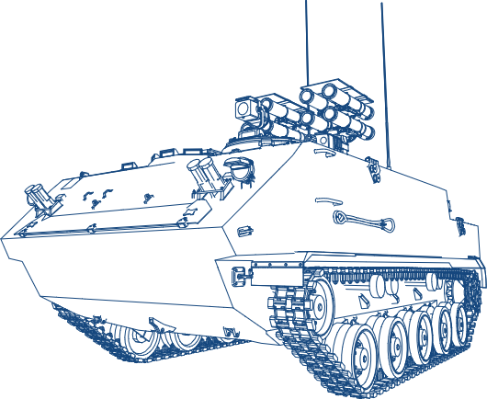
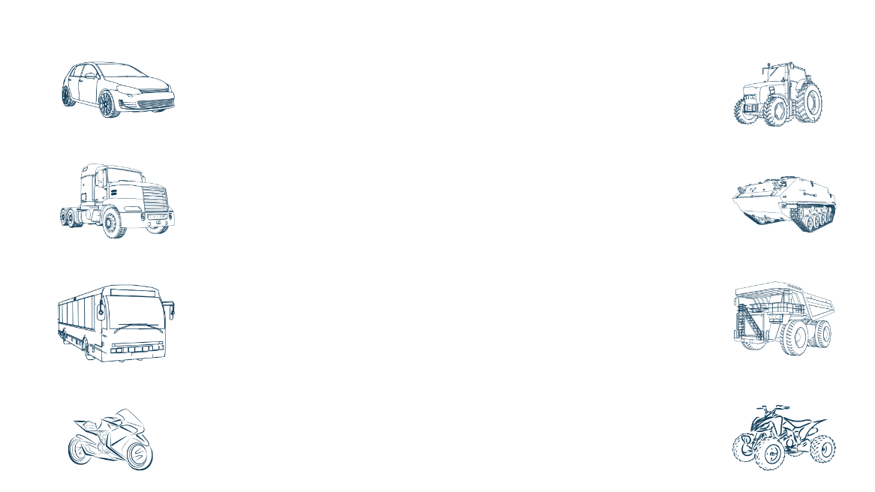
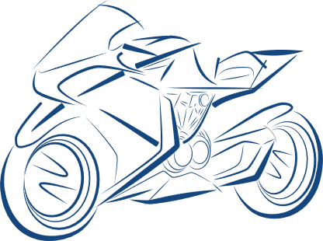
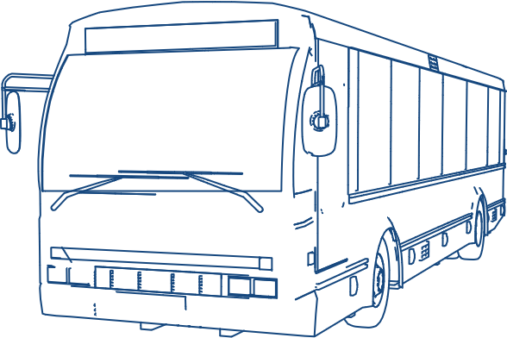
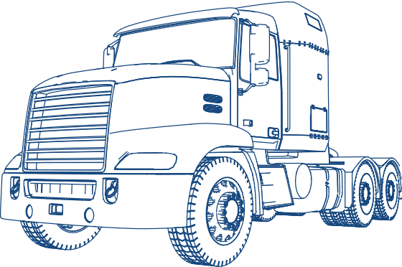
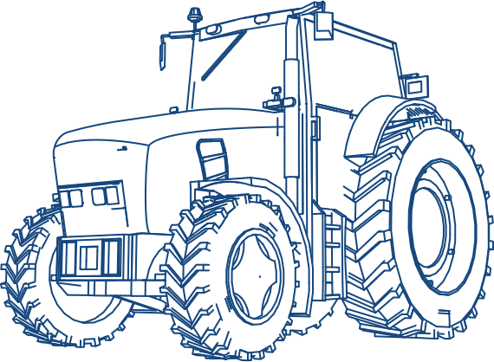
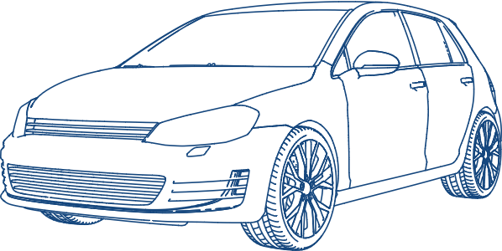

Virtual validation / CAE / CFD – services for mobility industry
We support
USP
Trusted by major global OEMs
> 90% correlation with phy. Testing
Global delivery model
Multi million hours of CAE run
State of the art tools / facilities
Engineering team / SME availability at system and vehicle level
Solution oriented approach
Ensuring product performance
Ensuring regulatory compliances
First time right
Reliable simulation of real-world scenarios
Reduced prototyping and physical testing
Reduced product cost
Reduced investments
Robust product development
Faster time to market
Enhance competitiveness
New system development
Variants development
Optimization and lightweighting
Scenarios
New vehicle development
Refreshes & facelifts
Electrification related changes
Two
wheeler
Passenger
vehicle
Commercial
vehicle (bus)
Commercial
vehicle (truck)
Agriculture
vehicle
Defense
vehicle
Mining
vehicles
Off-road
vehicles

Slide 3


















Simulations we do
Software infrastructure
Meshing and model build
Modal analysis​
Static & dynamic analysis​
Durability, fatigue & fracture analysis​
Thermal analysis​
Crash analysis / roll over / FOPS / ROPS​
Nvh​
Acoustics​
Vehicle dynamics​
Computational fluid dynamics (CFD)​
Optimization​
Electromagnetics
HyperWorks
Mechanical Solvers
CFD Solvers
FEKO
FLUX
SimSolid
SimLab
OptiStruct
ANSA
META
Animator
Generator
ABAQUS
Simpack
fe-safe
StarCCM suite
StarCCM Solver
LS-Dyna
ANSYS Workbench
ANSYS Mechanical
ANSYS Fluent
ANSYS Electromagnetics
Patron
Nastran
Adams
Medina
Primer
suite
PamCrash
modeFrontier
Matlab

Slide 4



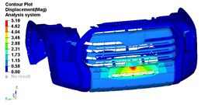
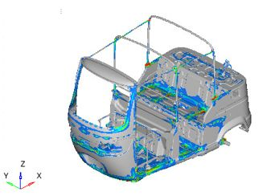
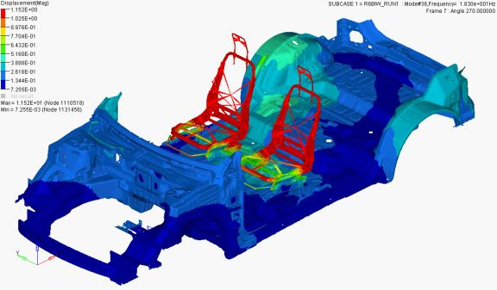


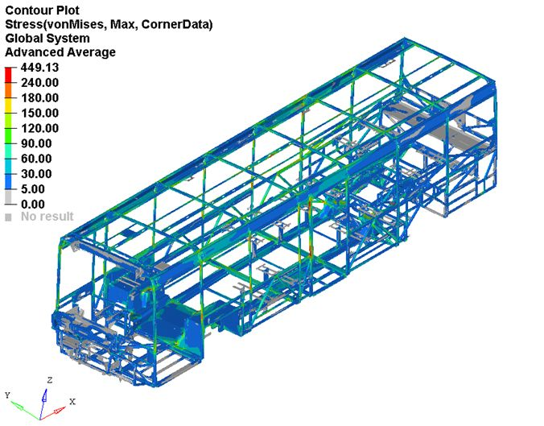
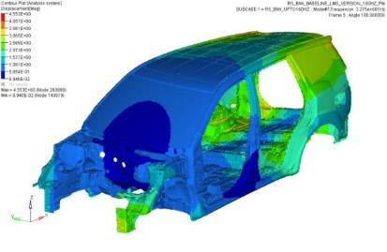
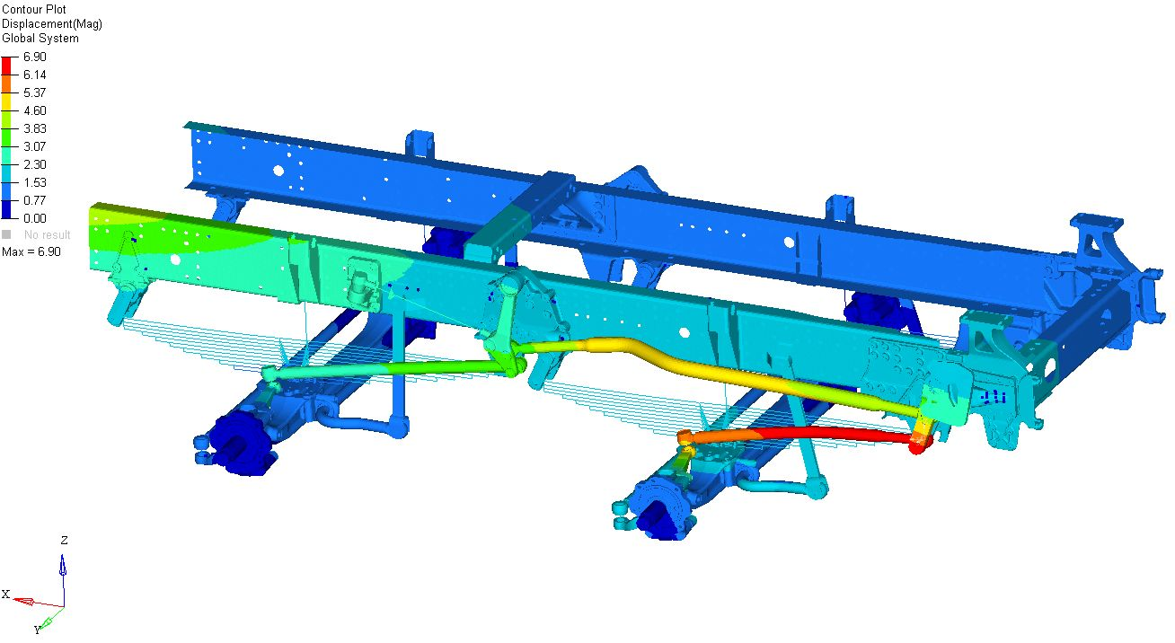


Structural & durability
Supported simulation
System / part type
Customer benefits
Bending and torsional stiffness
Static strength analysis - linear, non-linear
Structural - transient, modal transient
Shape, topology, & topography optimizations
RLDA based durability
Fatigue life estimations
Field failure correlation studies
Vehicle level / system level / part level
Full vehicle modelling of cars / commercial vehicles
Load body / axle / suspension / powertrain / interior / exterior
Modelling for bikes, LCV, trucks, buses & heavy industrial assemblies
MACRO based automation
Field failure correlation of chassis and powertrain components.
Provided various countermeasures during full vehicle simulations, to reduce the lead time of testing

Slide 5
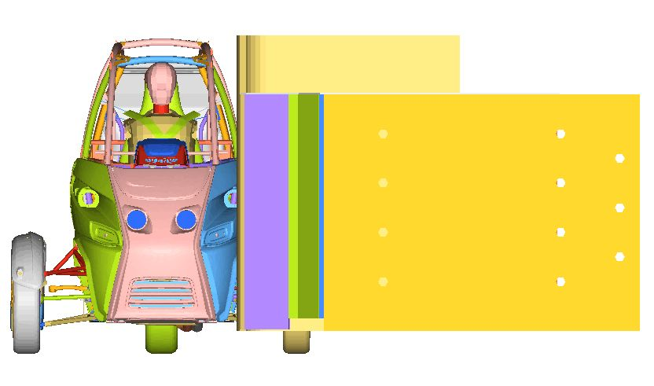
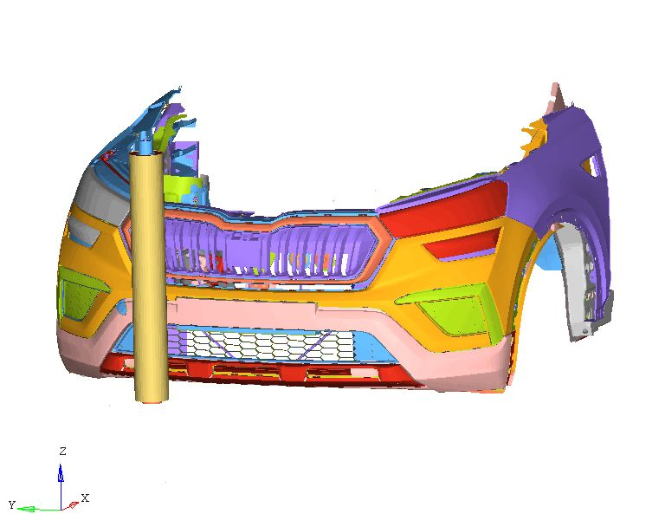
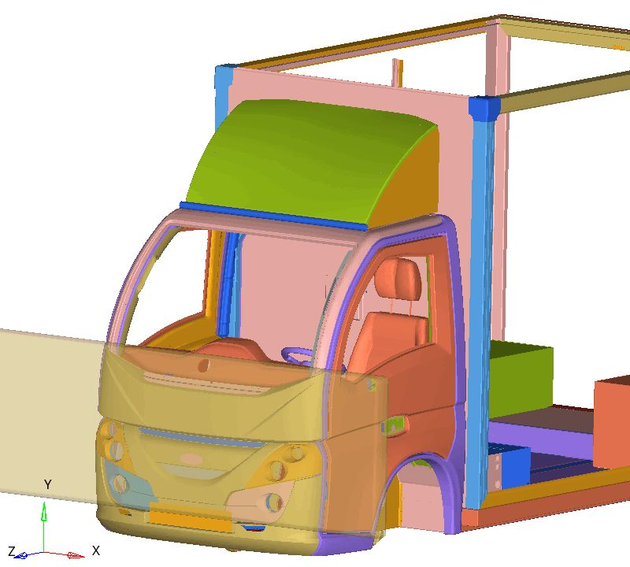
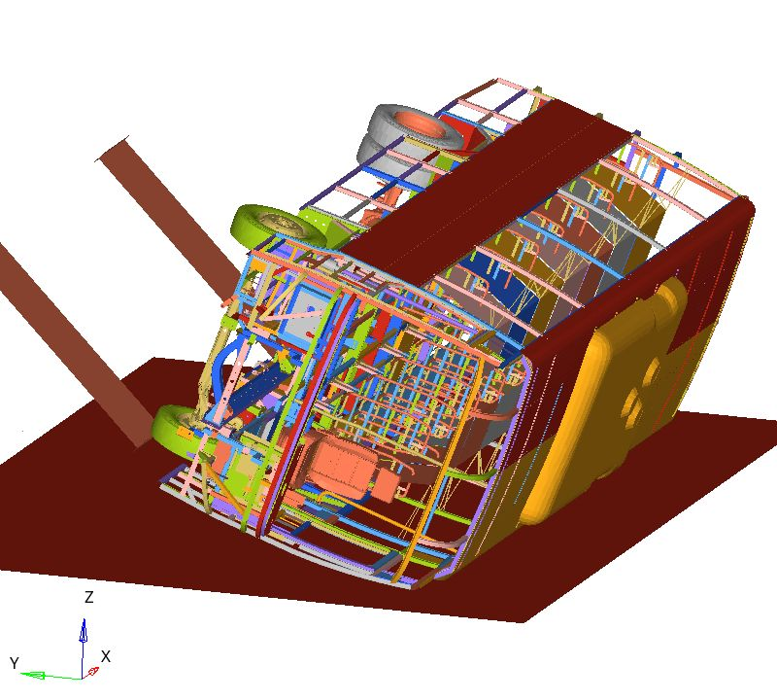
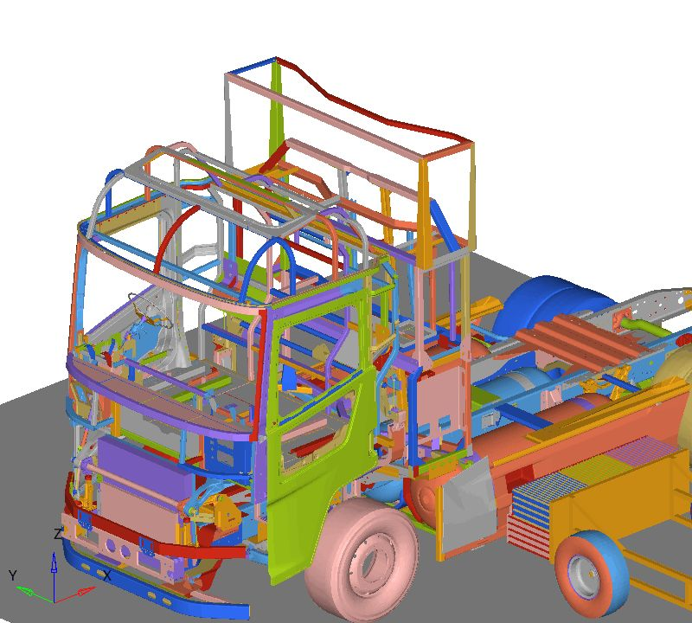
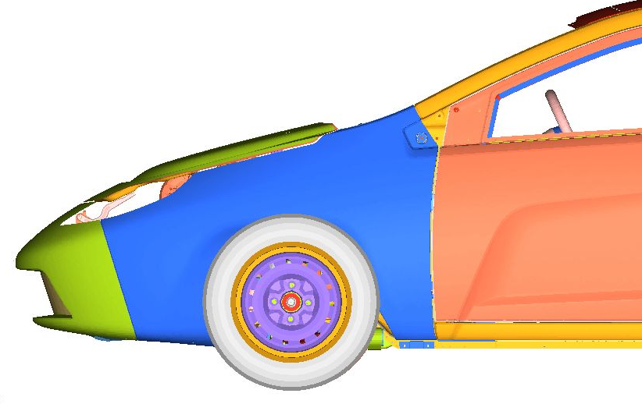
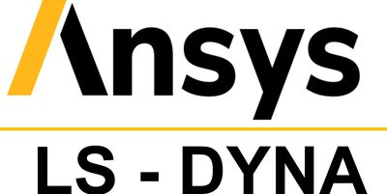
Crash & safety​
Supported simulation
System / part type
Customer benefits
Crash / impact / safety simulations for AIS, US, EU and various country regulations
Frontal impact, rear impact, side impact, seat / seat belt anchorage, roof crush & roll over simulations
Pedestrian impact simulations (adult & child heads, leg forms) and interior impact of knee, luggage retentions etc.
Sequential loading simulations with stress/strain carryover
Implicit simulations for OE parts and sub-assemblies for client specific loads
Clip insertions & retentions
Permanent set evaluation with loading and unloading for parts like springs , connectors etc.
Generic simulations like crush test , drop test etc. For client specific requirements
Full vehicle level simulations (car , trucks , trailers & LCV)
Sub system simulations like Bumper, IP, Closure, sunroofs, batteries, springs & other explicit problems
Simulations using composite, non-linear and hyper-elastic materials, manikins and barriers
Sequential load cases with preload

Slide 6
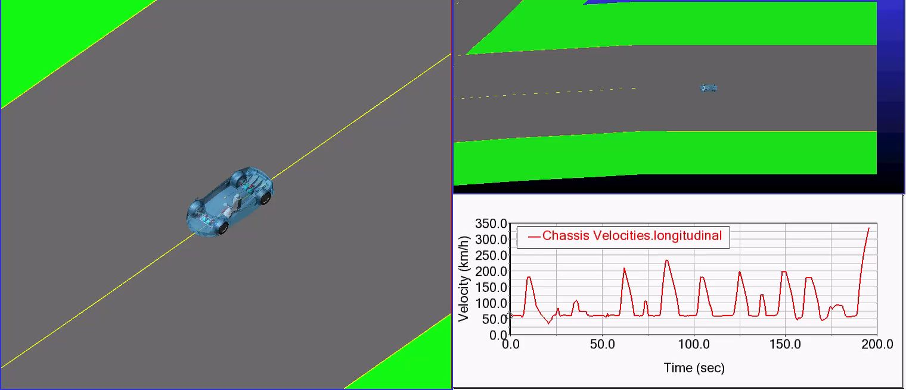
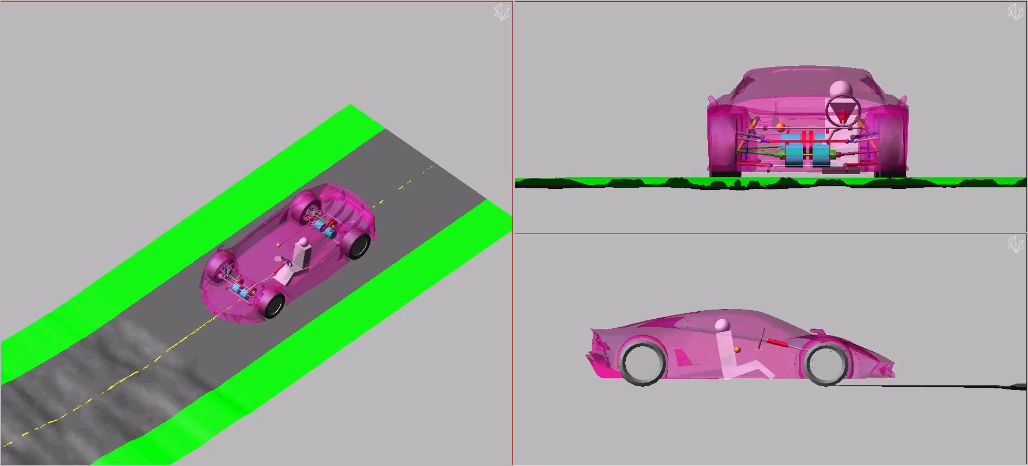
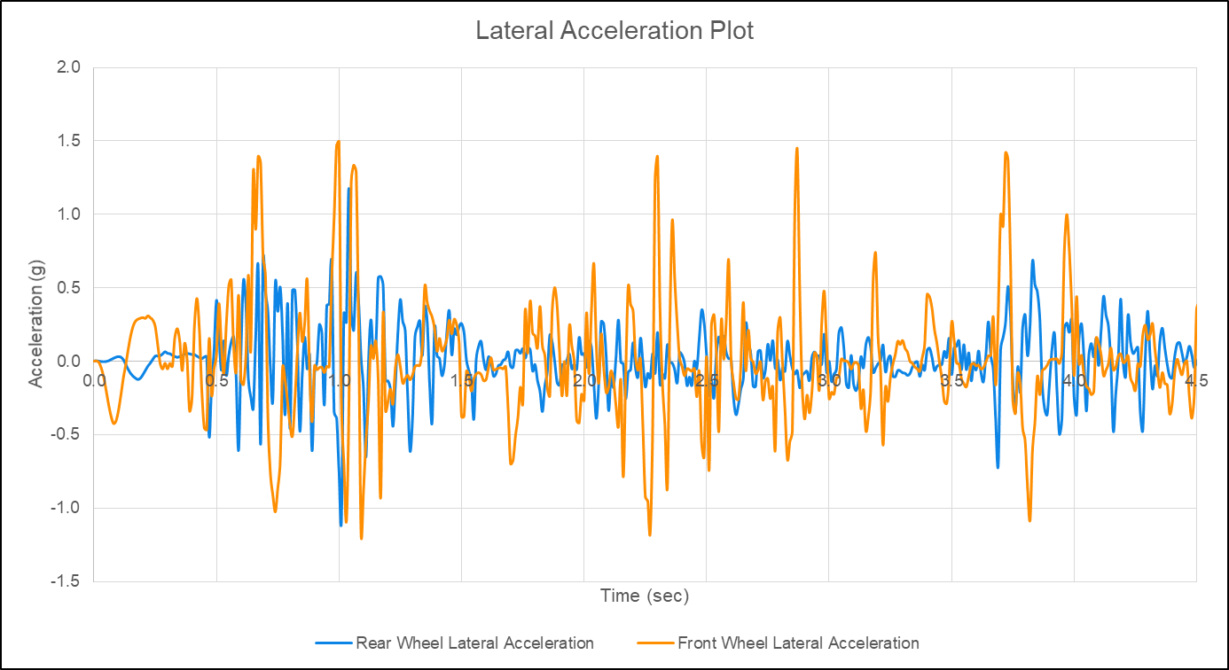
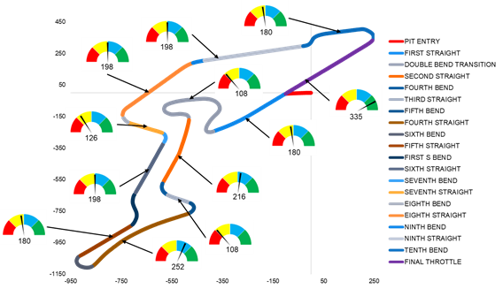
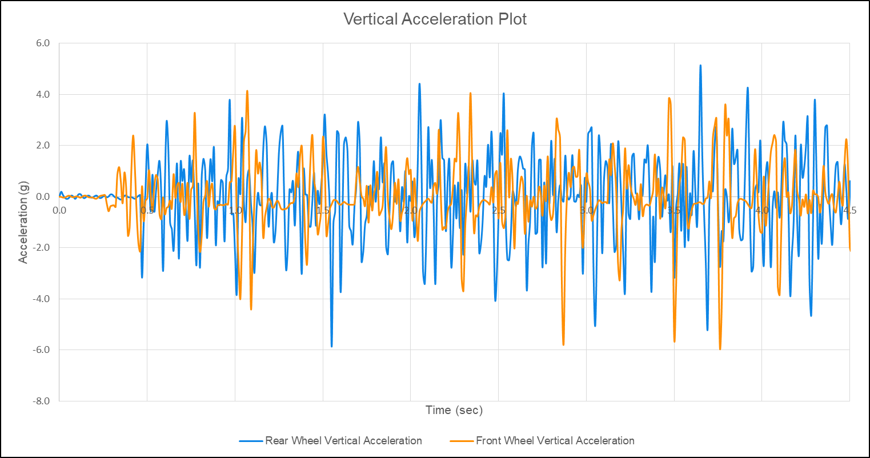
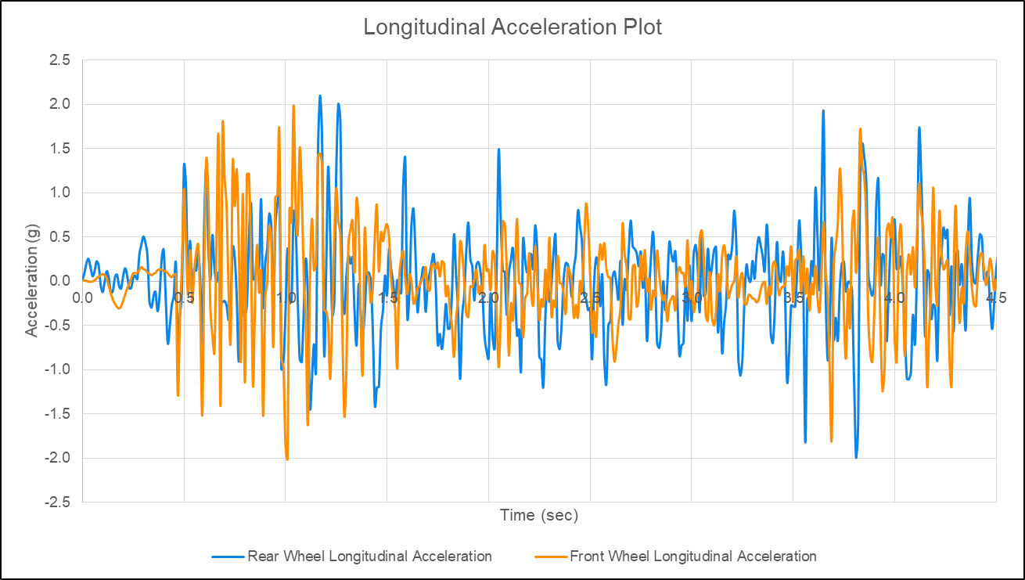
Multi body dynamics & vehicle dynamics
Supported simulation
System / part type
Customer benefits
Suspension kinematics & compliance – test-rig simulations
Quasi-static force extraction & full vehicle force extraction
Vehicle longitudinal behavior assessment
Vehicle lateral handling assessment
Ride & handling assessment - spring, damper, anti-roll bar sizing
Suspension & steering system hardpoint optimization
Lever’s design & optimization & driveline simulations
Wheel envelope generation for steering & worst-case scenarios
Two-, three-, four-, light & heavy commercial vehicle MBD
Full vehicle
Chassis
Suspension & steering system
Powertrain (throttle) & braking system
Quasi-static load extraction fed into CAE analysis at the initial phase of vehicle development helps in minimizing the lead time to design the chassis & structural components
Flexible body modelling of chassis & suspension components for linear, non-linear & transient vehicle handling assessment
Comprehensive suspension K&C study for 200+ parameters
Virtual road load data extraction for life cycle durability

Slide 7
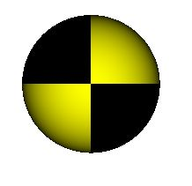
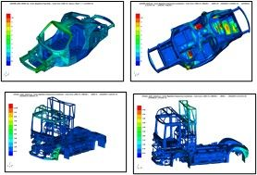
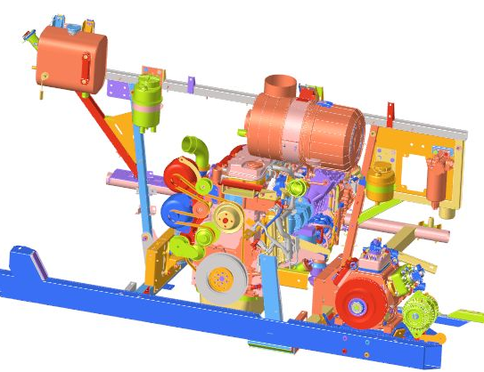
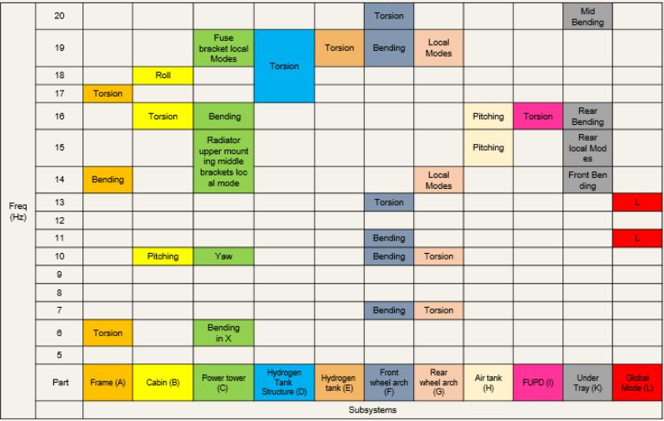
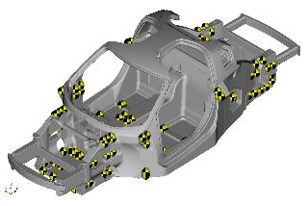
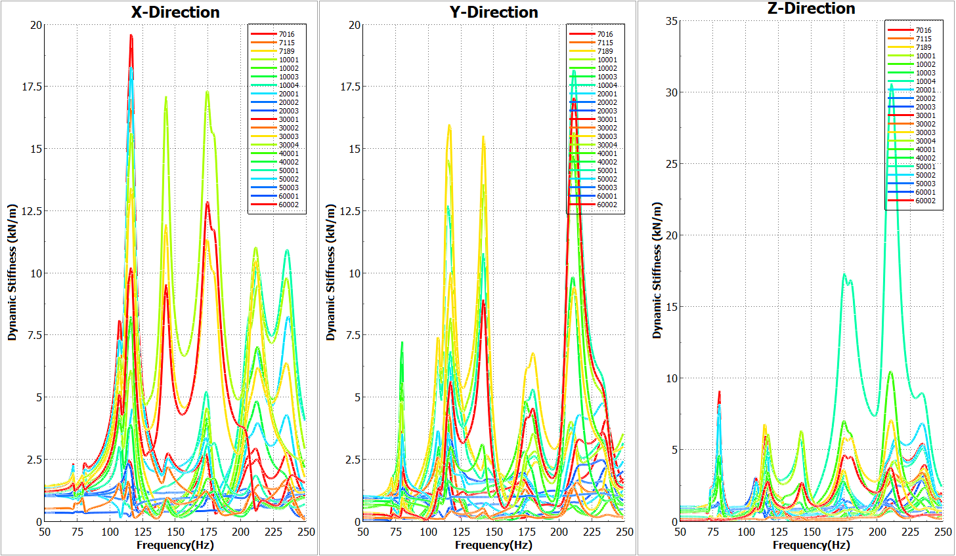
NVH - Vibration & noise
Supported simulation
System / part type
Customer benefits
Modal transient & modal super position simulations
Frequency response simulation with unit load and signal data
Harmonic & random vibration analysis with field data / spectrums, point mobility
Vibration simulation with thermal mapping
Modal analysis with nsm & mfluid
Equivalent radiated power prediction
Buzz squeak & rattle analysis
Full vehicle
Body & Chassis
Suspension & steering system
Powertrain NVH
Battery and various electronic assemblies
Various sub assembly brackets
Field failure correlation
Weak zone identification & addressal
Post process automation
Measuring points

Slide 8
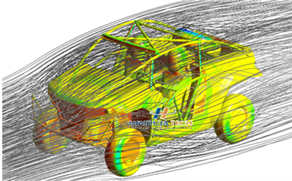
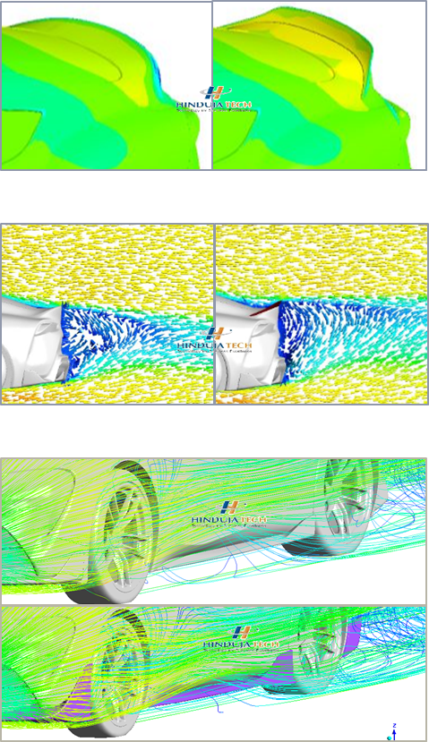
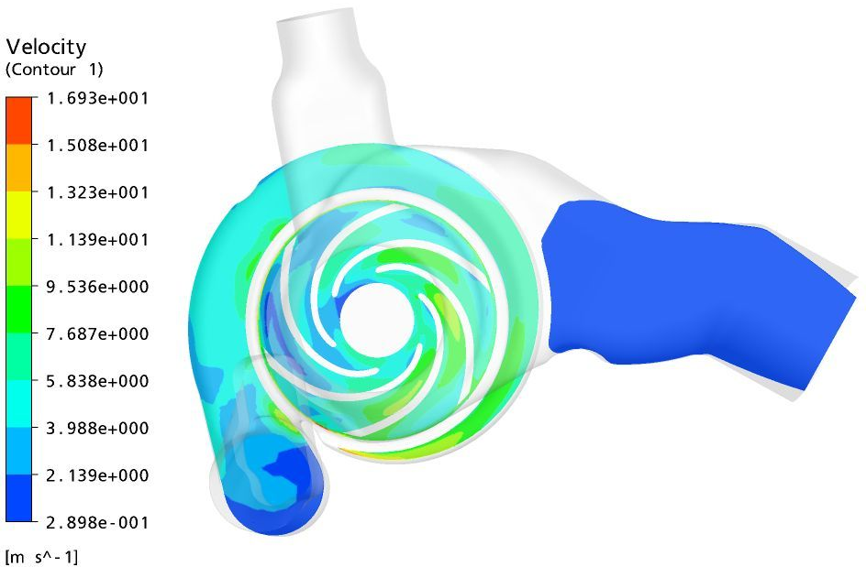
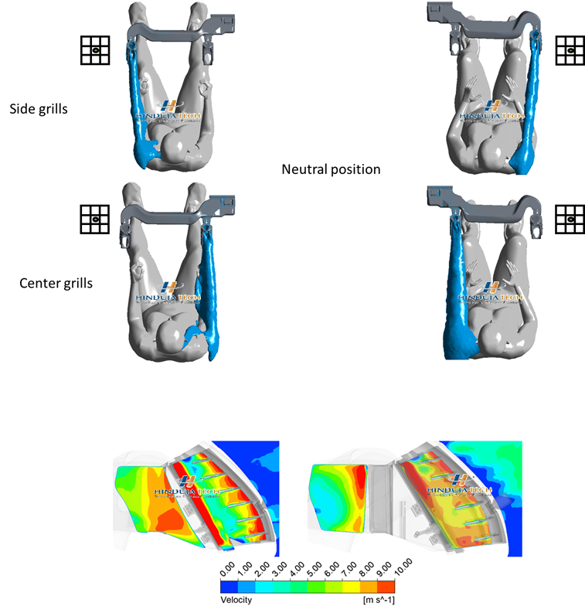
CFD – Flow
Supported simulation
System / part type
Customer benefits
External aerodynamics
Drag force prediction
Lift force/downforce prediction
Aero balance between axles
Aero stability during cornering
Under hood flow analysis
Internal flow
Pressure drop analysis
Flow distribution analysis
Mixing simulations
Sloshing analysis
Filling analysis
Full vehicle (2,3 wheeler, cars, buses & trucks)
System level (engine cooling jacket with radiator flow)
Sub-system level (HVAC cabin flow, AIS )
Component level( aero wings, fans, pumps, fuel tanks, manifolds)
Correlation with physical testing (wind tunnel)
Countermeasures through simulations which reduces TAT

Slide 9
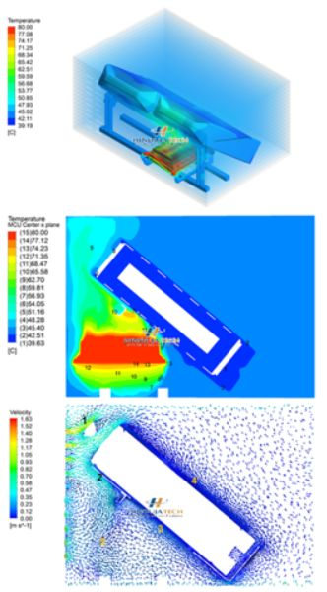
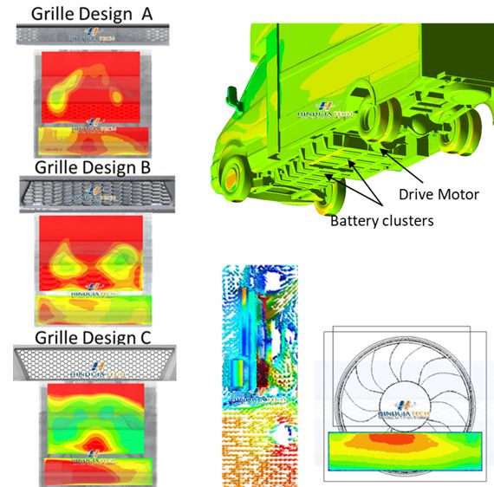
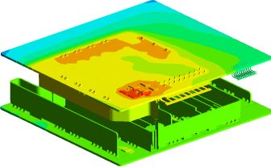

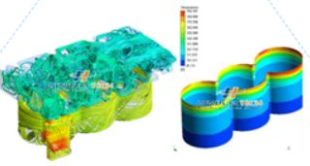
Thermal
Supported simulation
System / part type
Customer benefits
Flow thermal analysis
Thermal mixing and distribution
Conjugate heat transfer analysis
Oil and EGR coolers
Engine cooling jacket
Under hood thermal analysis
Electrical & electronic components
PCB level
Batteries
Warm up and cooling circuits
Solar soak and solar loading simulation
Demist simulation with wall film modelling
Full vehicle (2,3 wheeler, cars, buses & trucks)
System level (engine cooling jacket with radiator flow)
Sub-system level (HVAC cabin flow, AIS )
Component level( aero wings, fans, pumps, fuel tanks, manifolds)
Test vs correlation
Thermal management/ hot spot avoidance expertise

Slide 10
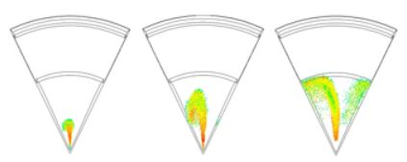
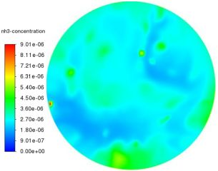
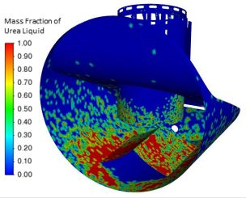
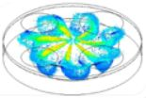

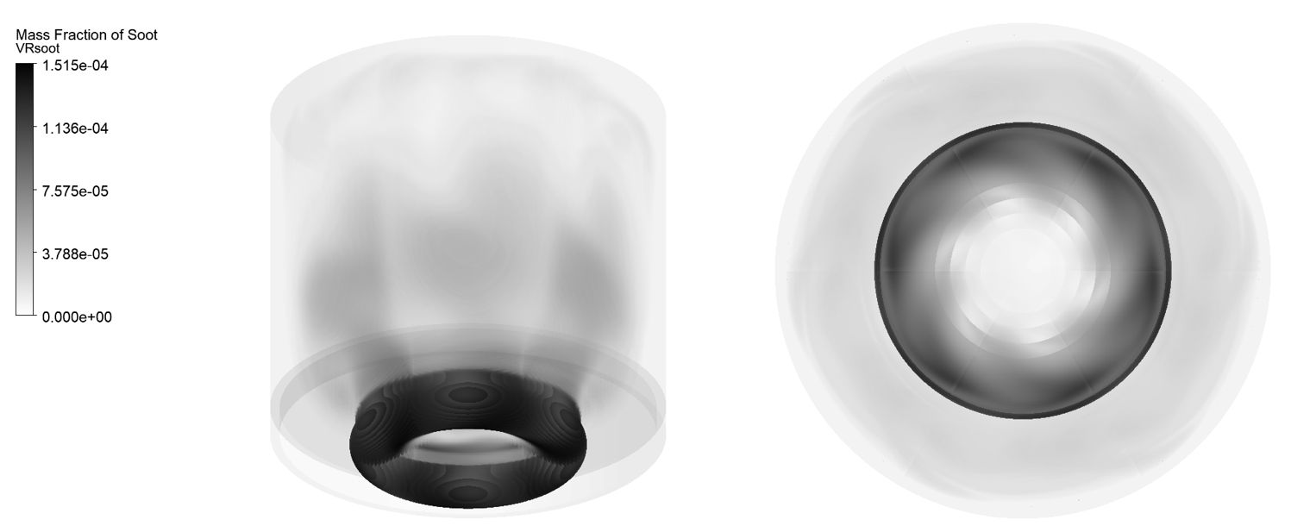
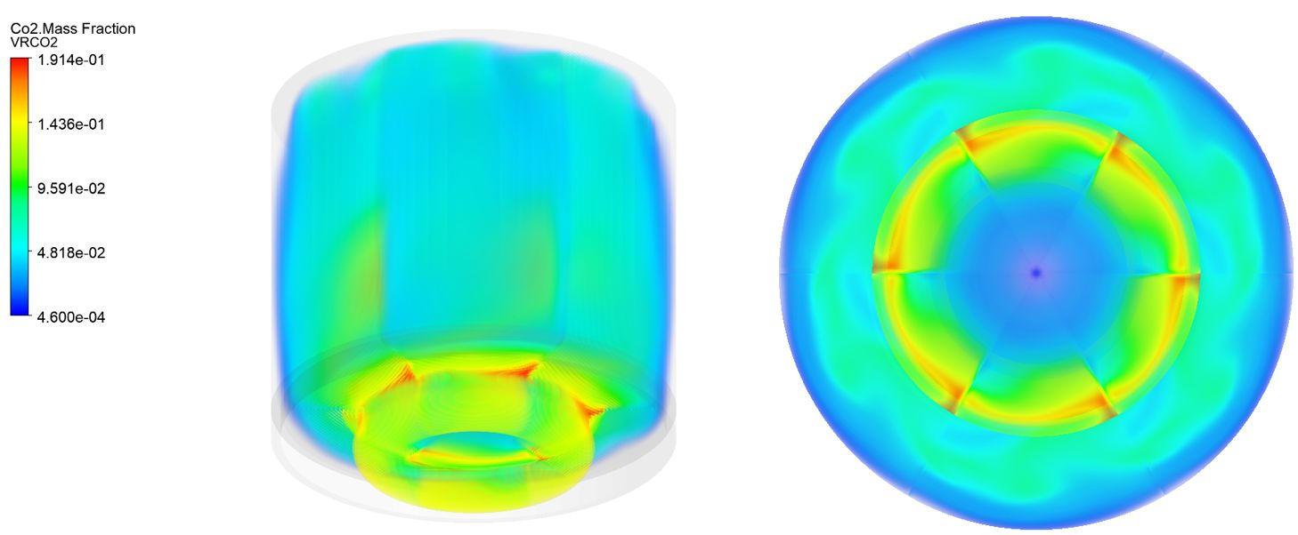
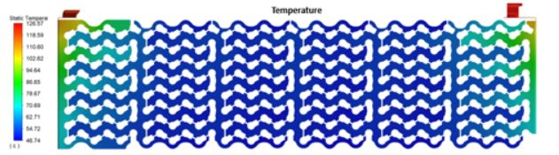
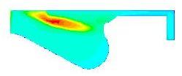
CFD – Multiphysics
Supported simulation
System / part type
Customer benefits
Combustion simulation
Diesel DI
Gasoline PFI, DI
SCR simulations
Busbar – joule heating
Fluid structure interactions
Single cylinder combustion
Sector combustion
Spray calibration
NH3 formation and uniformity
Fuel/ SCR fluid spray development, evaporation and mixing
Force acting on piston and structures using 6dof solver
Emission trend prediction
Injector nozzle hard point finalization
SCR mixer optimization
Test vs simulation correlation
Combustion improvements

Slide 11
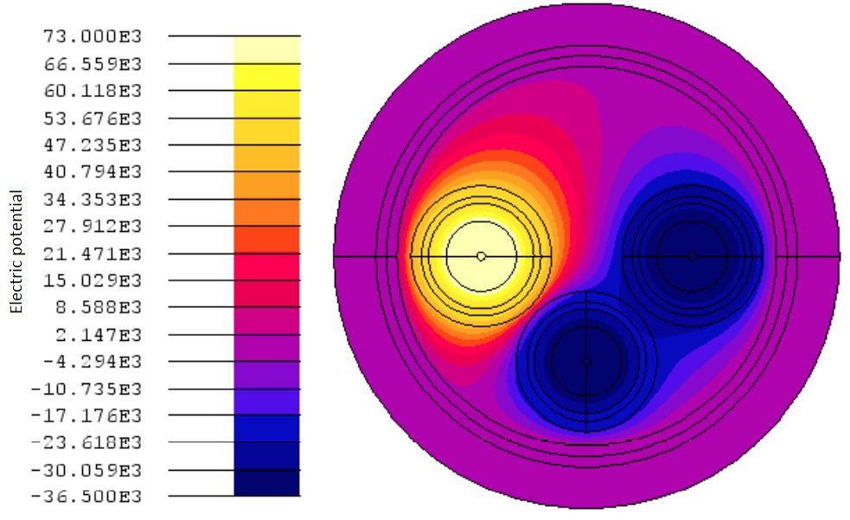
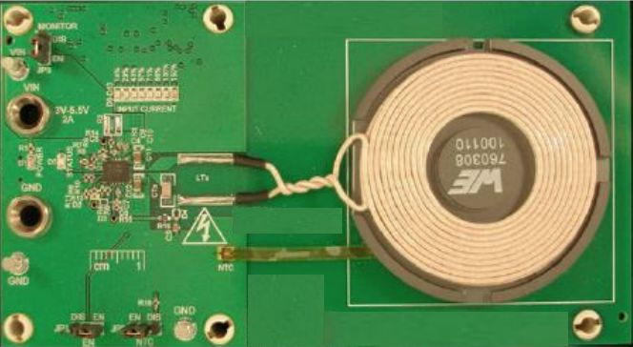










Electromagnetics
Supported simulation
System / part type
Customer benefits
EMI/EMC analysis
Demagnetization analysis
Electromotive force computation
Motor Efficiency calculation
Magneto static, steady-state, and transient conditions
Test Compliance with EMC Standards
Low frequency and high frequency system simulation
Cogging Toque & Back EMF
Motor
Actuator
Transformer
Electromagnetic sensor
Low & high voltage circuits
EMI/EMC on cables
Contactless charging
Antenna
Understand complex systems through simulation
Significant time saving in prototype design & testing.
Power cable
Current density distribution PCB
Wireless
charging
4 pole BLDC motor
EMI and EMC
Analysis on signal cables
3 phase transformer

Slide 12






Weight optimization
Supported simulation
System / part type
Customer benefits
Shape optimization
Size optimization
Weight optimization
Topology optimization
Topography optimization
Cabin
Chassis
Load body
Containers
Powertrain parts
Sub-systems
Aggregate parts
Alloy Wheels
Weight / material savings
Cost Reductions
Alternate material suggestions
Section Optimization through 1D Model concept
Material and Thickness Optimization were performed on the structure to improve the strength and the stiffness of the radiator mounting

Slide 13










Correlation
Supported simulation
System / part type
Customer benefits
Field failure correlation
Root cause analysis
Estimating precise engineering life of product.
Identifying methodologies and suggesting best practices
Time bound iterations and trials to understand the gap between test and simulations
Body & chassis
Brackets & sub assemblies
Suspension & steering system
Powertrain system
Full vehicle (durability)
Battery and various electronic assemblies
Counter measure suggestions
Failure mode correlated with physical testing
Methodology/gap identification between simulation and physical test
Test
CAE
Module edge got damaged – During Drop test

Slide 14








CAE Model build
Material / process supported
System /
part type
4
Supported simulation
Customer benefits
Mesh & model build
Structural mesh
CFD mesh
Any code – any specification
Polymer / plastic mesh components
Castings / forgings
Sheet metal
Composites
Machined components
Vehicle level / system level / part level
Full vehicle modelling of cars
Powertrain assembly modelling with node mapping etc.
Modelling for bikes ,LCV , trucks , buses & heavy industrial assemblies
MACRO based automation
Can handle Model size of 10 million+ nodes
Fast turnaround time

Slide 15












Prototyping & physical testing
Rotary & linear actuators
Vibration platform / ED shaker
Elastomer test system
Wind tunnel (radiator testing)
Durability testing
Metallurgical testing
Engine testing (performance, durability & emission)
4 poster / 6 poster
Test tracks
Belgium pave / corrugation / herringbone / setts / pot hole / water wading / articulation / high speed / steering pad / gradeability
test tracks
Complete instrumentation set up
Data acquisition system for measuring
test tracks
Force
Strain
Pressure
Vacuum
Power
Speed
Acceleration
Velocity
Displacement

