Slide 1

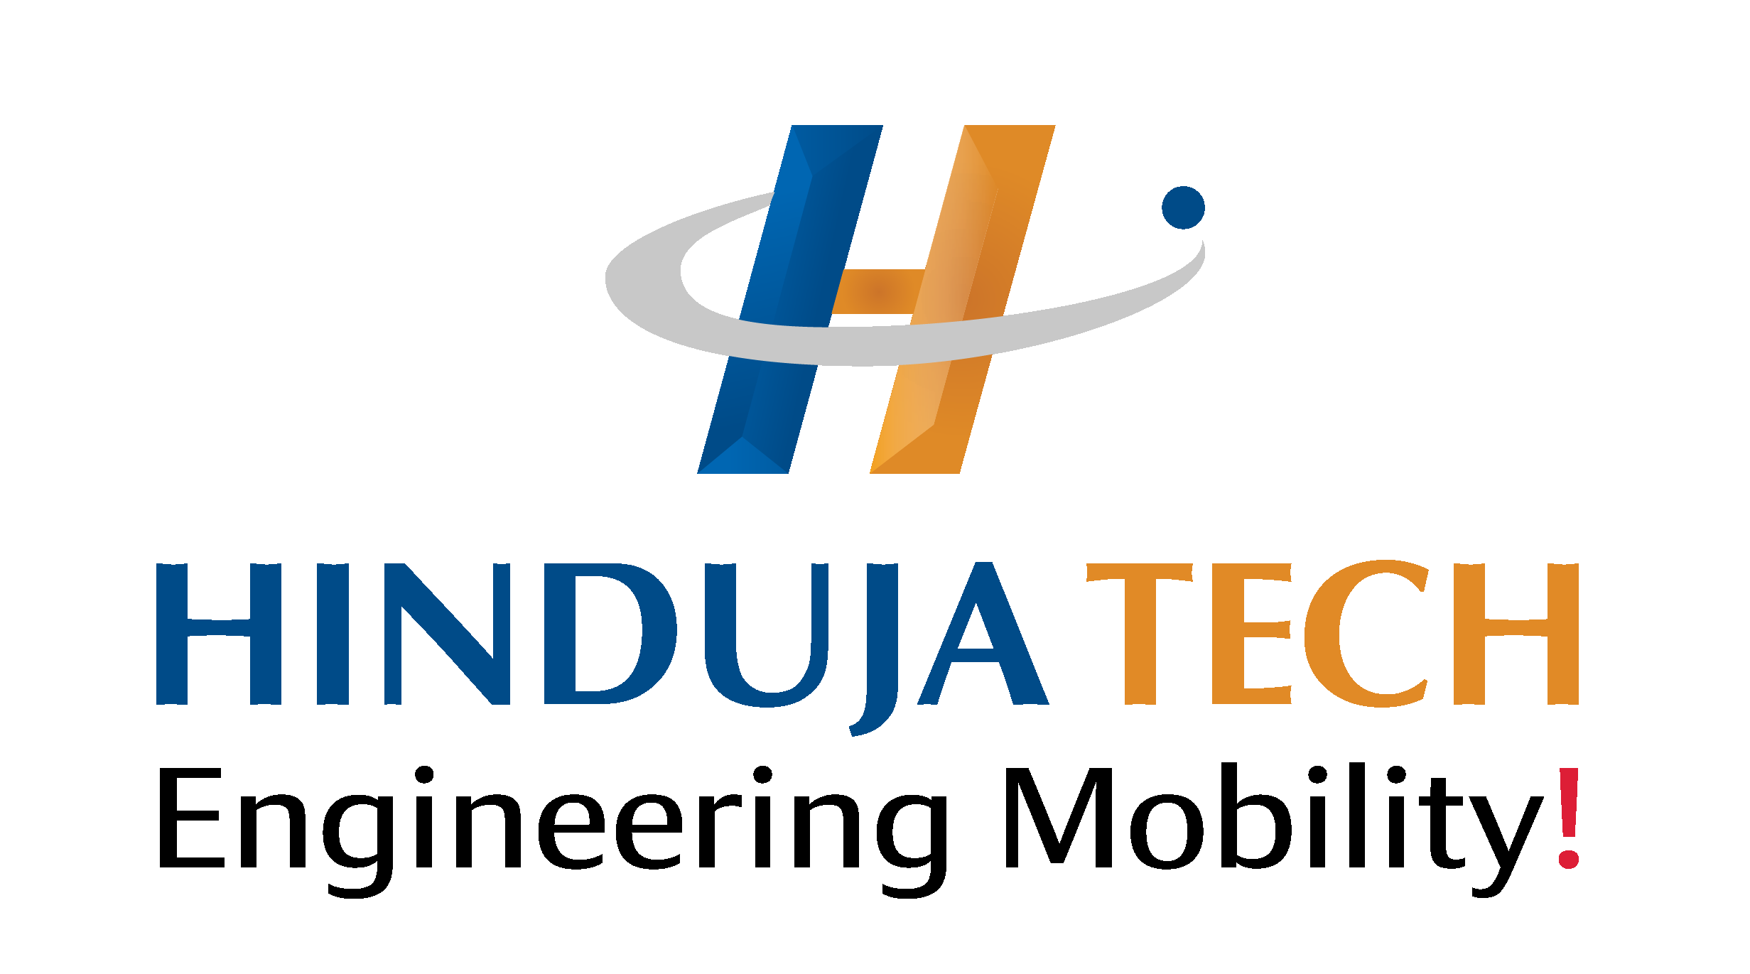
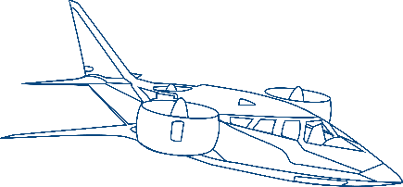

Engineering Sustainable Mobility
Corporate Overview
© Hinduja Tech Limited 2026
Notes:
Welcome everyone. Today, I'm thrilled to provide an overview of Hinduja Tech. As you can see, our focus is on 'Engineering Sustainable Mobility.' We are a leading provider of engineering and digital technology solutions, partnering with global mobility leaders to shape the future of transportation.
Let's delve deeper into who we are and what we do.

Slide 2





























HINDUJA GROUP
One of India’s
Founded in
HQ in London, UK
Multi Billion $
Global presence across
Employs over
Premier transnational conglomerates
1914
Global Business conglomerate
38 countries
200,000 people
Automotive
IT & ITeS
Banking & Finance
Oil & Specialty Chemicals
Power
Media
Real Estate
Healthcare
Project Development
Trading
Work to Give | Word is a Bond | Act Local, Think Global | Partnership for Growth | Advance Fearlessly
Notes:
Let's take a step back and look at the bigger picture. Hinduja Tech is part of the esteemed Hinduja Group, a global conglomerate with a rich history dating back to 1914. The group has a strong presence across various sectors, including automotive, IT, banking, and energy.
With a global footprint spanning 38 countries and employing over 200,000 people, the Hinduja Group is a true testament to its reach and impact. This strong foundation provides a solid platform for Hinduja Tech to thrive and innovate.

Slide 3

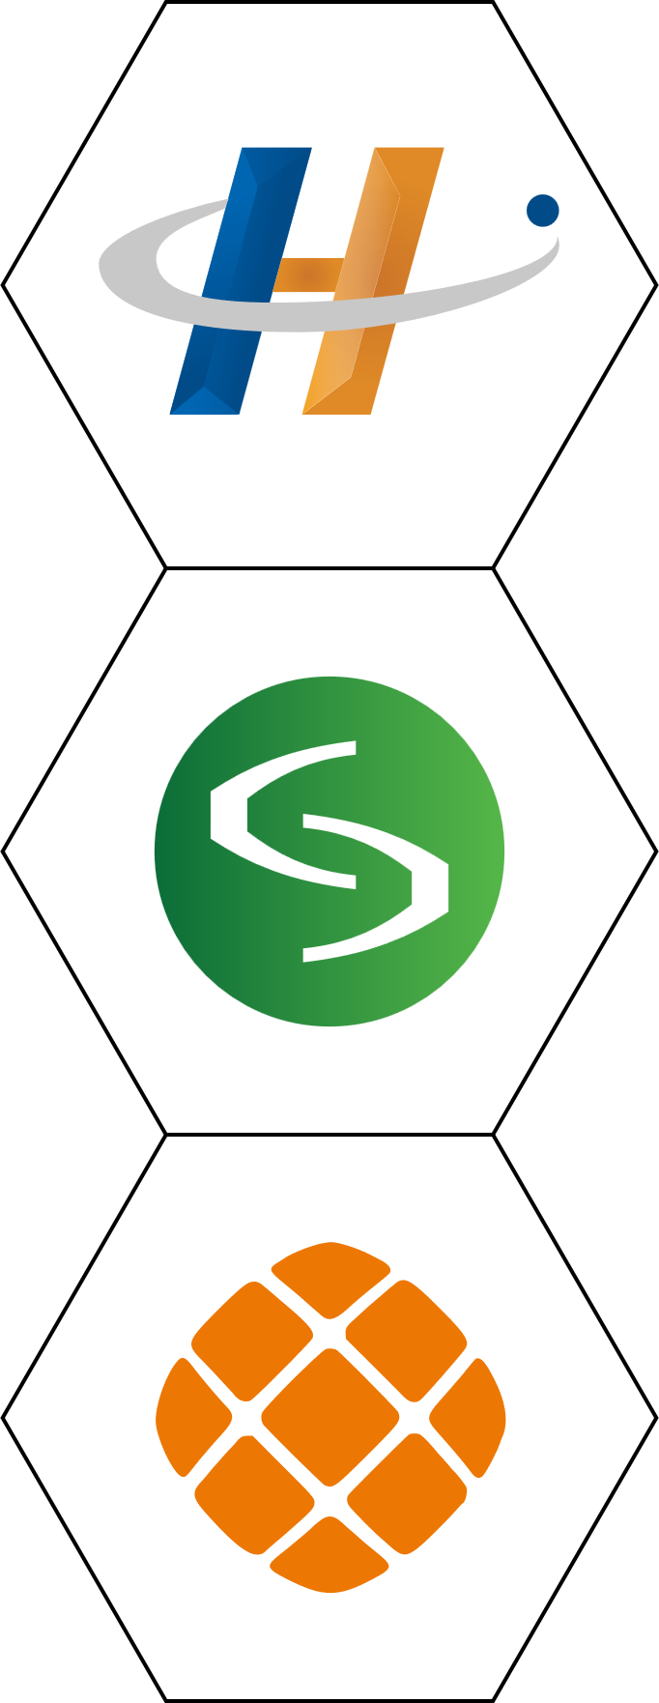











Hinduja Tech: Who We Are
We Deliver SUSTAINABLE ENGINEERING & DIGITAL SOLUTIONS across Mobility Industries
Our Group
Hinduja Tech, a key part of India's leading multibillion dollar transnational conglomerate, Hinduja Group together with its subsidiaries
Drive System Design & Tecosim
End to End Vehicle Engineering & Integration
33 + years
Purpose
of serving 100+ Global OEMs, Tier 1s and Disruptive players
Creating Sustainable Mobility
360°
Ecosystem for PV/CV/ EV development using robust processes based on Frugal engineering paradigm
An advanced Powertrain Engineering Division of Hinduja Tech
2300 +
Mobility and eMobility experts Globally
Vision
To be among the Top 10 Global Mobility Engineering and R&D Companies
An advanced Virtual Simulation Division of
Hinduja Tech
100 +
Co-developed vehicle models in Production and running
Notes:
Now, let's zoom in on Hinduja Tech itself. We are a key player within the Hinduja Group, delivering sustainable engineering and digital solutions across various mobility industries.
With over 33 years of experience, we have a proven track record of serving 100+ global OEMs, Tier 1s, and disruptive players. Our purpose is clear: to create sustainable mobility.
To achieve this, we have built a 360° ecosystem for PV/CV/EV development, leveraging robust processes based on frugal engineering principles. We are stronger together with Drive System Design and Tecosim, advanced divisions specializing in powertrain engineering and virtual simulation, respectively.
Our vision? To be among the top 10 global mobility engineering and R&D companies. With over 2650+ mobility and e-mobility experts globally and 100+ co-developed vehicle models in production and running, we are well on our way to realizing this vision.

Slide 4
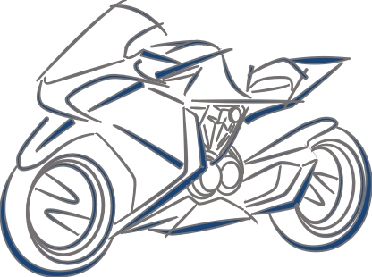




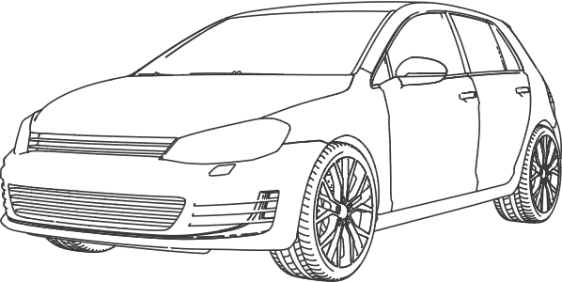
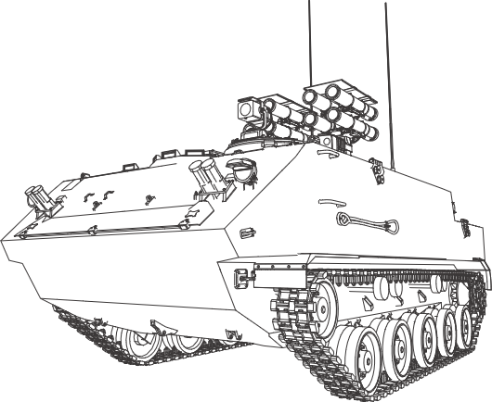


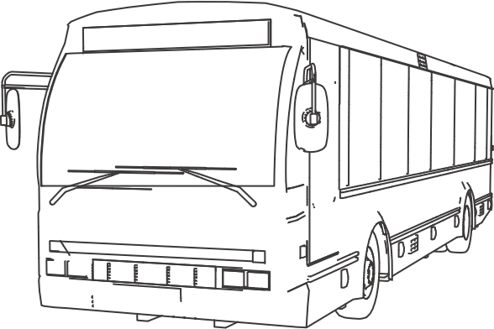
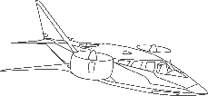


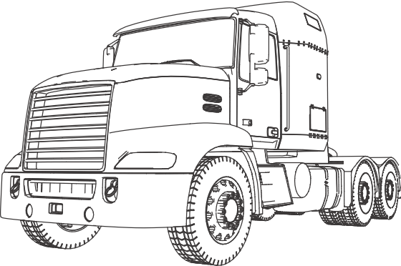
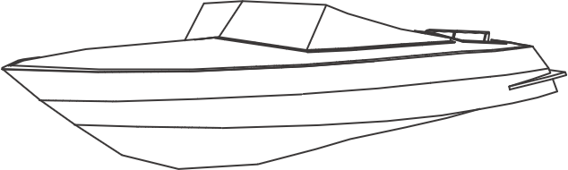
Engineering Sustainable Solutions for the Mobility Industry
An Overview
Automotive Verticals
Other Industry Verticals
Body Engineering
Two
Wheeler
Off-road
Vehicle
Vehicle
Engineering
Computer-Aided Engineering
Passenger
Vehicle
System Engineering & Integration
Defense Vehicle
Vehicle Electronics
& Software
Enterprise & Digital Technologies
Commercial
Vehicle (Bus)
Aerospace/Aircraft (eVTOL)
Supply Chain Management
Propulsion
Systems
Commercial
Vehicle
(Truck)
Marine
Americas | APAC | EMEA | India
Notes:
Let's now explore the breadth of our capabilities. We offer a comprehensive range of engineering solutions across various mobility verticals.
Within automotive, we cover everything from two-wheelers to passenger vehicles, commercial vehicles, and off-road vehicles. Our expertise extends to digital technologies, powertrain systems, and body engineering.
Beyond automotive, we also serve other industries, including defense, aerospace, and marine. Our services span the entire product lifecycle, from systems engineering and integration to virtual validation and manufacturing engineering.
With a global presence across the Americas, EMEA, APAC, and India, we are well-positioned to serve customers worldwide.

Slide 5
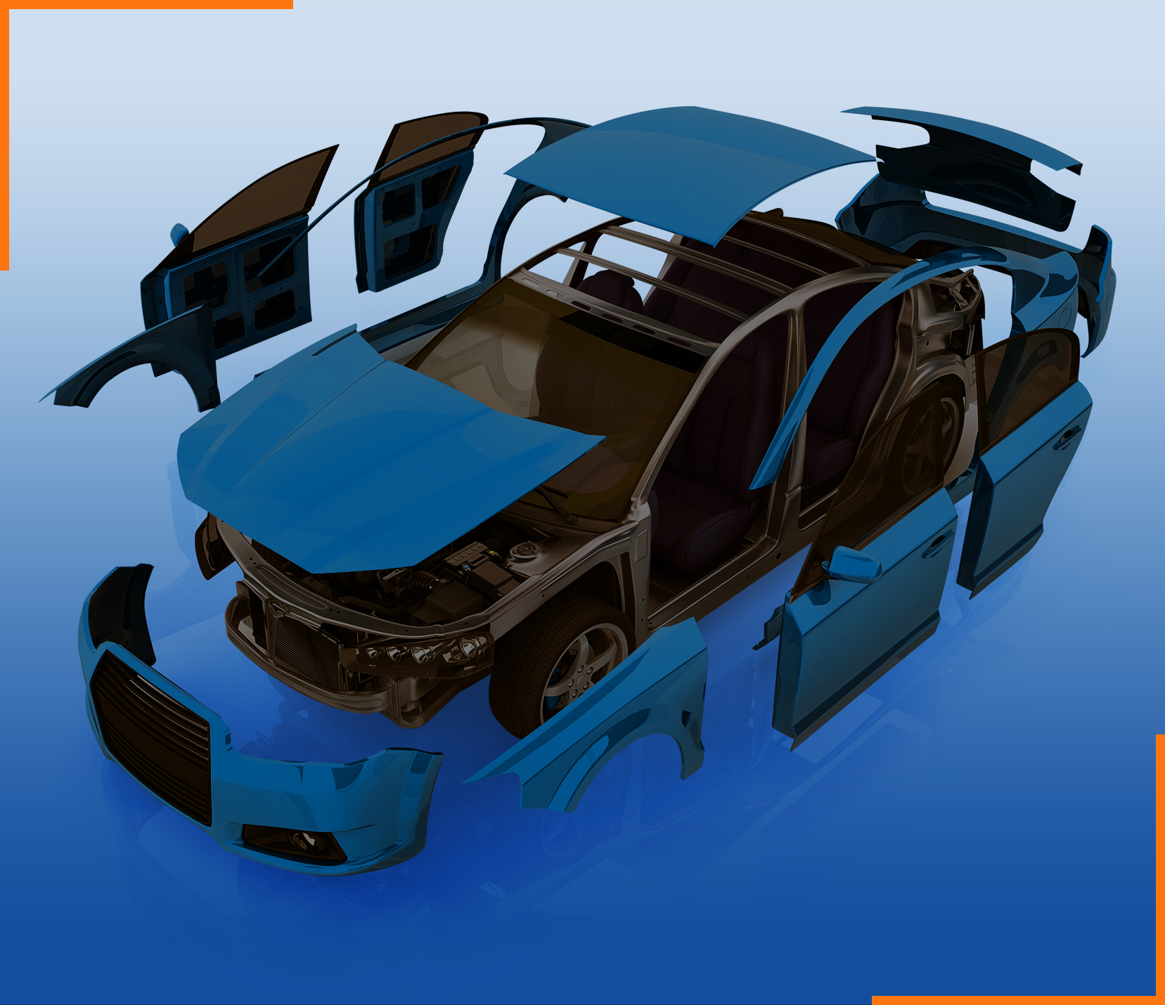


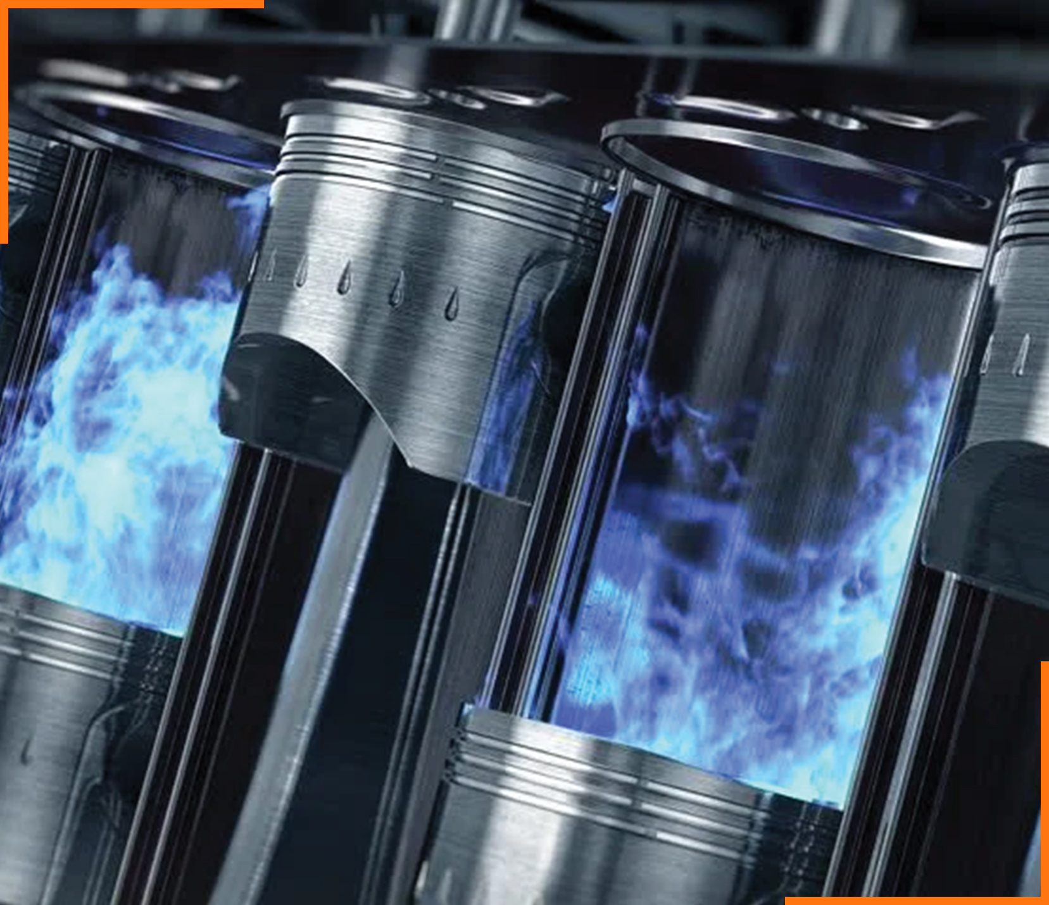



Concept to SoP Development and Digital Transformation
Body Engineering | Computer-Aided Engineering | Enterprise & Digital Technologies | Propulsion Systems | Supply Chain Management | Vehicle Electronics & Software | Vehicle Engineering
Concept to SoP Development
Simulation led Engineering
Digital
Transformation
Concept to SoP Development
Optimizing value chain Efficiency
Concept to SoP Development
Engineering to Integration
Sub-Offering
Body in White
Closure
Interiors
Exteriors
Sub-Offering
CAE
CFD
Static & Dynamic Analysis
Modal Analysis
Thermal / Flow Analysis
Multibody Analysis
NVH
Performance Prediction
Acoustics
Sub-Offering
SAP Services ​
Application Services ​
Digital Consulting and Solutions​
Sub-Offering
‘(up to) 8 in 1’ Electrified Propulsion
Conventional and xEV Driveline and Transmission System Solutions
Hybrid Powertrain
‘3+in1’ sub-system / Component Solutions
Control Systems and Supervisory
Driveline and Transmission Testing
IC Engine Design and Development
Sustainability
Sub-Offering
ZBC / Should Costing
Strategic Sourcing Support
Global Sourcing / Localization
Part / System Prototyping
Part Development (APQP/PPAP)
Static and Tear Down Benchmarking
Performance Benchmarking
Cost Benchmarking
SOP and Post-SOP Support
Aggregate Benchmarking
Production Supplies (as Tier 1)
Sub-Offering
Onboard Charger
DC-DC Converters
Traction Inverters
BDU/PDU
BMS
Sub-Offering
Certification / Homologation
Vehicle Ergo & Integration
Vehicle Proto & Physical Validation
Benchmarking, DMU, Cost & BOM Management
Chassis Systems
Vehicle Thermal, E&E, Diagnostics, Software System & Validation
Solutions
Full System Development
Virtual Validation
Regulatory Compliance
Prototyping
Physical Testing
System Level
Vehicle Level
Costing / Sourcing
Solutions
Enterprise Application (SAP)
Implementation
Customization
Support
Dealer Management Systems
Cloud Technologies
Implementation
Customization
Support
Web/Mobile Applications
Industry 4.0 / IIoT
Telematics
Solutions
Full System Development
Hardware
Software (AUTOSAR)
Functional Safety
HW/SW/ Mechanical / Electrical Integration
Prototyping
Testing (MIL/SIL/HIL)
Costing / Sourcing
Solutions
Structural Analysis
Durability Analysis
Multi Body Dynamics
Crash & Safety Analysis
Lightweighting & Optimization
Computational Fluid Dynamics (CFD)
NVH
Battery Thermal
Manufacturing
Solutions
Benchmarking & Targets
Vehicle Concept & Architecture
System Sizing, Specs, & Integration
Electricals & Control Systems
Costing, Sourcing, & PPAP
Prototyping & Physical Testing
Regulatory Compliance
Solutions
New Design
Application Engineering
Power / Torque upgrades
Emission Upgrades
Benchmarking
Target Setting
Concept Development
Detailed Design
Design Validation
Strategic Sourcing
Proto development
Testing
SOP
Notes:
This slide provides a deeper dive into our key service offerings. We focus on a 'Concept to SoP' approach, delivering comprehensive solutions across the entire product lifecycle.
Powertrain: Our expertise spans from conventional and electrified powertrain solutions to advanced hybrid and electric systems. We offer everything from system design and development to testing and validation.
Body Engineering: We cover the entire vehicle body, from body-in-white to interiors and exteriors. Our capabilities include full system development, virtual validation, and prototyping.
Virtual Validation: We leverage simulation-led engineering to optimize designs and reduce development time. Our virtual validation capabilities include CAE, CFD, and NVH analysis.
Vehicle Integration: We ensure seamless integration of all vehicle systems, from concept development to certification and homologation.
Embedded Electronics: We develop and integrate advanced electronic systems, including embedded software, hardware, and functional safety solutions.
Digital Technologies: We help our clients leverage digital technologies to transform their engineering processes. This includes digital transformation solutions, enterprise applications, and web/mobile applications.

Slide 6






Our Value Proposition
We strive to deliver
Product BOM
Cost Reduction
7-21%
Faster Time
to Market
15 - 33%
R&D Cost
Optimization
30-50%
BCC Sourcing
14-38%
Customer
Experience
4.2/5
through
Simplicity.…..
Focus on core functions, simplify with
3-click setups, and use integrated designs
Hinduja Tech‘s
Frugal 7S Model
Sustainability
Minimize waste, use recyclables,
and design for longevity
S1
S7
7-21%
Product BOM
Cost Reduction
Speciﬁcation and Substitution
Align localized specs to target markets using cost-effective materials without quality loss
Sourcing and Serialization
Optimize sourcing, industrialization, and localize to cut logistics costs
S2
S6
Standardization and Scalability
Scale in homogeneous markets with
ﬂexible resources for customer needs
S3
S5
Simulation
Use simulation led engineering to minimize prototyping and testing
S4
Serviceability
Enabling seamless integration and efficient engineering support
Notes:
Now, let's talk about our value proposition. At Hinduja Tech, we strive to deliver tangible benefits to our clients.
Product BOM Cost Reduction: Through our Frugal 7S Model, we aim to reduce product BOM costs by 7-21%. This is achieved through strategies like simplification, specification and substitution, and standardization.
Faster Time to Market: We help our clients accelerate their product development timelines by 15-33% by leveraging simulation-led engineering and optimizing processes.
R&D Cost Optimization: We optimize R&D costs by 30-50% by minimizing prototyping and testing through virtual validation and efficient engineering support.
Better Cost Control (BCC) Sourcing: We optimize sourcing, industrialization, and localization to cut logistics costs by 14-38%.
Enhanced Customer Experience: We consistently strive to deliver a positive customer experience, with a rating of 4.2 out of 5.
Our commitment to these value propositions sets us apart and makes us a preferred partner for leading mobility solutions providers worldwide.
Let's look closer at our Frugal 7S Model, a key enabler of our value proposition. This model is a unique methodology that guides our approach to engineering and product development.
S1: Simplification: We focus on simplifying designs, reducing complexity, and eliminating unnecessary features. This not only reduces costs but also improves manufacturability and maintainability.
S2: Specification and Substitution: We meticulously analyze specifications and explore alternative materials and components to achieve cost optimization without compromising quality.
S3: Standardization and Scalability: We promote using standardized components and platforms whenever possible to leverage economies of scale and reduce development time.
S4: Service and Scalability: We provide flexible and scalable engineering services to meet our clients' evolving needs, enabling seamless integration and efficient support.
S5: Simulation: We heavily rely on simulation and virtual validation to reduce the need for physical prototypes and testing, leading to significant cost savings and faster time-to-market.
S6: Sourcing and Serialization: We optimize sourcing strategies, explore local manufacturing options, and streamline logistics to minimize costs and improve efficiency.
S7: Sustainability: We prioritize sustainability in all our endeavors. We minimize waste, utilize recyclable materials, and design for longevity to create a positive environmental impact.
The Frugal 7S Model is not just a cost-cutting measure; it's a holistic approach that drives innovation, efficiency, and sustainability throughout the product lifecycle.

Slide 7













Our Global Footprint
220+
130+
UK
Germany
~300+
Germany
Americas
United Kingdom
Basildon
London
Norwich
Warwick
Hamburg
Cologne
Munich
Stuttgart
United States
Farmington Hills
Irvine
Phoenix
South Korea
20+
France
Seoul
APAC
Paris
1850+
India
Japan
Osaka
India
Chennai
Bengaluru
Pune
Mexico
Romania
Monterrey
Cluj-Napoca
Bucharest
100+
Sydney
Romania
Corporate HQ
Sales Office
Delivery Centre
Overall Headcount
Labs
Notes:
This slide illustrates our global footprint. We have a strong presence across key regions, enabling us to serve customers worldwide.
Americas: We have a significant presence in the Americas, with key locations in the United States, Canada, and Mexico.
EMEA: Our EMEA footprint spans major markets like the UK, Germany, Romania and France.
India: India is a large market, with a strong presence in major cities like Bengaluru, Chennai, and Pune.
APAC: We are expanding our presence in the Asia Pacific region, with a growing presence in countries like Japan and Australia.
This global network allows us to leverage local expertise and respond quickly to the evolving needs of our customers in different regions through our differentiated global delivery model. We have the optimum mix of onshore, nearshore, and offshore expertise to provide enhanced value across the entire value chain.

