Slide 1


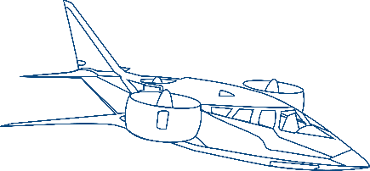

Engineering Sustainable Mobility
Corporate Overview
© Hinduja Tech Limited 2026

Slide 2





























HINDUJA GROUP
One of India’s
Founded in
HQ in London, UK
Multi Billion $
Global presence across
Employs over
Premier transnational conglomerates
1914
Global Business conglomerate
38 countries
200,000 people
Automotive
IT & ITeS
Banking & Finance
Oil & Specialty Chemicals
Power
Media
Real Estate
Healthcare
Project Development
Trading
Work to Give | Word is a Bond | Act Local, Think Global | Partnership for Growth | Advance Fearlessly

Slide 3













Hinduja Tech: Who We Are
We Deliver SUSTAINABLE ENGINEERING & DIGITAL SOLUTIONS across Mobility Industries
Our Group
Hinduja Tech, a key part of India's leading multibillion dollar transnational conglomerate, Hinduja Group together with its subsidiaries
Drive System Design & Tecosim
End to End Vehicle Engineering & Integration
33 + years
Purpose
of serving 100+ Global OEMs, Tier 1s and Disruptive players
Creating Sustainable Mobility
360°
Ecosystem for PV/CV/ EV development using robust processes based on Frugal engineering paradigm
An advanced Powertrain Engineering Division of Hinduja Tech
2300 +
Mobility and eMobility experts Globally
Vision
To be among the Top 10 Global Mobility Engineering and R&D Companies
An advanced Virtual Simulation Division of
Hinduja Tech
100 +
Co-developed vehicle models in Production and running

Slide 4
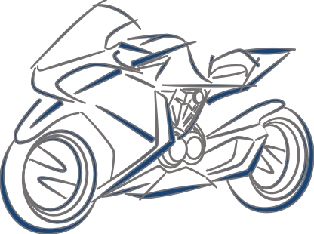
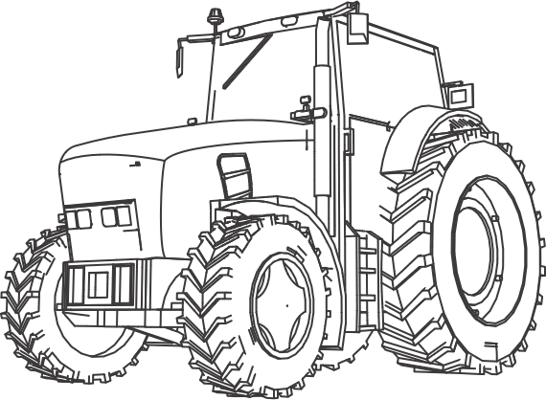



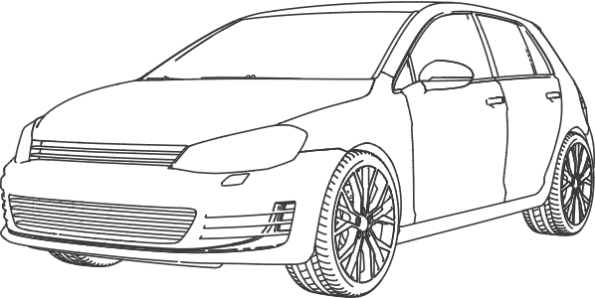
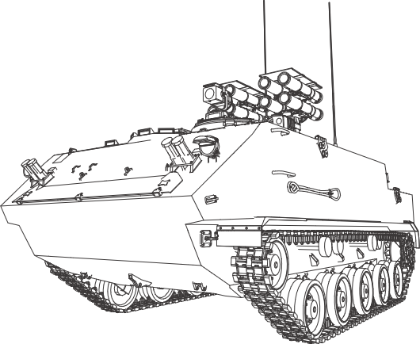


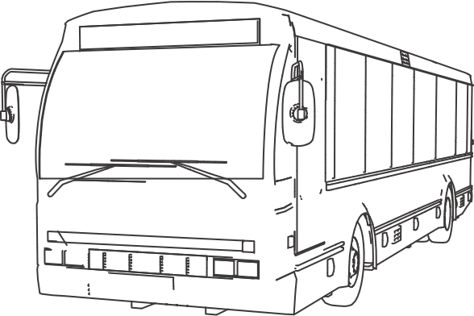



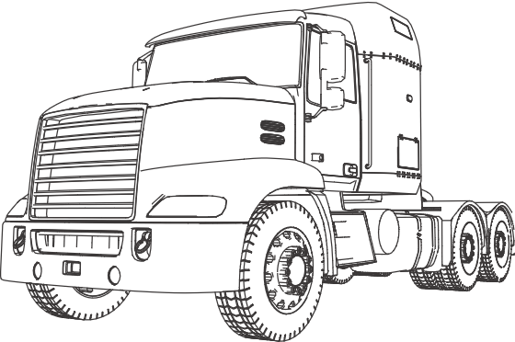
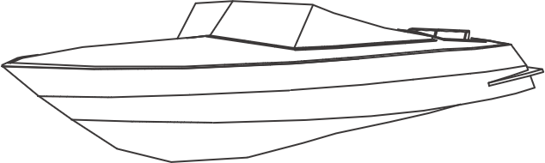
Engineering Sustainable Solutions for the Mobility Industry
An Overview
Automotive Verticals
Other Industry Verticals
Body Engineering
Two
Wheeler
Off-road
Vehicle
Vehicle
Engineering
Computer-Aided Engineering
Passenger
Vehicle
System
Engineering &
Integration
Defense Vehicle
Vehicle Electronics
& Software
Enterprise & Digital Technologies
Commercial
Vehicle (Bus)
Aerospace/Aircraft (eVTOL)
Supply Chain Management
Propulsion
Systems
Commercial
Vehicle
(Truck)
Marine
Americas | APAC | EMEA | India

Slide 5
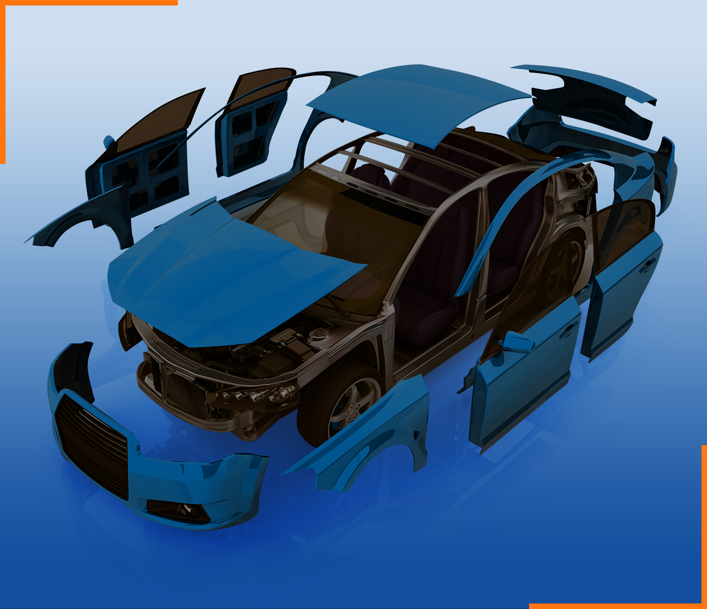


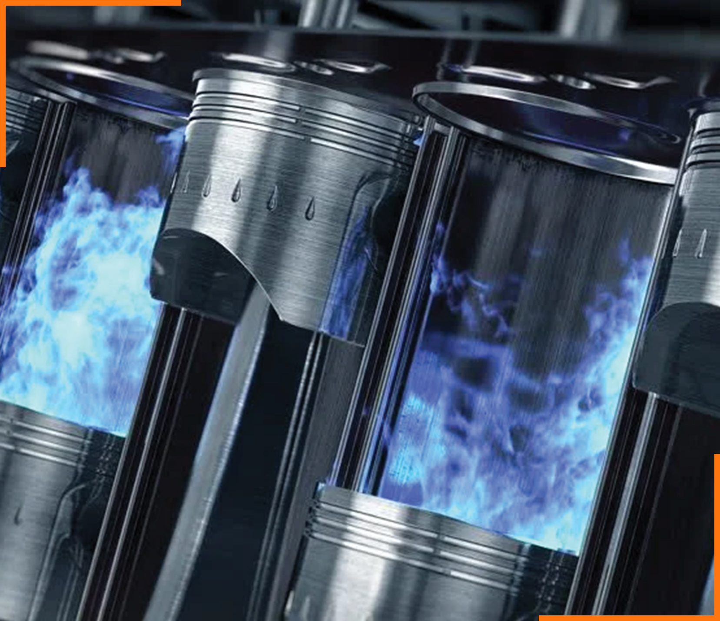



Concept to SoP Development and Digital Transformation
Body Engineering | Computer-Aided Engineering | Enterprise & Digital Technologies | Propulsion Systems | Supply Chain Management | Vehicle Electronics & Software | Vehicle Engineering
Concept to SoP Development
Simulation led Engineering
Digital
Transformation
Concept to SoP Development
Optimizing value chain Efficiency
Concept to SoP Development
Engineering to Integration
Sub-Offering
Body in White
Closure
Interiors
Exteriors
Sub-Offering
CAE
CFD
Static & Dynamic Analysis
Modal Analysis
Thermal / Flow Analysis
Multibody Analysis
NVH
Performance Prediction
Acoustics
Sub-Offering
SAP Services ​
Application Services ​
Digital Consulting and Solutions​
Sub-Offering
‘(up to) 8 in 1’ Electrified Propulsion
Conventional and xEV Driveline and Transmission System Solutions
Hybrid Powertrain
‘3+in1’ sub-system / Component Solutions
Control Systems and Supervisory
Driveline and Transmission Testing
IC Engine Design and Development
Sustainability
Sub-Offering
ZBC / Should Costing
Strategic Sourcing Support
Global Sourcing / Localization
Part / System Prototyping
Part Development (APQP/PPAP)
Static and Tear Down Benchmarking
Performance Benchmarking
Cost Benchmarking
SOP and Post-SOP Support
Aggregate Benchmarking
Production Supplies (as Tier 1)
Sub-Offering
Onboard Charger
DC-DC Converters
Traction Inverters
BDU/PDU
BMS
Sub-Offering
Certification / Homologation
Vehicle Ergo & Integration
Vehicle Proto & Physical Validation
Benchmarking, DMU, Cost & BOM Management
Chassis Systems
Vehicle Thermal, E&E, Diagnostics, Software System & Validation
Solutions
Full System Development
Virtual Validation
Regulatory Compliance
Prototyping
Physical Testing
System Level
Vehicle Level
Costing / Sourcing
Solutions
Enterprise Application (SAP)
Implementation
Customization
Support
Dealer Management systems
Cloud Technologies
Implementation
Customization
Support
Web/Mobile Applications
Industry 4.0 / IIoT
Telematics
Solutions
Full System Development
Hardware
Software (AUTOSAR)
Functional Safety
HW/SW/ Mechanical / Electrical Integration
Prototyping
Testing (MIL/SIL/HIL)
Costing / Sourcing
Solutions
Structural Analysis
Durability Analysis
Multi Body Dynamics
Crash & Safety Analysis
Lightweighting & Optimization
Computational Fluid Dynamics (CFD)
NVH
Battery Thermal
Manufacturing
Solutions
Benchmarking & Targets
Vehicle Concept & Architecture
System Sizing, Specs, & Integration
Electricals & Control Systems
Costing, Sourcing, & PPAP
Prototyping & Physical Testing
Regulatory Compliance
Solutions
New Design
Application Engineering
Power / Torque upgrades
Emission Upgrades
Benchmarking
Target Setting
Concept Development
Detailed Design
Design Validation
Strategic Sourcing
Proto development
Testing
SOP

Slide 6






Our Value Proposition
We strive to deliver
Product BOM
Cost Reduction
7-21%
Faster Time
to Market
15 - 33%
R&D Cost
Optimization
30-50%
BCC Sourcing
14-38%
Customer
Experience
4.2/5
through
Simplicity.…..
Focus on core functions, simplify with
3-click setups, and use integrated designs
Hinduja Tech‘s
Frugal 7S Model
Sustainability
Minimize waste, use recyclables,
and design for longevity
S1
S7
7-21%
Product BOM
Cost Reduction
Speciﬁcation and Substitution
Align localized specs to target markets using cost-effective materials without quality loss
Sourcing and Serialization
Optimize sourcing, industrialization, and localize to cut logistics costs
S2
S6
Standardization and Scalability
Scale in homogeneous markets with
ﬂexible resources for customer needs
S3
S5
Simulation
Use simulation led engineering to minimize prototyping and testing
S4
Serviceability
Enabling seamless integration and efficient engineering support

Slide 7













Our Global Footprint
Our Global Footprint
205+
96+
UK
Germany
269+
United Kingdom
Germany
Americas
Hamburg
Cologne
Munich
Stuttgart
Basildon
London
Norwich
Warwick
United States
Farmington Hills
Irvine
Quebec
Czech Republic
South Korea
16+
Tunisia
Seoul
APAC
France
1637+
Paris
India
Japan
Osaka
India
Chennai
Bengaluru
Pune
Mexico
Romania
Monterrey
Cluj-Napoca
Bucharest
72+
Sydney
Romania
Corporate HQ
Sales Office
Delivery Centre
Overall Headcount
Labs

