Slide 1


Vehicle Engineering
Bringing it all together

Slide 2
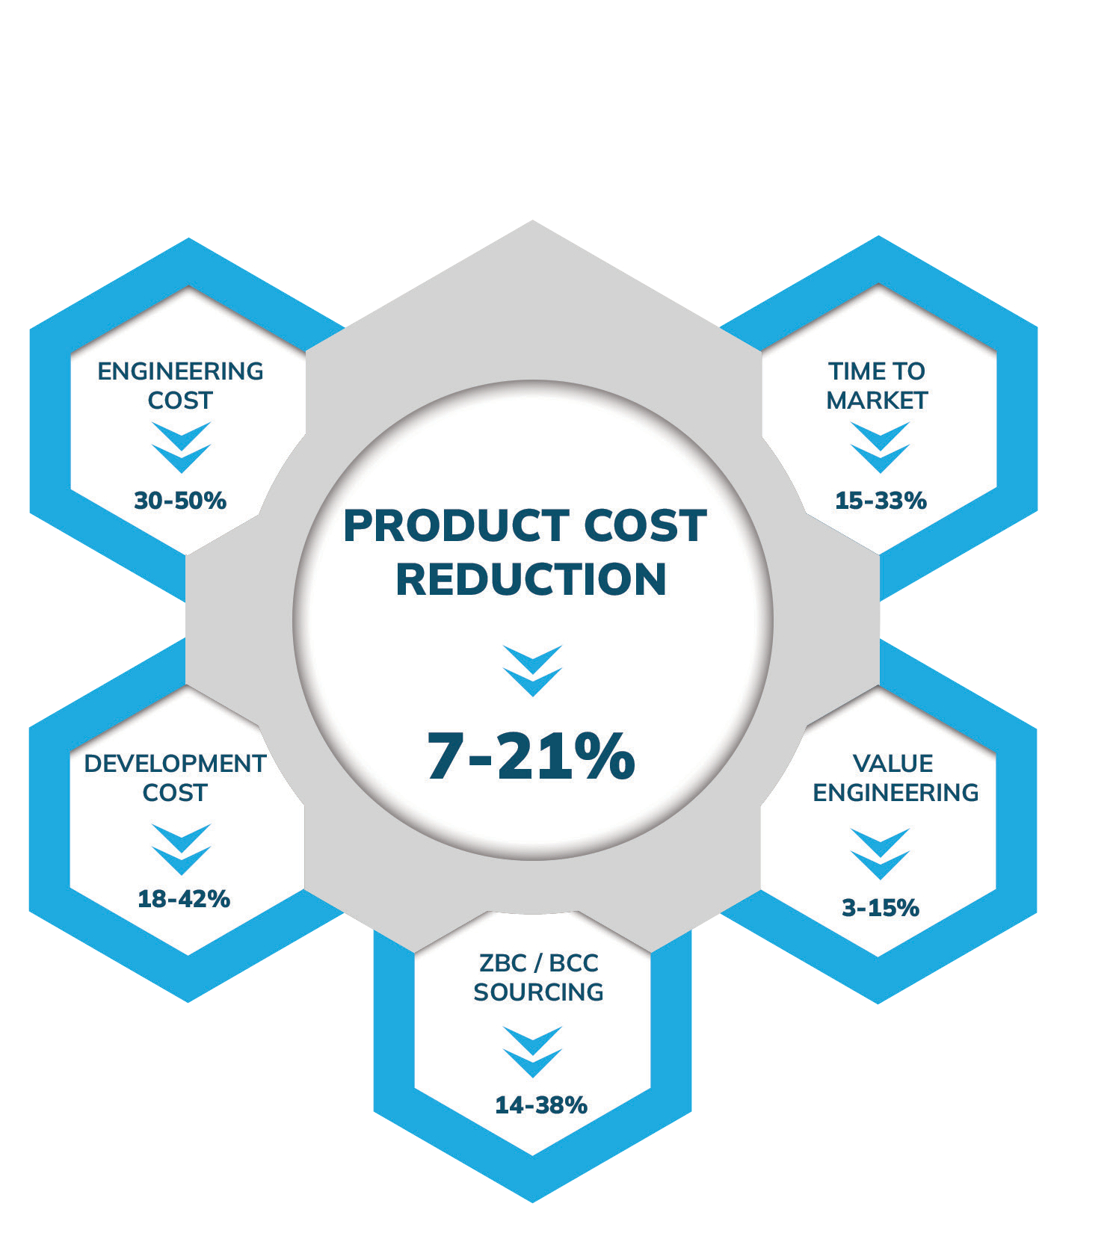
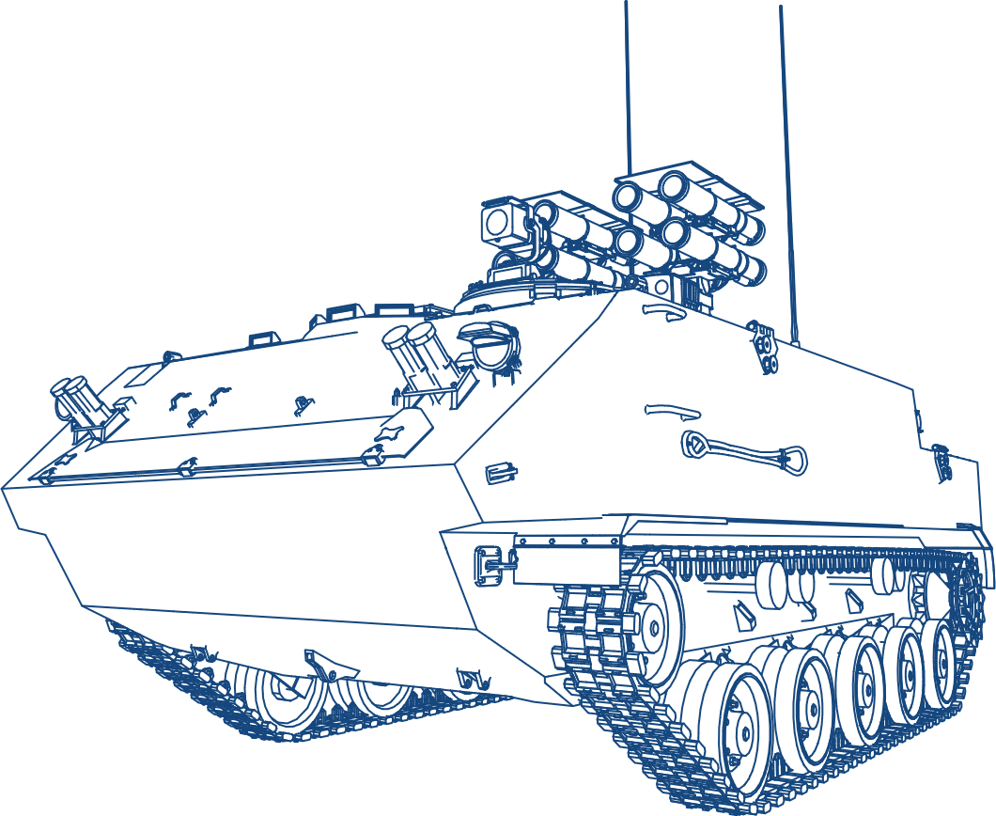

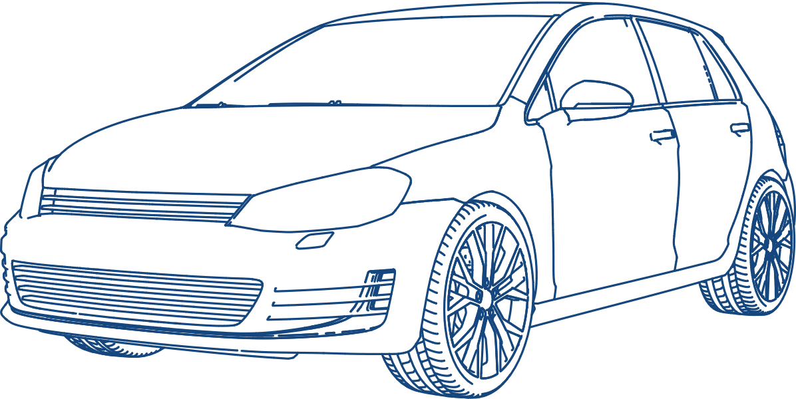
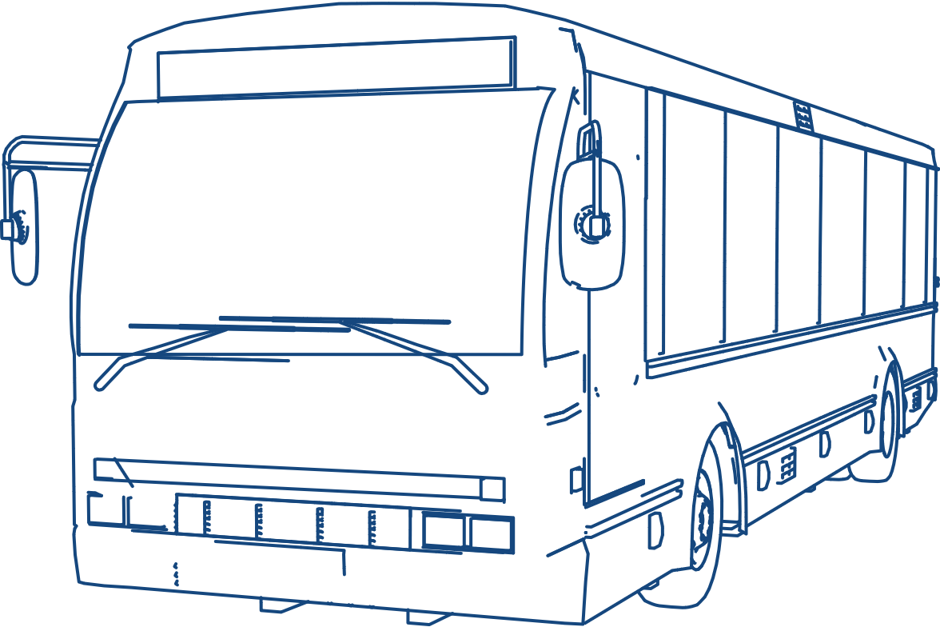
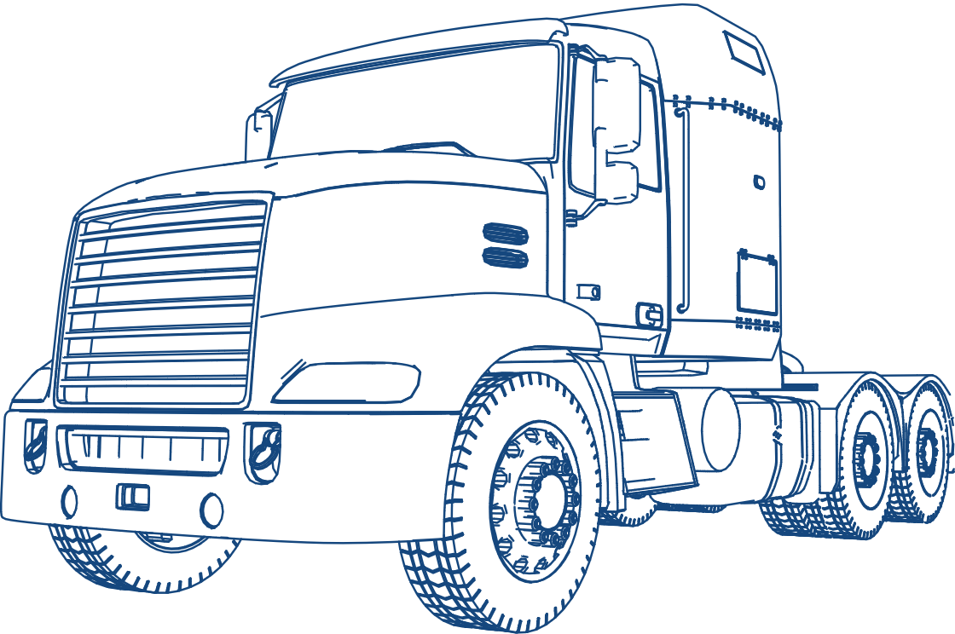



Mobility Engineering
Concept to SOP Support – Full Vehicle Engineering & Development
Full vehicle development
Variant development
Application development/ vehicle application
Facelifts and refreshes
Electrification
Hybridisation
USP
Frugal Engineering / Design to Cost
Global Delivery Model
Participation in 100+ Vehicle Engineering & Development Programs, globally, 60+ Vehicles on road
Participation in 20+ Alternative Energy Propelled vehicles, 8+ On road
Developed Vehicles at 1/3rd of global investments benchmarks
Concept to Production readiness in 24-30 months
700+ Supply Chain partners
Frugal EngiNEARing &
“Design for Customer” Philosophy
Areas
Benchmarking / Target Setting / PALS & PATS
Architecture / System Sizing & Selection
Human Ergonomics
Platform Engineering
Structure
Suspension, Brakes & Steering
Vehicle Electricals (HV/LV)
Control System / SW & Diagnostics
Thermal management
Prototyping & Testing
Homologation / Certification
Notes:
Closures
AMERICAS,APAC, EMEA and India
Remove the word verticals
All sentence case in Brit English

Slide 3







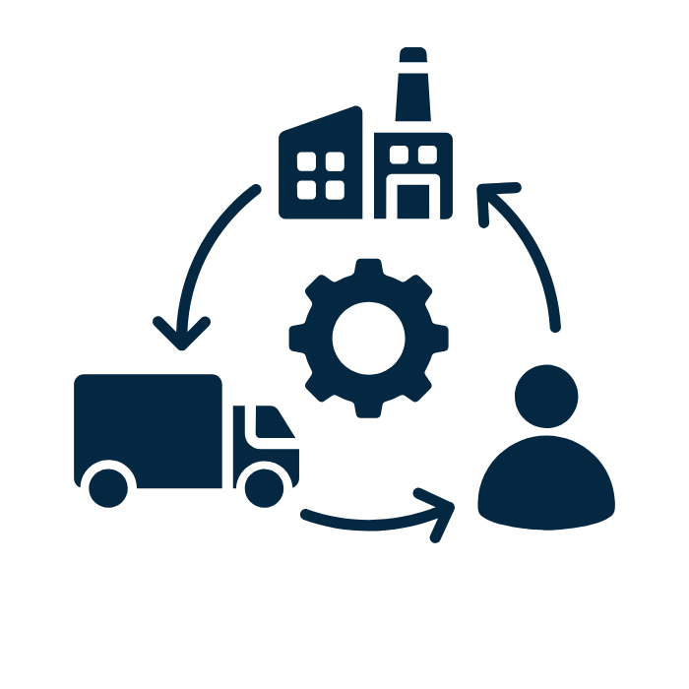




Elements
Competitor Benchmarking
Target Setting
Concept
Architecture
Performance
Tear down
Cost
Investment
Subjective / Objective
PALS
Product Cost
Investment
Layout / Ergonomics
Regulations
Concept BoM
Cost Cascading
Mechanical Systems
Vehicle Electricals
Communication & Control Architecture
System Sizing / Selection
Detailed Design
Vehicle Integration
Supply Chain Management
Powertrain Elements
SoR for proprietary systems (Brakes, Suspension, Steering. Seats etc.)
Vehicle Simulations
Platform /Chassis Design
Upper Body Design
System & Vehicle Level : Virtual Validation
BoM Management
Weight Management
Supplier Onboarding
Platform / UB Integration
Mech/ Elec/ EE Integration
Ensuring
System / Performance
Product Cost
Investment limits
Regulatory Compliance
RFQ process management
Supplier audit, selection & Onboarding
Tooling Development
PPAP / PSW
Post SoP Support
Simultaneous Engineering
Vehicle Electricals
Electronics & Software
Prototyping
Physical Testing / Certification
Architecture / Load Calculations
Schematics / Layout
Wiring Harness Design
Form Board Drawing
Integration of Electrical components
Selection of OTS HW
Integration of EE Components (BCM, Cluster etc)
Software Architecture
Software Development
SW Testing
SW Diagnostics
Component Sourcing (Proto or production process)
Inspection and System / Vehicle Assembly
Static Checks
Performance Trials
Durability Testing
EE / SW testing using
Vehicle HIL
LABCAR
Compliance Testing

Slide 4
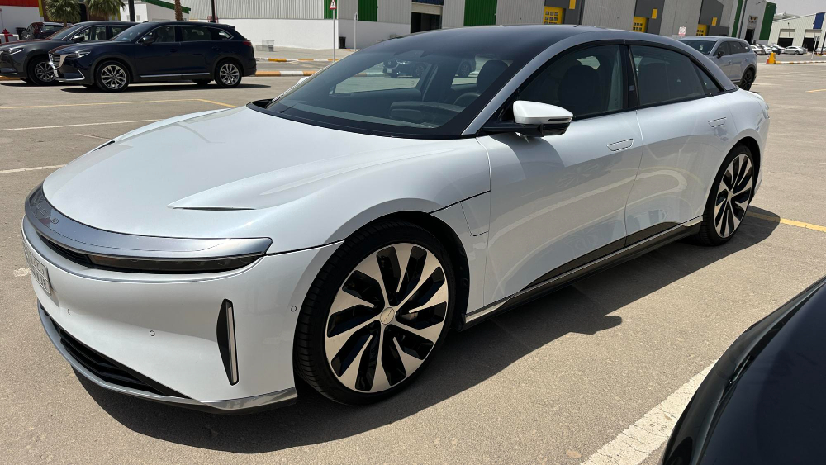
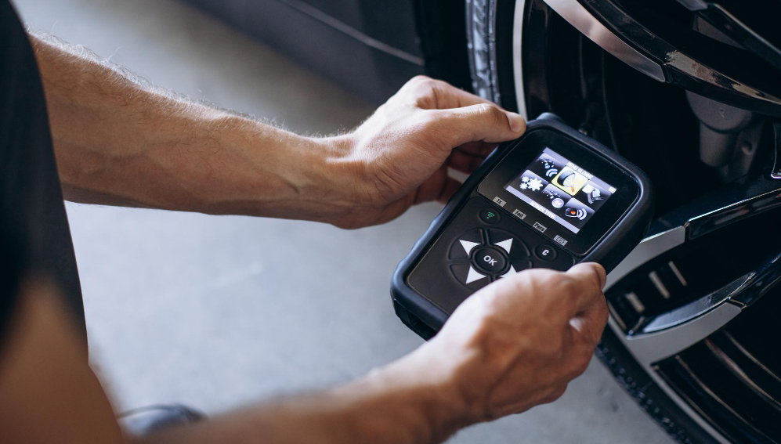

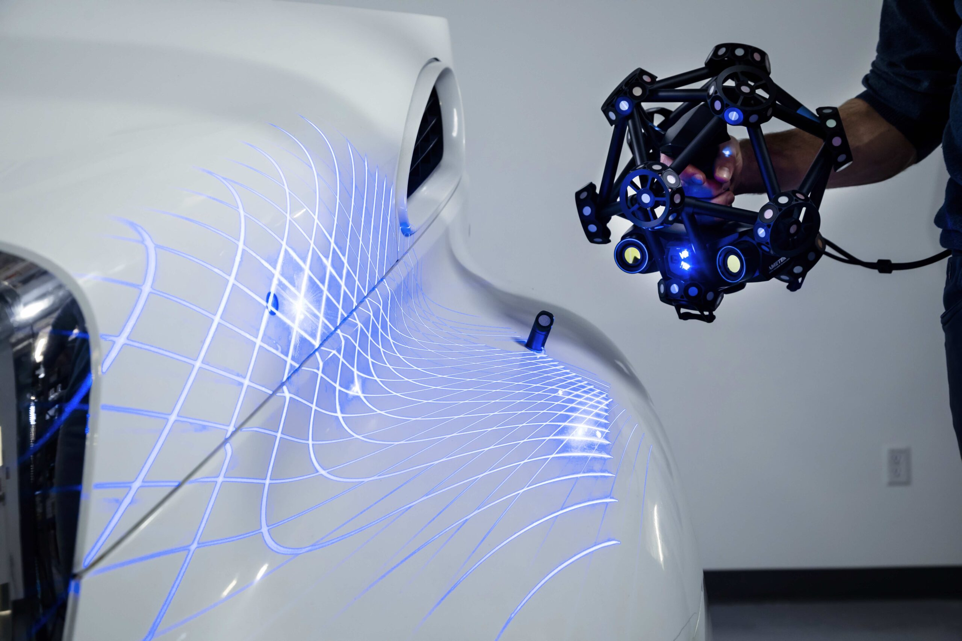
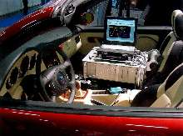
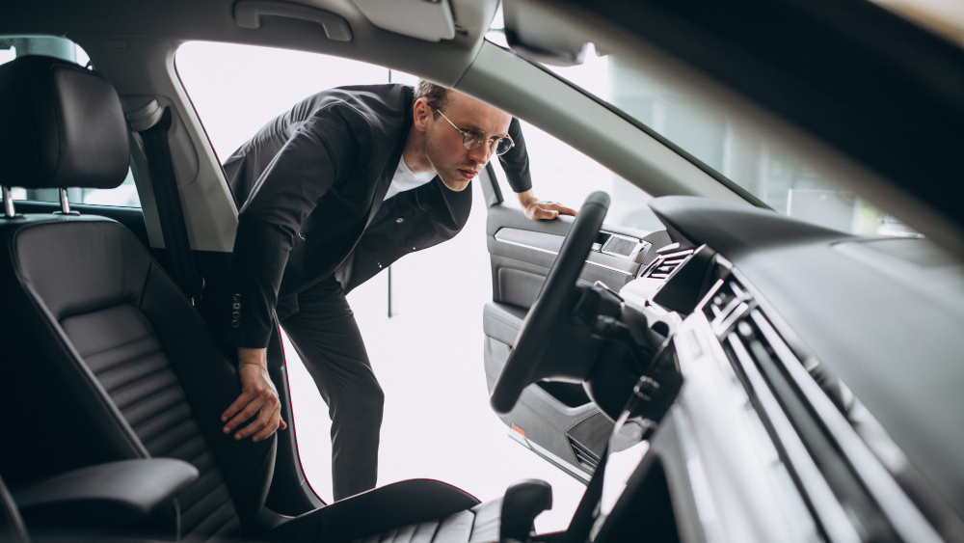
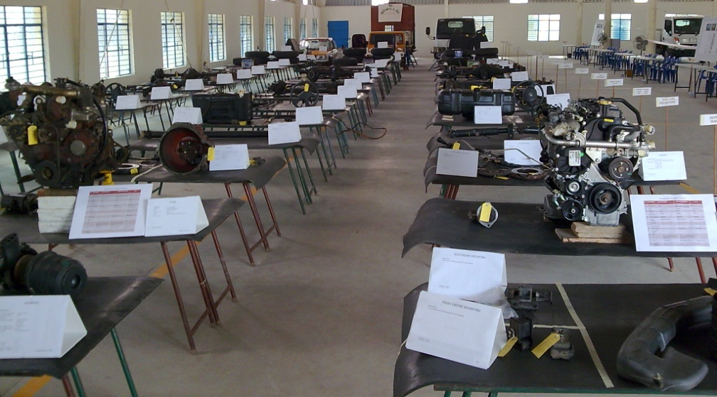
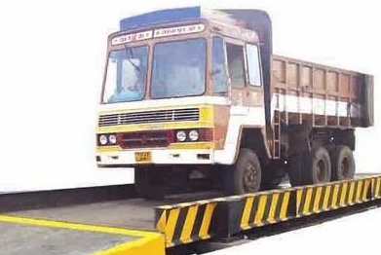
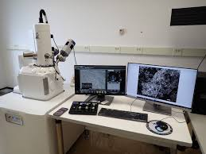
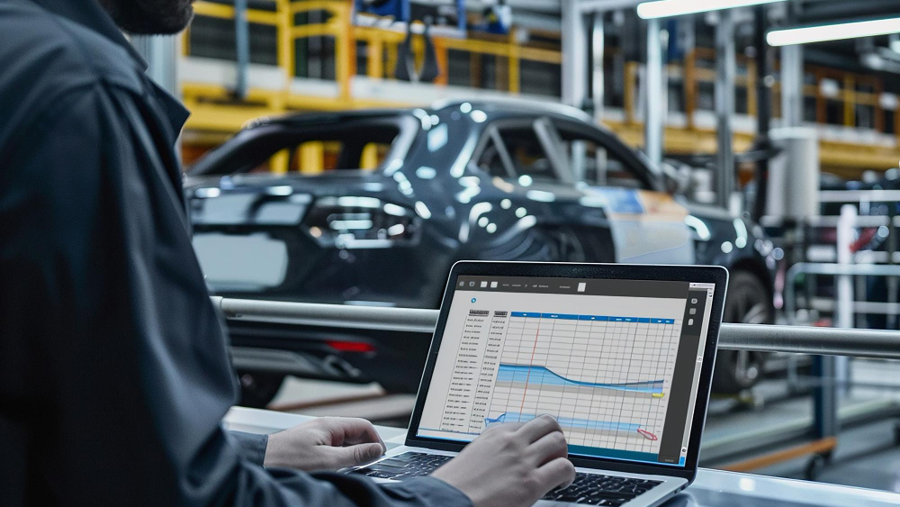
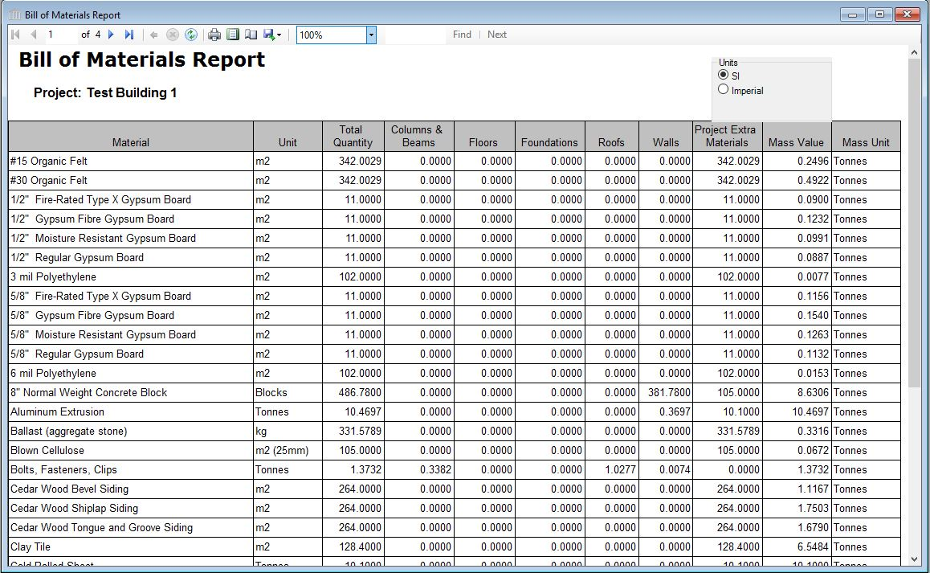
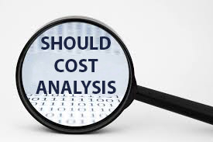
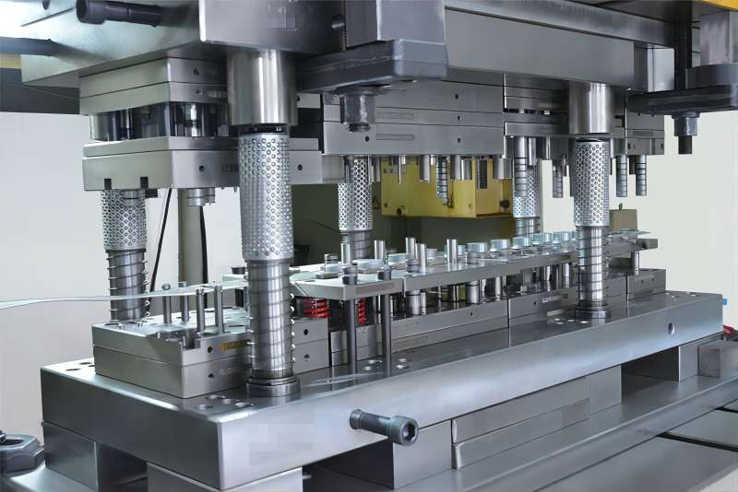
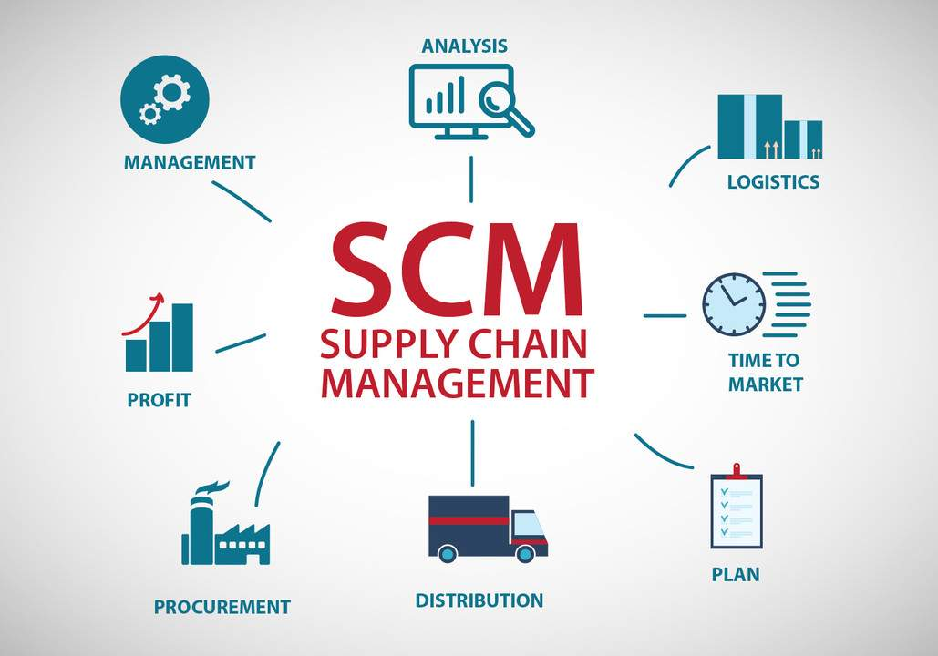

Competitor Benchmarking : Extracting Meaningful Insights
Database of 110+ Vehicles
Extensive Cost database / Should Costing Templates
Inhouse Performance Benchmarking setup
Inhouse Teardown facility
Proven processes for capturing wholesome data a
Cross Functional team for meaningful insights
Detailed product cost and investment calculation (ZBC)
Vehicle Photos
Vehicle Measurement
Feature List
Vehicle Scanning
Performance testing / RLDA
Ergonomic Assessment
Layout
Tear Down
Weight Analysis
Material Testing
Manufacturing Assessment
BoM Preparation
Zero Based BoM Cost
Tooling Estimation
Supplier List
VAVE Ideas
Notes:
Images to be replaced. Sync with the tags given below.

Slide 5
Target Setting : Establishing Superordinate Goals
Benchmarking
Brand Conscious
Extensive database
Proven Processes
Inhouse Cross Functional SMEs / Experts

Slide 6
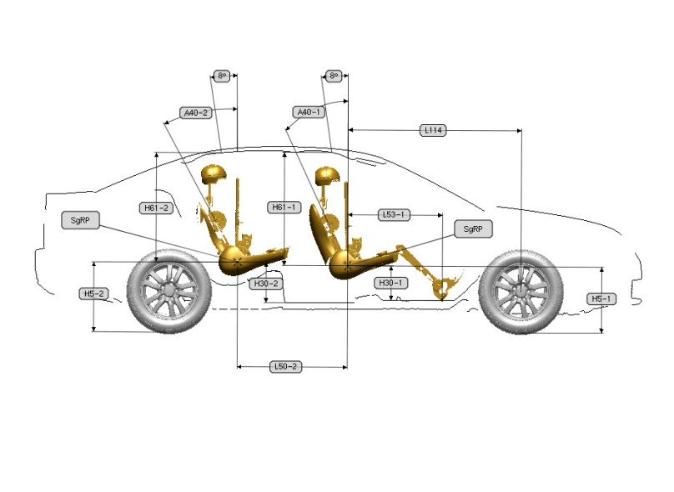
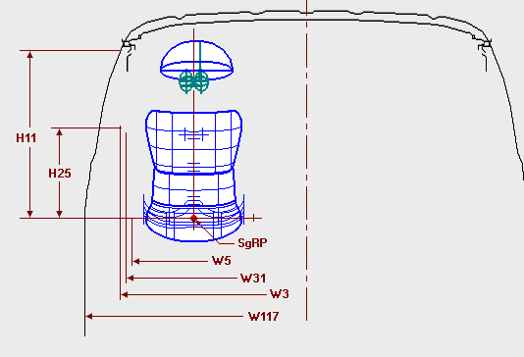
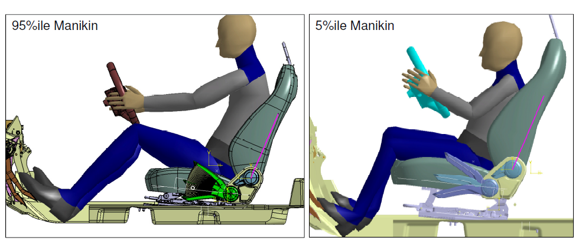
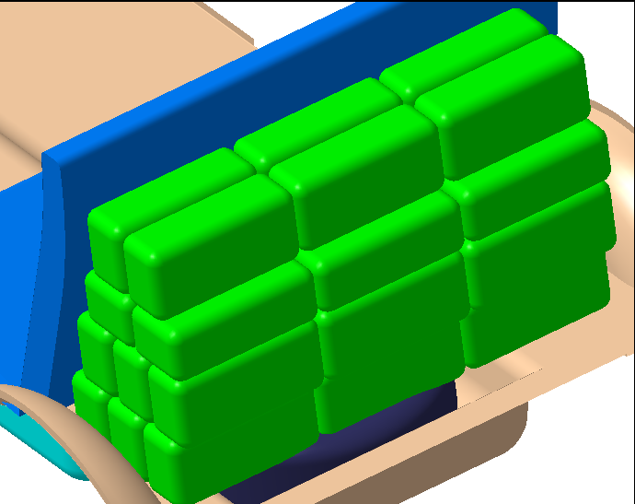
Concept layout
Platform studies and benchmarking
Scalability & modularity
New / carryover definition
Regulatory requirement assessment
System concepts
Occupant & vehicle packaging , geometry creation
Weight & cost estimations
Inputs for business case evaluation
Vehicle architecture : packaging & layout

Slide 7
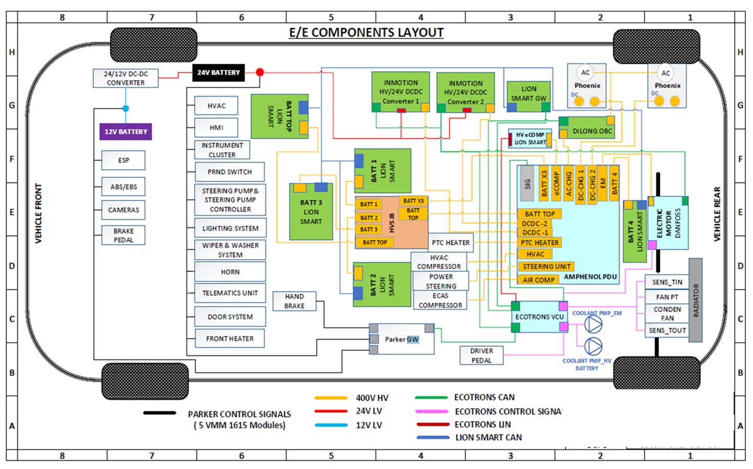
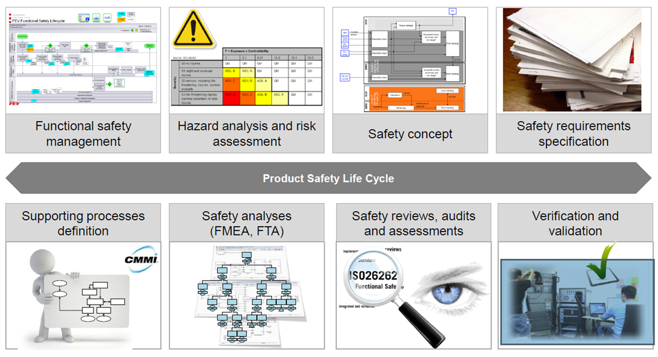
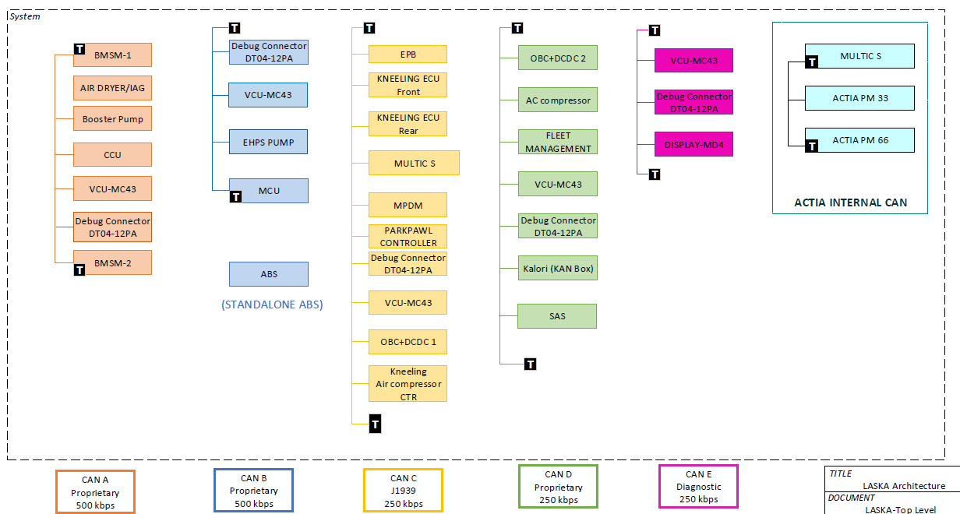
Architecture: Electrical, communication, and control
Vehicle architecting to enable product feature realization
Functional definition & distribution
Function logical realization
Reusability, modularity, scalability
Optimizing of quality, time & cost

Slide 8
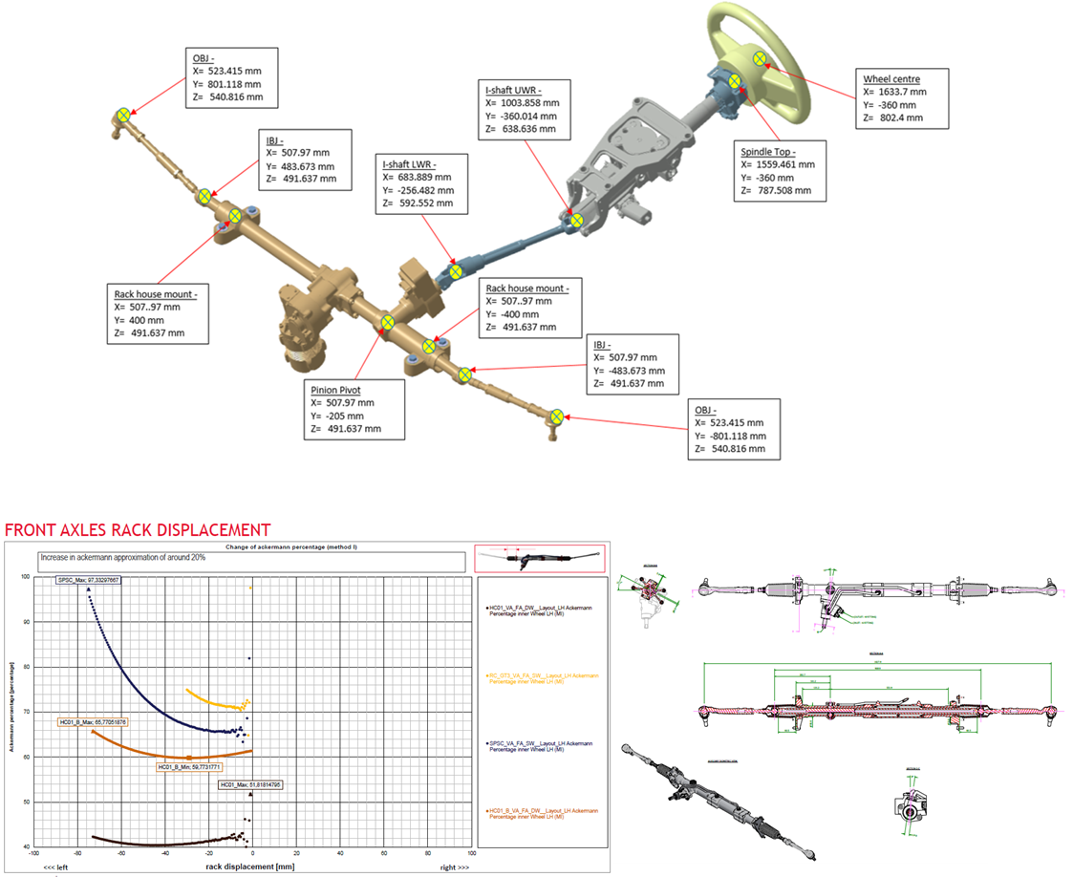
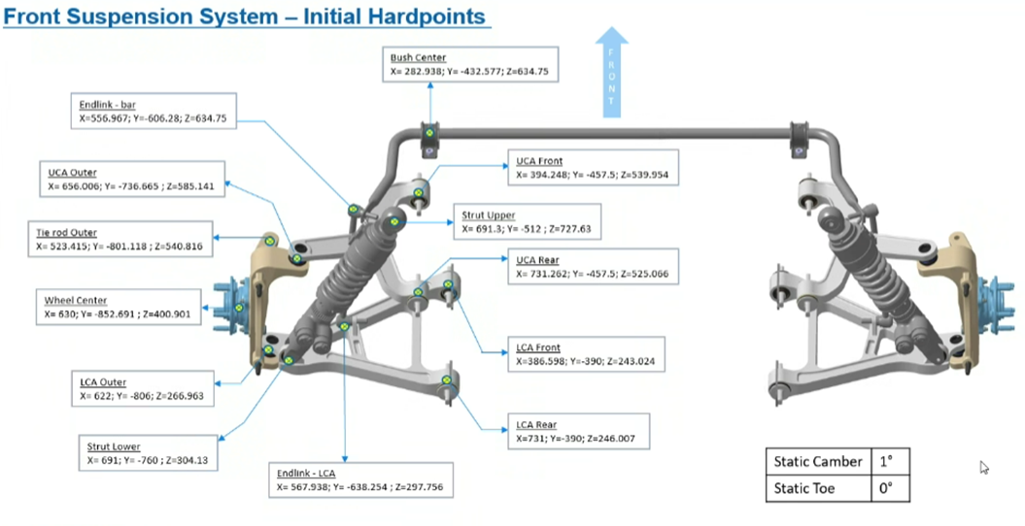
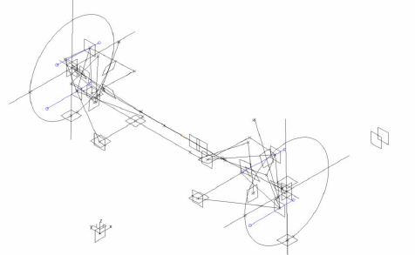
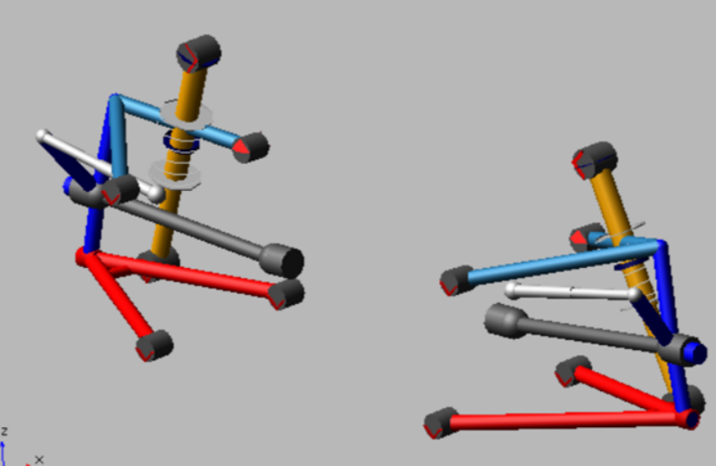
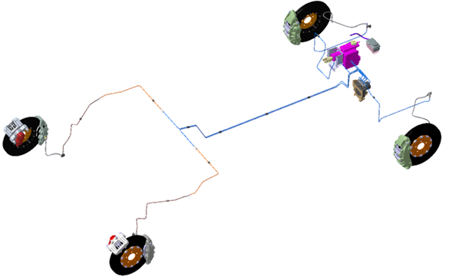
Vehicle system sizing /selection : mechanical
Hard point definition, geometry & packaging
Sizing , selection, design of vehicle sub-systems
Kinematics / performance simulation
Detailed engineering
Supplier engagement, early concept freeze
Detailed statement of requirements
Design validation plan (DVP)
Value engineering and cost reduction
Design for manufacturing (DFM), assembly (DFA)

Slide 9
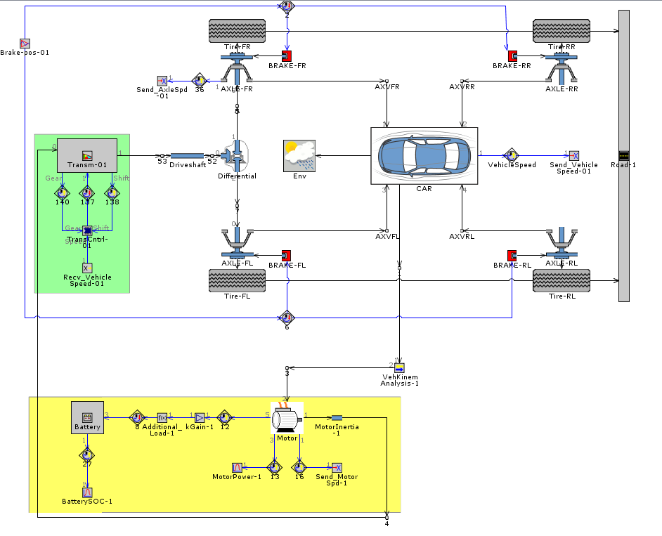
Vehicle system sizing /selection : electrical and electronics
Activities
System Sizing / Selection
Detailed Statement of Requirements
DVP
Supplier onboarding

Slide 10
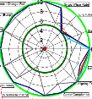

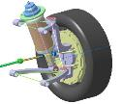
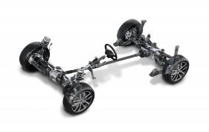
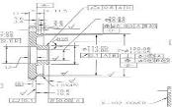
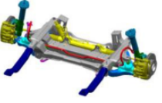
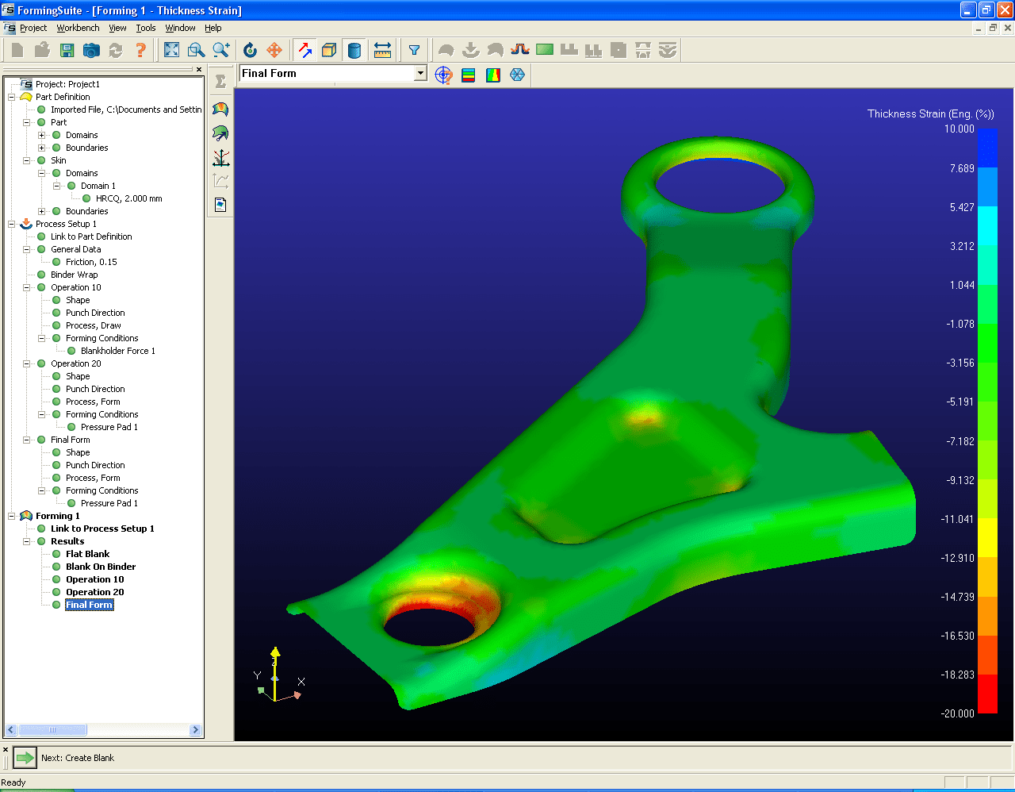

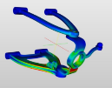
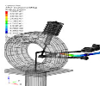
Chassis Engineering
Target Setting
Concept Finalization
Performance Parameters
Functional Image
Cost & Weight
Ride and Handling
Performance Benchmarking
Suspension Type Selection
Hard Point Finalization
Wheel Envelopes
Initial Packaging
Mounting Arrangements
Design Release
Detailed Engineering
GD & T
Tolerance Stack-up
Manufacturing Drawing
Proto / Production
Kinematic Simulation
Detailed Part Modeling
Weight Optimization
Modularity
Packaging & Clearances
Chassis System
Design For Manufacturing
Virtual Validation
Manufacturing Feasibility Study
Zero Based Costing
VAVE
Supplier Tech Sign off
K&C Simulations in ADAMS
CAE Structural Durability
NVH Simulations
Digital Mock-Up

Slide 11
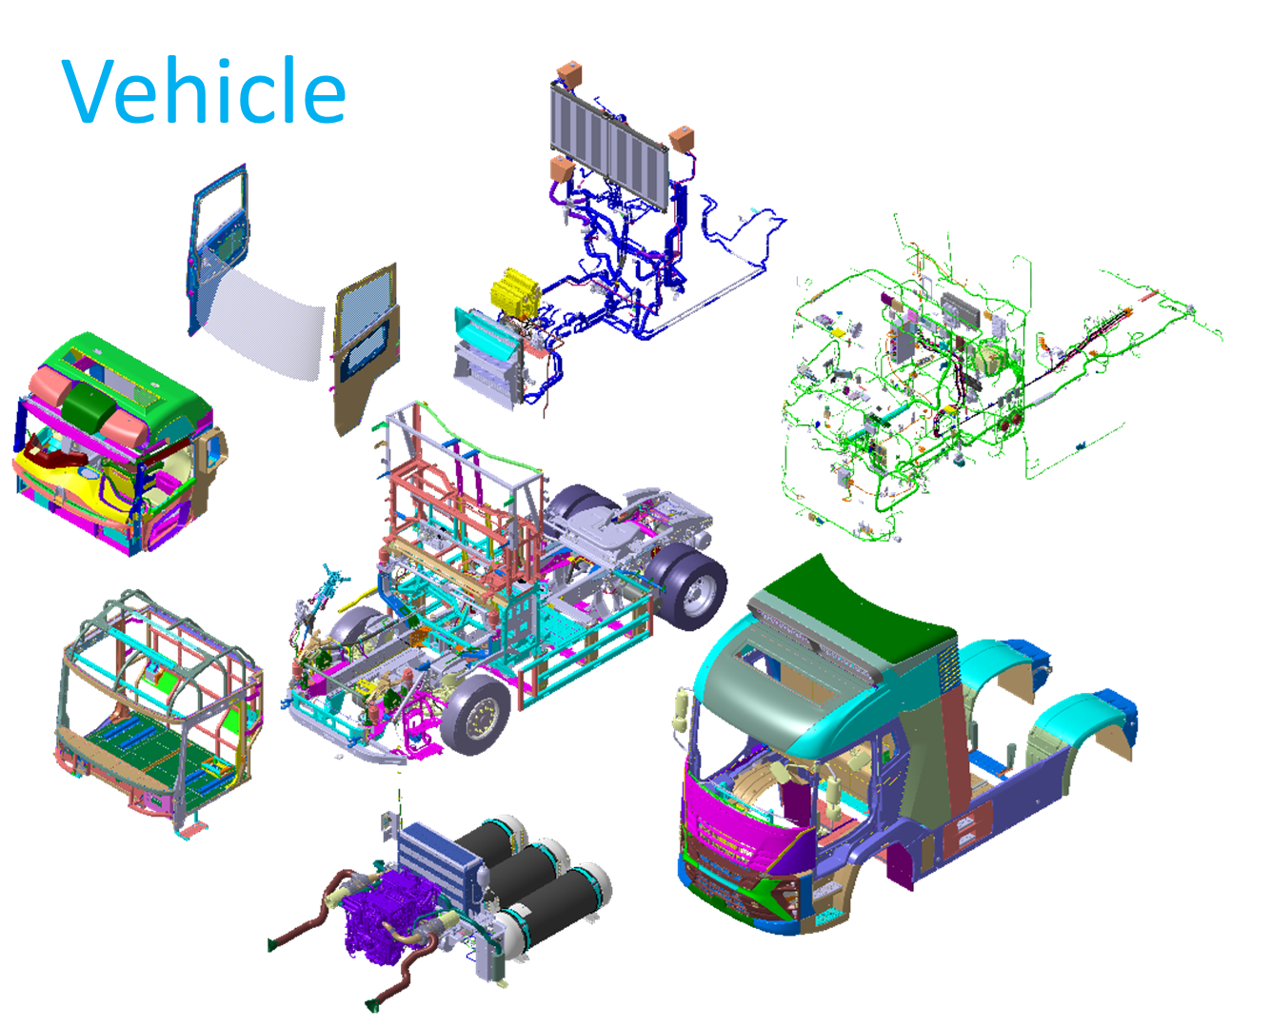
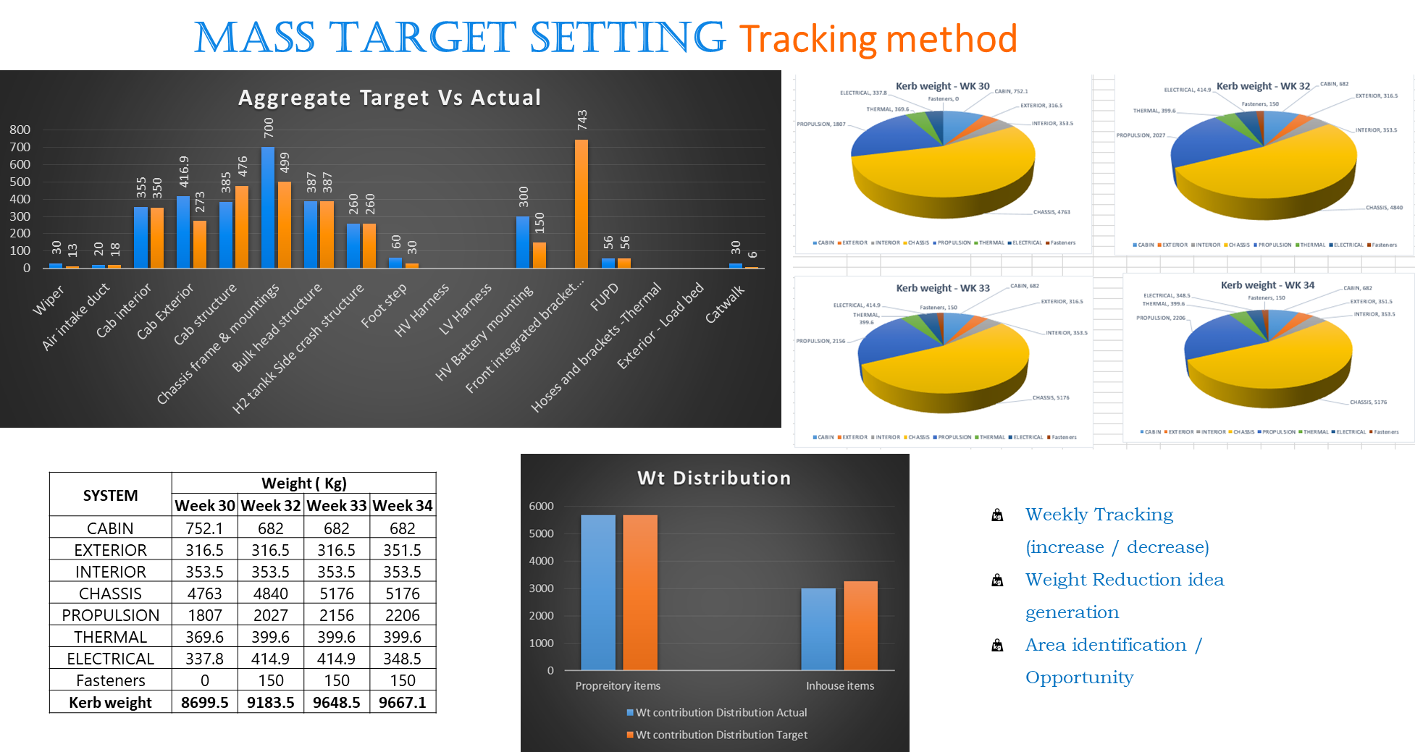
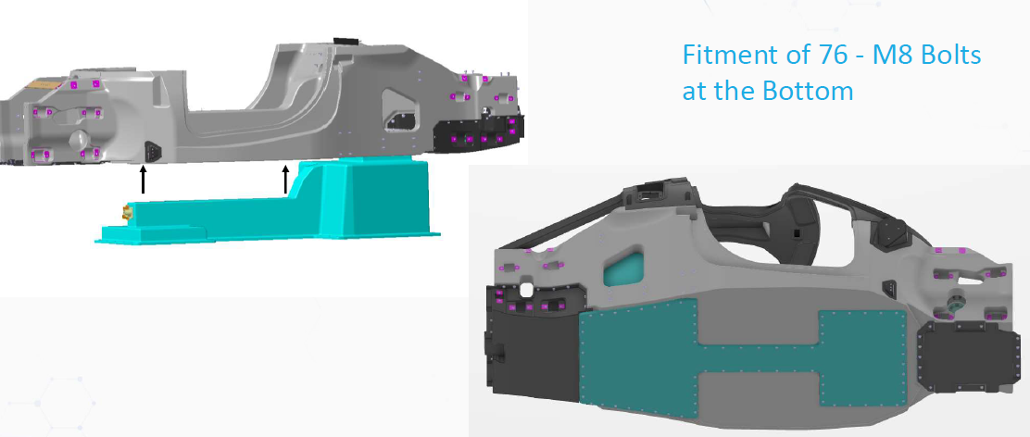
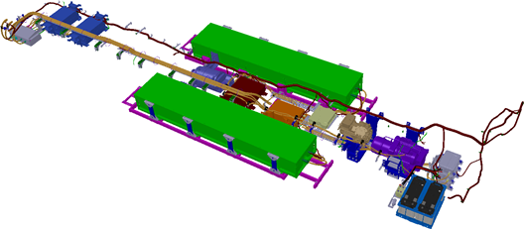
Vehicle DMU, BOM, & regulatory confirmation
Full vehicle digital mock-up
Vehicle system interface check / integration
Regulatory compliance
Comfort & safety compliance
DFA, DFM, DFS checks
BOM management
Weight management

Slide 12
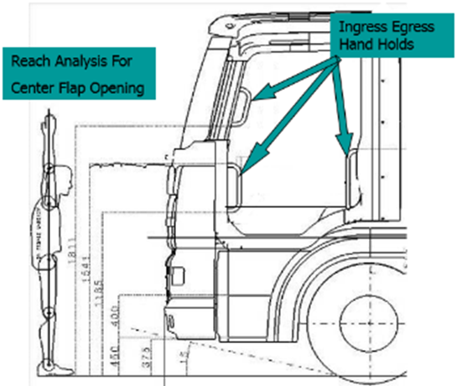
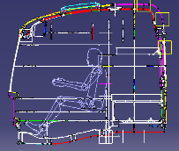
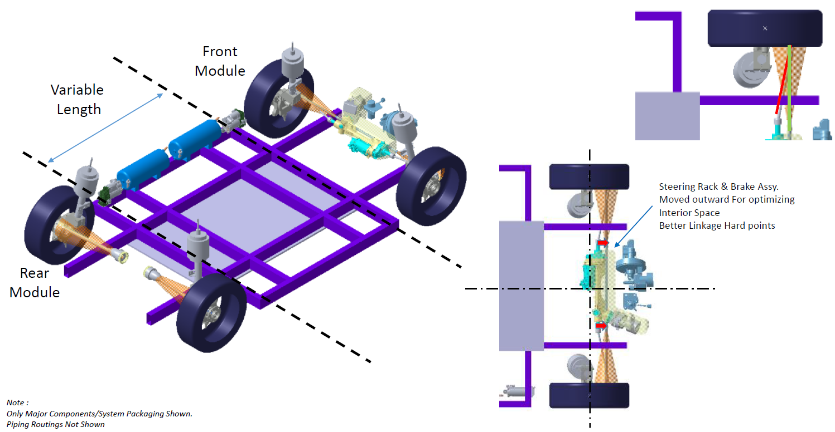
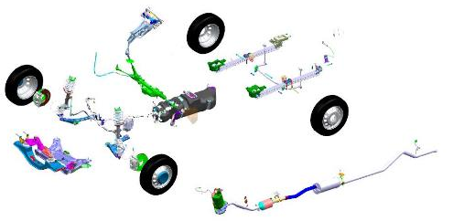
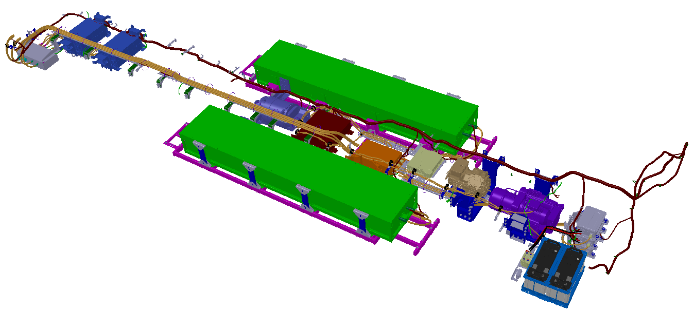
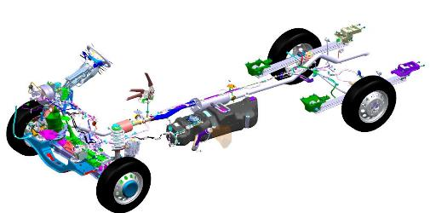

Vehicle Integration
Activities
Full Vehicle Digital Mock-up
Clearance & Interference checks
Weight & Cost Compliance
Regulatory Compliance
Comfort & Safety Compliance
DFA, DFM, SAM
BoM,
Weight & Cost
Manufacturing documentation

Slide 13



Vehicle thermals : HVAC & cooling systems
Cooling & heating load calculations
System sizing & selection
1D simulations
HVAC system integration
Engine / traction system cooling
Battery system cooling
Control strategy & system optimization

Slide 14


























Thermal Management Capabilities
 | Activities
Engine / Motor / Transmission / EDU / Power Electronics | Heat Rejection Calculations / Cooling System Design / Virtual Simulation / Validation Supply Chain Management / Integration Control SW Prototyping / Testing / Vehicle Integration
HVAC | System Sizing SoR / DVP Virtual Simulation / Validation Supply Chain Management / Integration Control SW Prototyping / Testing / Vehicle Integration
Circuit Boards | Heat Rejection Calculations Component re-distribution / Board Re-design Virtual Simulation / Validation Heat Sink Design / Enclosure Design Prototyping / Testing
Battery Thermal | Detailed Thermal Profiling | V
Vehicle Thermal | Heat Mapping (Virtual / Physical) Redesign / Packaging updates RCA / System Level Intervention Prototyping / Testing

Slide 15














Vehicle Electricals
Activities
Load calculations / System Sizing / Charge Balance Study
Architecture / Schematics / Interface definition
Harness routing / 3D Wiring Harness Design
Dynamic clearance checks
2D Drawings / Form bord drawing
Proto / Bench Testing
Notes:
Load Calculations / System Sizing / Charge Balance Study
High Level Architecture / Schematics
Schematic creation as per vehicle architecture
Design interfaces between modules, relay logic and major components used in Automotive.
2D harness drawings for harness supplier
3D harness CAD for Electrical harness packaging, packaging of electrical components
Testing (Bench / Functional Vehicle)

Slide 16

Vehicle software development , validation & diagnostics
Requirement planning
SW architecture design
BSW SW / application SW development
3rd party (system supplier) SW integration
Unit & integration testing
Hardware in loop (hil) testing
LABCAR build and SW validation + vehicle level testing
Vehicle diagnostics development

Slide 17


Vehicle Supervisory Software Development
Activities
Requirement Planning / Detailing
SW Architecture Design
BSW SW Configuration / Integration
Application SW Development / Integration
3rd Party (System Supplier) SW Integration
Unit & Integration Testing
Hardware in Loop (HiL) Testing
LABCAR Build and SW Validation + Vehicle Level Testing
Common CAN dbc file creation for all in vehicle network.
Communication & diagnostic network definition
Vehicle Diagnostics Development

Slide 18

Costing, Sourcing & Supply Chain Integration
Zero Based Costing / Pricing Targets
Vendor development and integration with customer
Supplier audit and approval for the process capability.
Involvement right from tooling development stage
Coordinate with the suppliers for preparing APQP plan
Development of sample parts processes (PPAP)
Quality inspection and documentation of parts.
Designing and certification of export worth packing.
Total logistic coordination
Back office administration and support for bulk supplies.
Coordination with customers during trail fitment and testing.
Resolving quality / delivery or financial issues.
Design support if need be.

Slide 19
Should Costing (Zero Based Costing)
Feasibility
2
Design
PPAP / SOP
6
4
1
3
5
7
Stages
Concept
Supply
Chain Deployment
Post SoP
Notes:
At each milestone, HT Costing engineers will calculate cost of the part and compares with targets set. HT has developed specific methodologies to narrow the gap as project progresses.
各マイルストーンで、HT Costingエンジニアは部品のコストを計算し、設定された目標と比較します。 HTは、プロジェクトの進行に合わせてギャップを狭めるための特定の方法論を開発しました。

Slide 20






Manufacturing Engineering Support
Layout Engineering
Digital Simulation Engineering
Requirement study
2D Layout Planning
Equipment selection
Space planning & analysis
Gangway planning
Assembly process planning & simulation
Human Task Simulation
Ergonomic analysis – Posture, Reach, Vision
Work cell / Station layout
Path Planner
Robot & Weldgun optimization
Reachability & Collision study
Offline programming
Plant Simulation & Through put study
Bottle neck analysis
Layout & flow optimization
Process Engineering
Tool Designs and Development
Work flow study & Configuration
Process Sheets
Work / Load Balancing
Cycle time calculation
Visual Work Instruction Sheets
Time Study
BIW Fixture Design
Assembly line Tools & Fixtures
Checking Fixtures
Trolley/Pallets/Tackle Design
Legacy Data Conversion
Press Tool Design
Notes:
HT has full capability in process, layout and plant engineering. HT has been supporting plant engineering for global OEMs. HT has also been supporting many Tier1s in developing low-cost micro factories to support low to moderate volume production.
HTは、プロセス、レイアウト、およびプラントエンジニアリングにおいて完全な機能を備えています。 HTは、グローバルOEM向けのプラントエンジニアリングをサポートしてきました。 HTはまた、少量から中程度の大量生産をサポートするための低コストのマイクロファクトリーの開発において、多くのTier1をサポートしてきました。

Slide 21








Vehicle physical validation
Mechanical performance & durability (part, system and vehicle level)
EE testing / EV performance testing
in lab / on track / on road testing & data acquisition
Material testing / characterization
EMI / EMC testing
Hardware in loop testing / LABCAR tests

Slide 22













Facilities & Infra
Rotary & Linear Actuators
Vibration Platform / ED Shaker
Elastomer Test System
Wind Tunnel (radiator testing)
Durability testing
Metallurgical testing
Engine testing (Performance, durability & Emission)
4 Poster / 6 Poster
Test Tracks
Belgium Pave / Corrugation / Herringbone / Setts / Pot hole / Water Wading / Articulation / High speed / Steering pad / Gradeability
Complete instrumentation set up
Data acquisition system For measuring Force / Strain / Pressure / Vacuum / Torque / Power / Speed / Acceleration / Velocity / Displacement / Pass by noise / Interior noise

Slide 23






Facilities & Infra
Dspace & Vector Vehicle HiL
Chennai, India
LABCAR Setup
Chennai, India
National Instruments
System + Dspace System HiL
Pune, India
Thermal Cycling
Chamber
Pune, India
400 kW Power HiL
MI, USA
EMC Test Chamber
UK
Extensive Powertrain Testing in UK and USA (Performance, Durability, Compliance)

Slide 24




In summary
Domain
Understanding
Availability of
Talent
Ability to set right targets
Design to cost
Dependable supplier / partner eco-system
06
Large internal pool
FAST recruitment & ramp up
Tie ups
Engagement
Maturity
Competitive
02
01
Experience
Robust & proven processes
State of the art tools / infra
05
Best in class efficiencies
Low development cost
Fast turnaround
Lower investment
04
03
Services mindset
Innovation
Flexible business model
Fast ramp up
Fixed and flexible manpower
Changes along the way
Culture of multidisciplinary innovation
Digital twin

