Slide 1

CoPilot Colour Instructions
Version 1.0
Your AI Centre of Excellence

Slide 2
3 Ways To Provide Colour Instructions To CoPilot
Describe well-known colours, for example: ‘Please use red to highlight text’. Remember you can ask for darker or lighter colour or a different hue if the colour is not quite right.
Use hex codes, such as #FF0000, for specific colour instructions
Provide an image or sample .. just snip the colour and tell CoPilot ‘please use this colour ‘

Slide 3
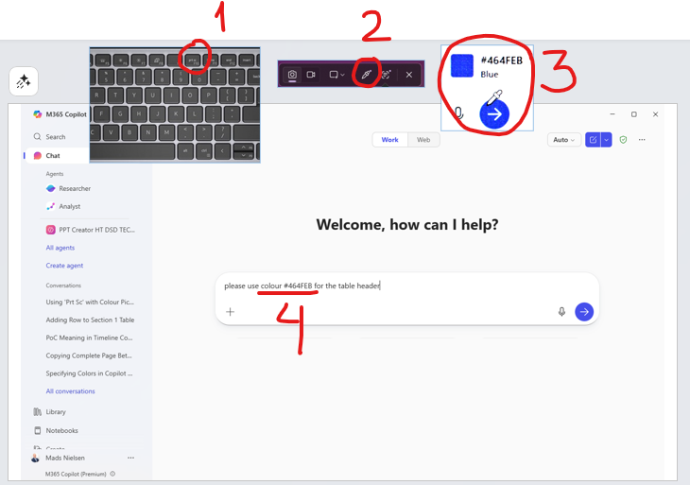
How To Find & Copy A Hex Code
An easy way to identify a hex code for given colour is to use the ‘Colour picker’ in the Snip App in Windows 11.
To activate the Snip App:
  Press F10 ‘prt scr’ button or ... Press Windows Key + Shift + S
  Click on the Colour picker (ensure it is set to show hex code)
  Click on any colour on any of your screens and Snip will identify the hex code and copy the code to the clip board
  Paste the code into your CoPilot prompt
NB. Colour hex codes are explained on the next slide!

Slide 4
What is a Colour Hex Code
Hexadecimal (or just“hex”) is another way of writing numbers, like decimal or binary.
  Binary = 0 1
  Decimal = 0 1 2 3 4 5 6 7 8 9
  Hexadecimal = 0 1 2 3 4 5 6 7 8 9 A B C D E F
For describing colours, a hex code looks like this: #RRGGBB
  RR = how much red
  GG = how much green
  BB = how much blue
Examples:
  #FF0000 → 🔴 full red → bright red
  #00FF00 → 🟢 full green → bright green
  #0000FF → 🔵 full blue → bright blue
  #FFFFFF → all max → white
  #000000 → all zero → black

Slide 5
Thank You
Your AI Centre of Excellence

