Slide 1

CoPilot Chat
Getting Started
Version 1.0
Your AI Centre of Excellence

Slide 2
CoPilot Chat – Your AI Companion
In the next slides you will learn:
How To Start CoPilot Chat
Security Checks Before Prompting
Get Prompting
Read, Check Sources & Copy
Check Contents Before Use

Slide 3
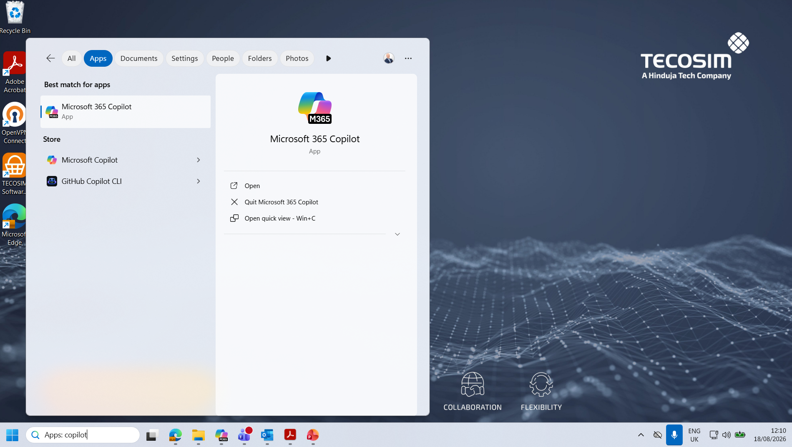
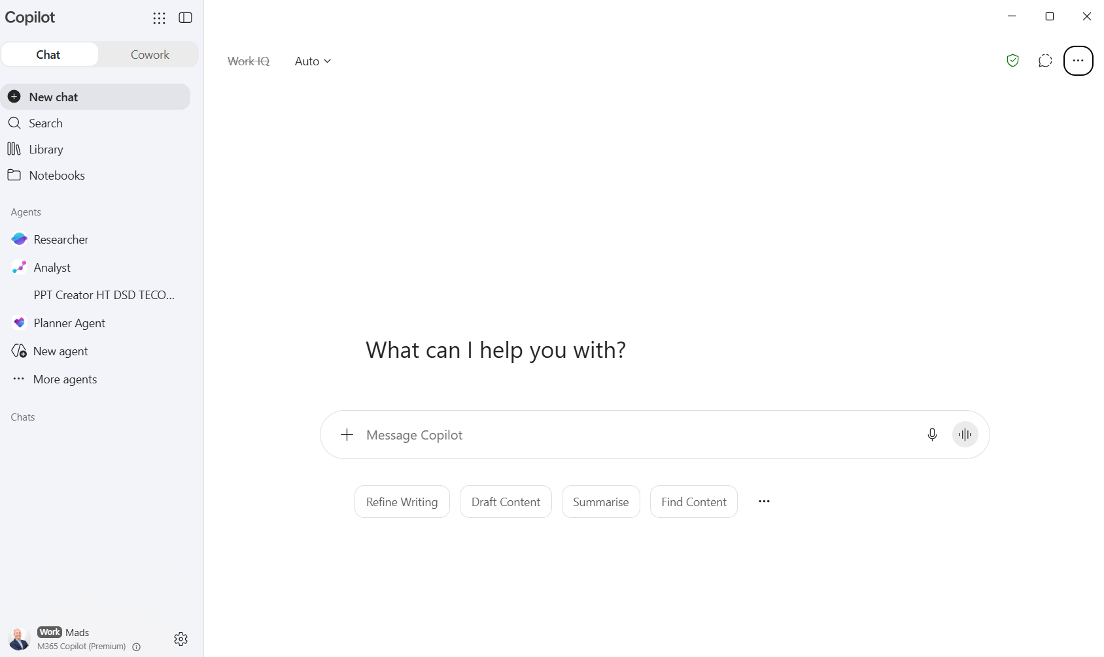
How To Start CoPilot Chat
2. Click on M365 CoPilot app
3. Start you prompt
1. Enter ‘copilot’

Slide 4
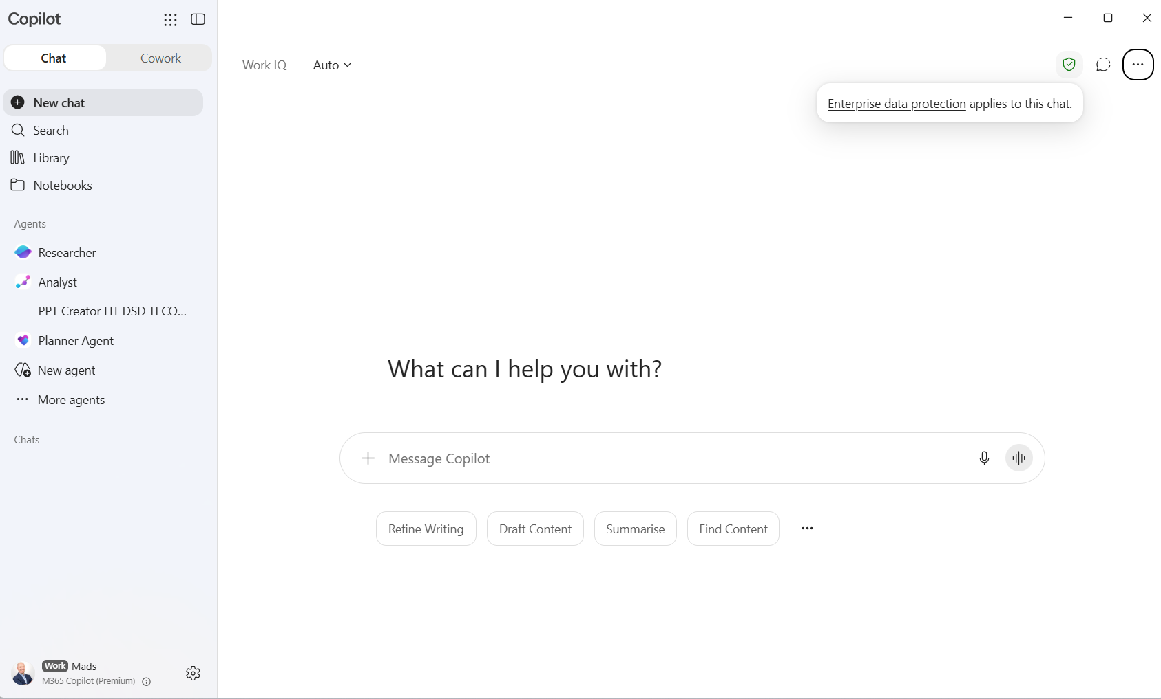

Security Checks Before Prompting
1. Check ‘Enterprise data protection’ applies to chat = data will not be used to train a public AI.
2. Check your credentials

Slide 5
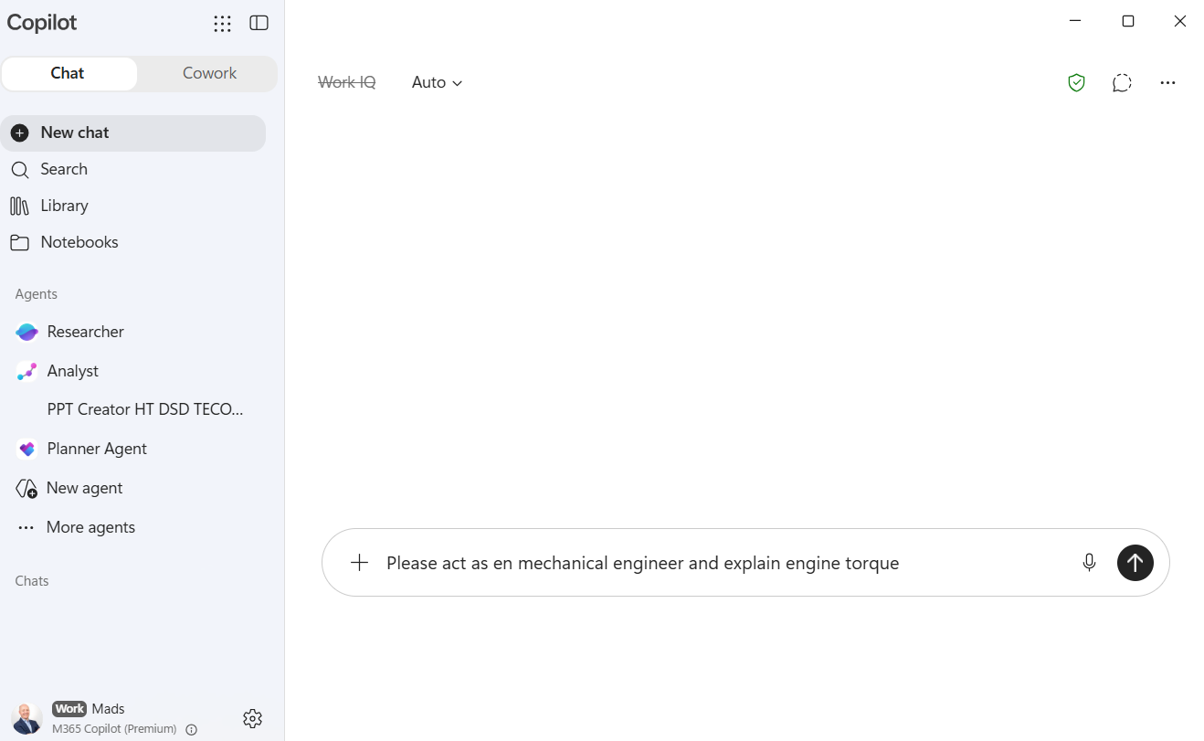
Get Prompting
1. Enter your prompt
2. Hit go

Slide 6
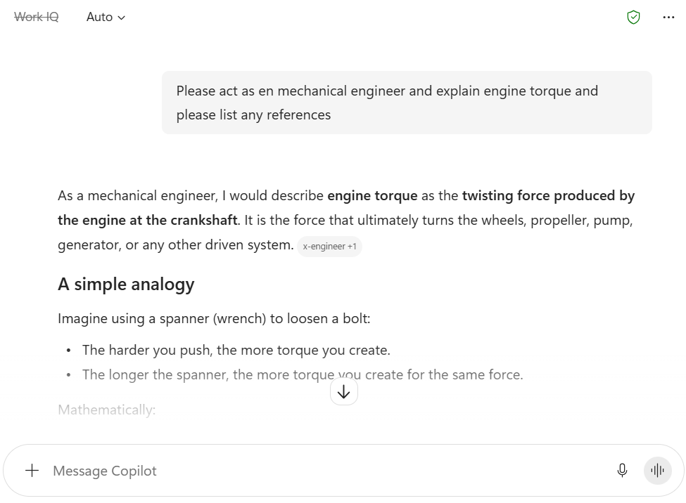
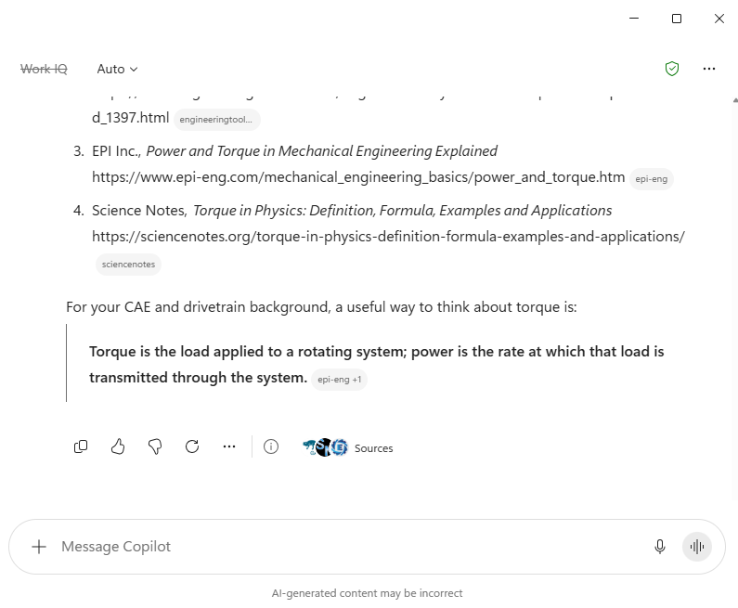
Read, Check Sources & Copy
1. Read response
2. Check Sources
3. Copy response

Slide 7
Check Content Before Use
Always Check AI Generated Contents Before Use!

Slide 8
Thank You
Your AI Centre of Excellence

